Slide 2
The bionic SOC is here
Transforming cybersecurity with human + AI collaboration

Slide 3







Leadership team
Brian Carbaugh
Alex Thaman
William MacMillan
Jaci Tomek
Greg Rattray, PhD
Co-founder and CEO
Chief Technology Officer
Chief Product Officer
Chief Revenue Officer
Chief Strategy Officer
CIA senior leader, Director of
CIA’s Special Activities Center
Chief of Staff to two CIA Directors
Engineering leader at Microsoft, Unity Software, and Scale AI
AI Advisor at Tola Capital
SVP of Infosec at Salesforce, CIA’s CISO and sr. leader for the Center for Cyber Intelligence.
VP, Cortex, Public Sector Sales
Palo Alto Networks, Lookingglass, iSight Partners, RSA/Netwitness
Global CISO of JPMorgan Chase
Director of Cybersecurity at the White House
Investors
Board
38M
Brian Carbaugh
Scott Howell
Grant Verstandig
Wes Bush
Chris Inglis
Co-founder and
CEO, Andesite
Fmr. Commander, JSOC; Advisor,
General Catalyst
Founder, Chairman, CEO of Red Cell Partners; Co-founder and Executive Chairman of Andesite
Fmr. Chairman
and CEO, Northrop Grumman
Fmr. National Cyber Director & Deputy Director of NSA
raised

Slide 4
Despite $215B spent
annually in cybersecurity, SOC teams are struggling.
THE PROBLEM
76%
of CISOs worry about the growing sophistication of cyber threats
37%
of SOC’s time is
spent investigating high priority threats
15%
annual growth
in cyber spending

Slide 5
Legacy approaches to cybersecurity are broken
Triage isn’t enough
Another point solution
isn’t the answer
Humans can’t be replaced
Analysts struggle to prioritize and act on the highest value indicators
Proliferating tools increase investigative friction and toggling between disconnected systems
The power of analysts' intellectual capital cannot be replaced by software

Slide 6



Safe AI Architecture™ for air-gapped self-managed deployments
OPERATORS
RELEASE BUNDLE
SECURITY ECOSYSTEM
Security platforms + tools
DEPLOYMENT ENVIRONMENT
Unstructured, semistructured and structured data
Alert sources
SELF-MANAGED DEPLOYMENT
SOC USERS
Enrichment sources
Threat intel
Cloud, Network, EDR
Integrations with your security ecosystem as it is + TLS encryption at-rest, in-transit, and in-storage.
No ETL, no data migration, no delays. Only the minimal data needed for the task at hand is stored on the single-tenancy environment. We do not train our AI with your data.
Access + identity security via IDP + CAC / PIV – the AI has the same permissions as its users.
Notes:
Access + identity security – the AI has the same permissions as its users.
End-to-end TLS encryption at-rest, in-transit, and in-storage.

Slide 7
Secure and Compliant by Design
Built-in security, compliance, and AI safety for the highest standards and requirements of the public sector based on DHS Secure by Design Pledge objectives.
Compliance Hight trust center documenting our security posture and over 450 continuous monitoring controls.
Aligned with FedRAMP High and SOC 2 requirements.
We don’t train our AI with customers’ data.
End-to-end encryption at-rest, in-transit, and in-storage.
Air-gapped self-managed deployment..
Third-party web apps and AI penetration tests twice a year.
Access + identity security – the AI has the same permissions as its users.
SOC USERS
TLS
CUSTOMER IDP + CAC / PIV
TLS
GOVCLOUD
CUSTOMER DATA
3PAO validated for FEDRAMP High
Security platforms
Unstructured, semistructured and structured data
Enrichment sources
Threat intel
Cloud, Network, EDR
API
TLS
WAF
TLS
PRIVATE SUBNET
VPC per Tenant
API
TLS
RDS
ElastiCache
DB
Notes:
Key points to emphasize:
The Investigative Workspace is the key to "human in the loop"/"bionic" SOC (differentiator). This is our mechanism to get analysts to work cases end-to-end in our product (from TIP to SOAR) instead of going to N other tools.
Everything they do in here becomes a source of data for our product to use for itself - every past investigation becomes something our AI can use to automatically learn from and replicate on its own (more on the SME knowledge base slide)

Slide 8

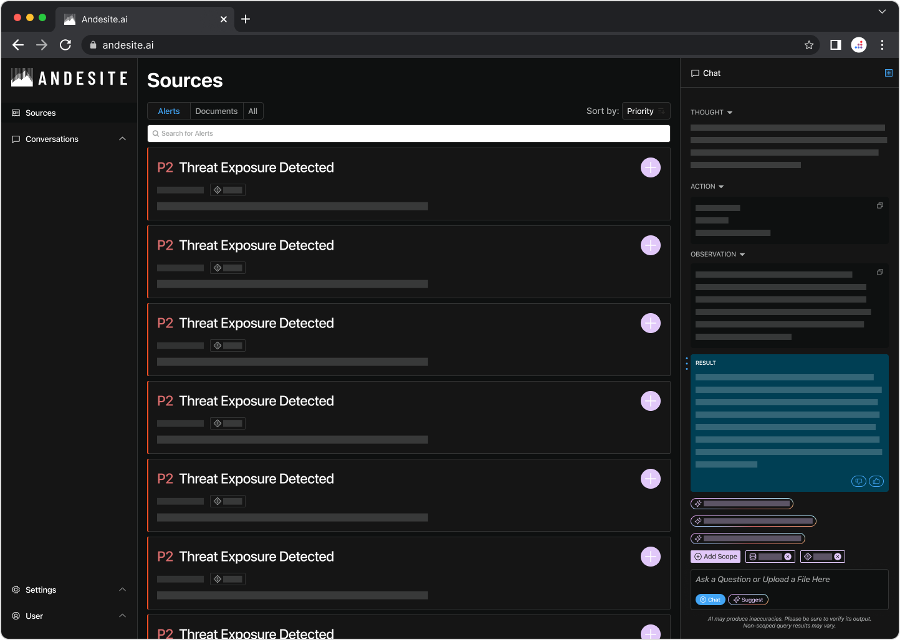
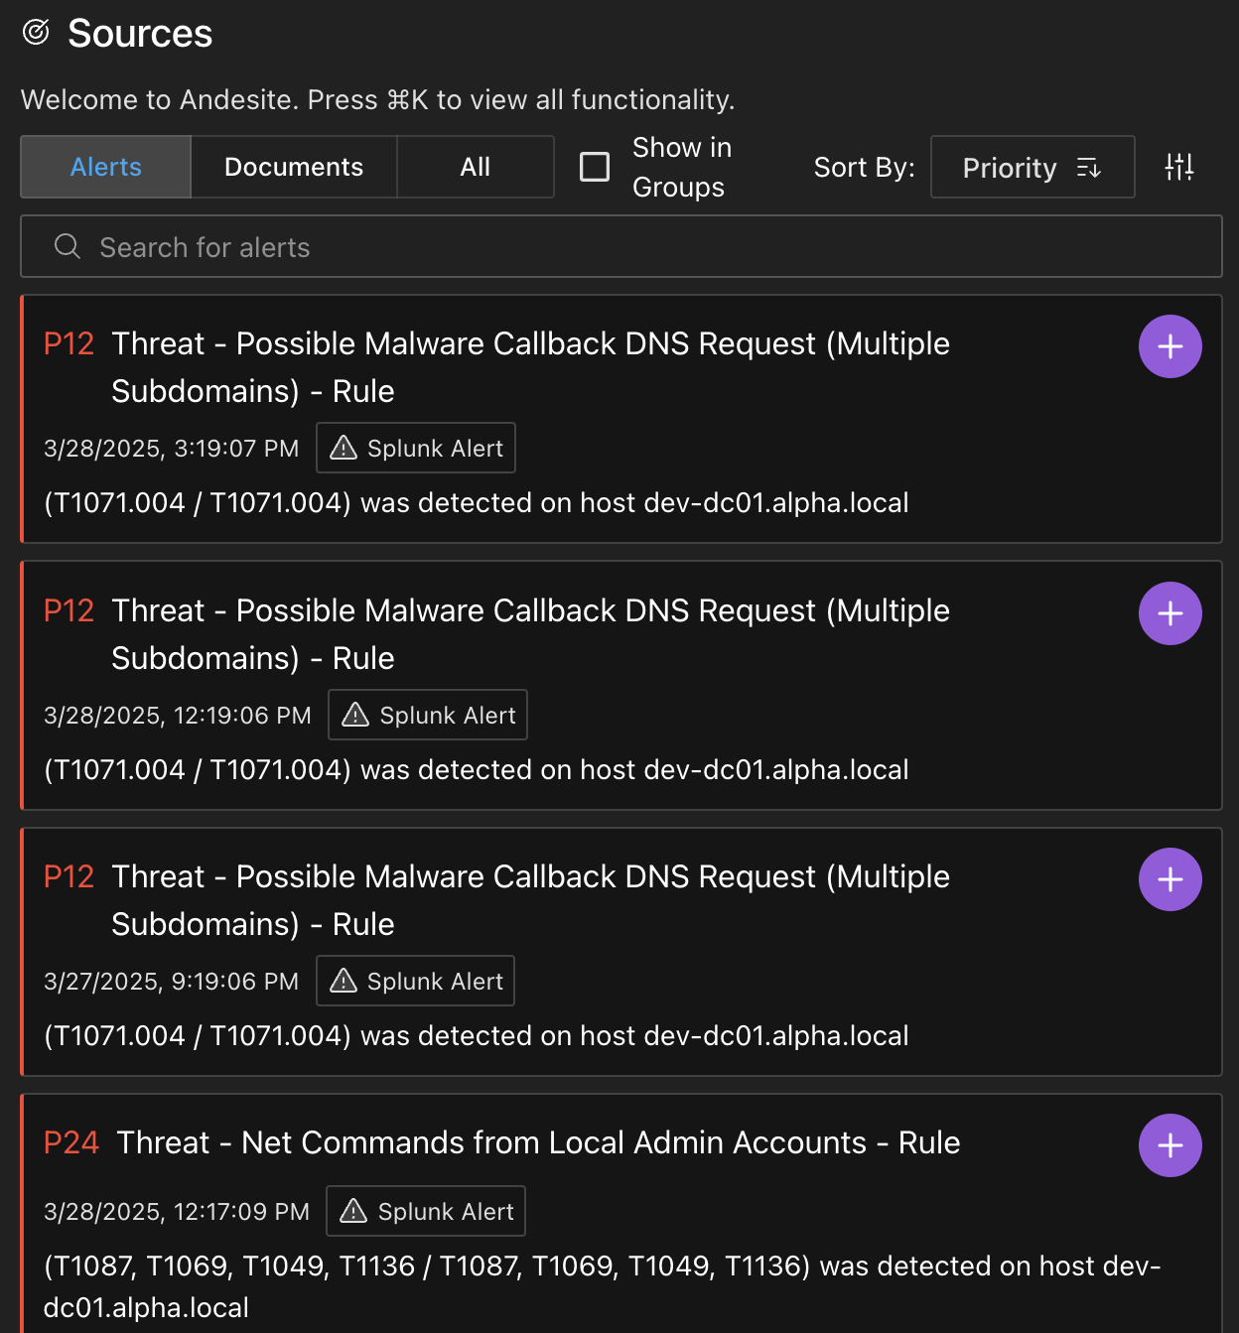
Unleash your team
02
Turn AI into an operational advantage
01
01
Benefit from having alerts from multiple sources prioritized in a single view
02
Utilize Evidentiary AI™ to ensure that analysts
can trace the process – no black boxes
03
Add multiple sources to the scope of a single investigation
03

Slide 9
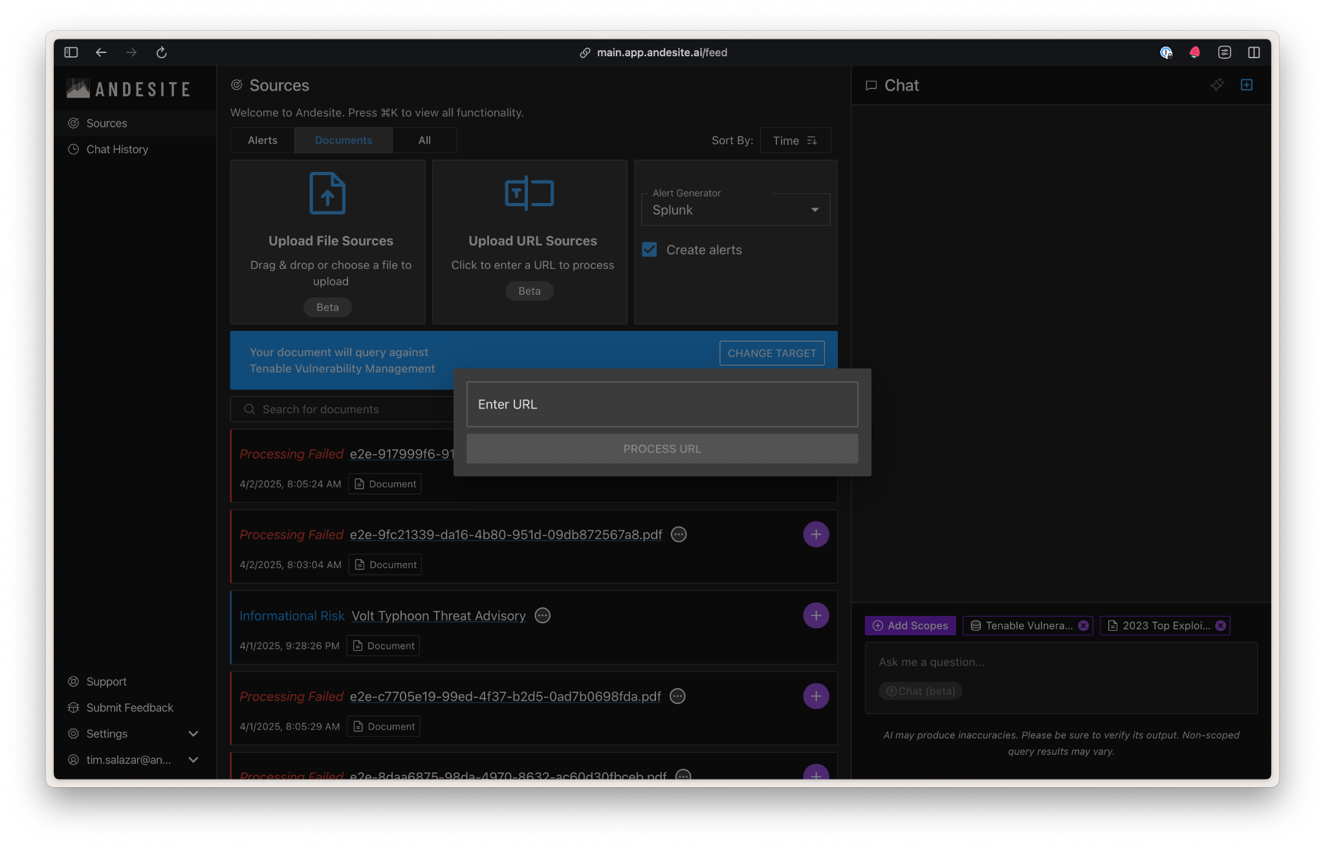
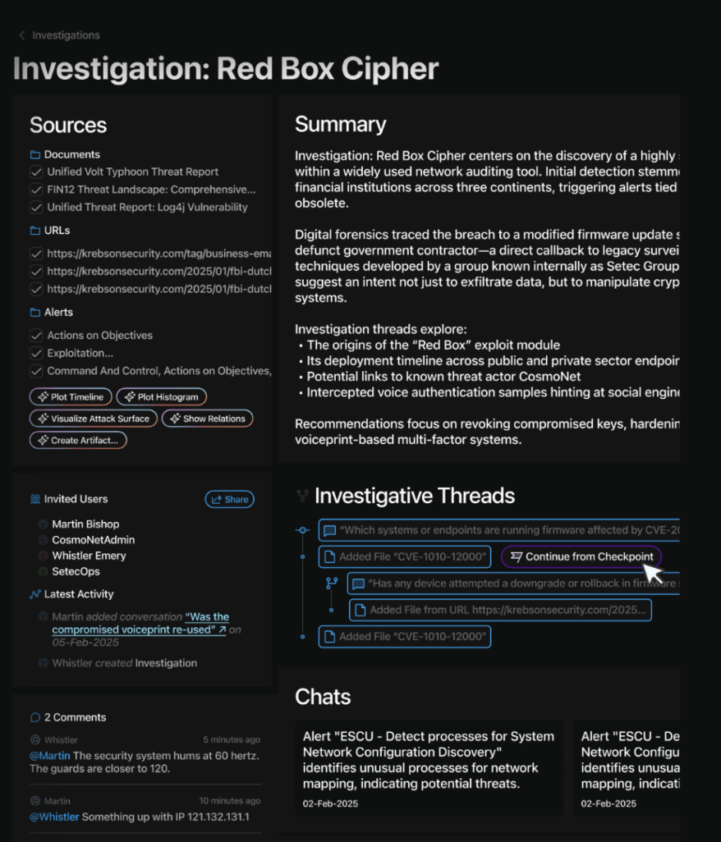
Threat intelligence insights at machine speed
Reduce the time from receiving a threat intel report to extracting key insights and starting an investigation, to minutes.
Initiate automated investigations and enrichment by uploading and linking threat intel reports
Start investigations directly from intelligence sources, including URLs and PDFs
Notes:
Our document processing functionality takes any document (PDF or URL) and summarizes it, performs an assessment against the connected data sources, and returns a personalized risk assessment, and recommended actions. Once the document has been processed, the user can engage with the chat agent to ask further questions relating to the context of the document.

Slide 10
Transform
your
outcomes
Effectiveness
The Andesite Difference
THE ANDESITE DIFFERENCE
Traditional System
Tier 3
Optimize SOC operations by elevating security analysts of all levels.
A junior analyst
with Andesite is more effective than a senior analyst without Andesite.
Tier 2
Tier 1
Experience

Slide 11
Live demo

Slide 12
Thank you
Matthew Loll
Director, Government Programs
matthew.loll@andesite.ai
703-507-9998

Slide 14

Andesite is the decision fabric of the bionic SOC
No ETL
required
A reinvented security workflow
Context-
aware AI
Seamless integration
No data migration
or extraction
needed, no delays
with human-AI collaboration at
its core
combs data
islands to unlock meaningful insights
with enterprise environment
as it is
Security
Platforms
& Tools
Unstructured, Semi-structured
& Structured Data
Threat
Intel
Cloud,
Network, EDR
Enrichment
Sources

Slide 15

WHY ANDESITE
We’re
mission-driven
We spent decades defending our nation against sophisticated adversaries, and founded Andesite
to build security products that support and empower those who protect others.

