Slide 1
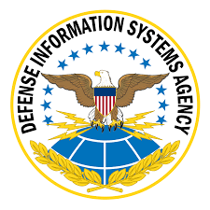
Ensuring Mission Resilience with Illumio
Assume breach. Minimize impact. Increase resilience.
Gary Barlet, Public Sector CTO, Gary.Barlet@illumio.com
John Westerman, Principal Sales Engineer, John.Westerman@illumio.com
Kevin Reed, Public Sector Regional VP, Kevin.Reed@illumio.com
James Emmons, Regional Sales Director, James.Emmons@illumio.com
Christine Farren, Federal Systems Integrator Partner Account Director, Christine.Farren@illumio.com
Mike Wilkens, Federal Partner Account Director, Mike.Wilkens@illumio.com
Notes:
(Introductions)
Illumio is the Zero Trust Segmentation company.
We stop breaches and ransomware from spreading across the attack surface

Slide 2
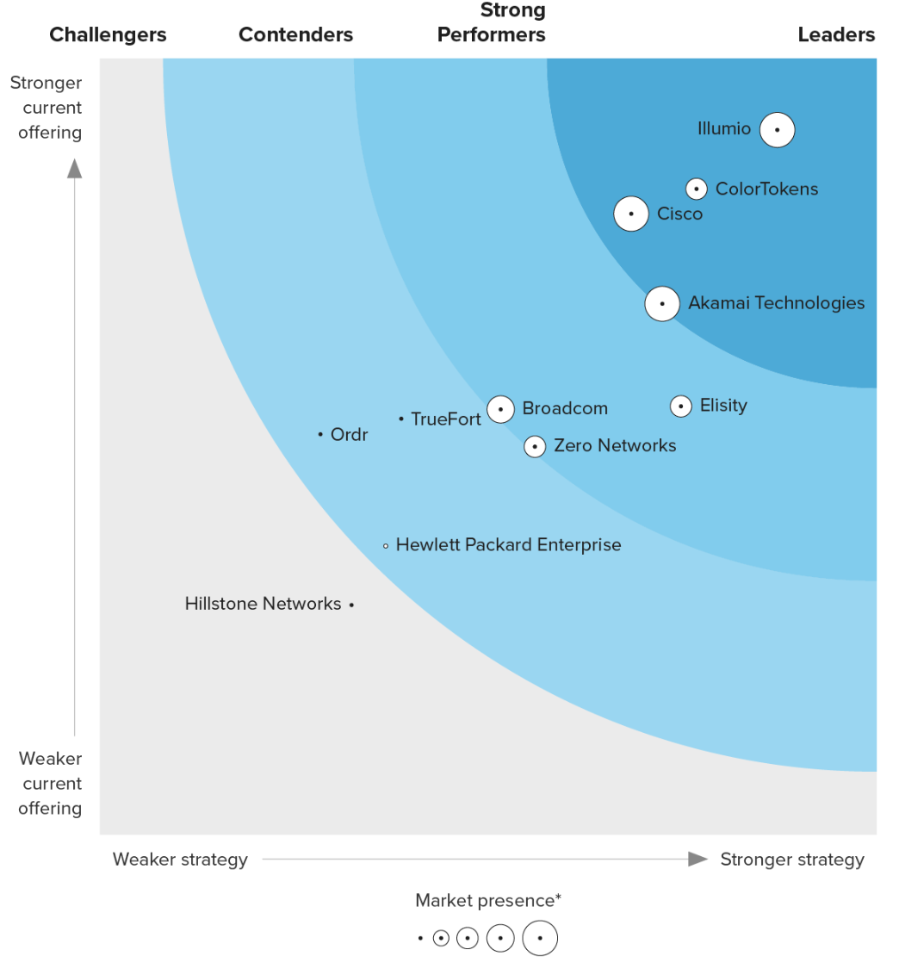



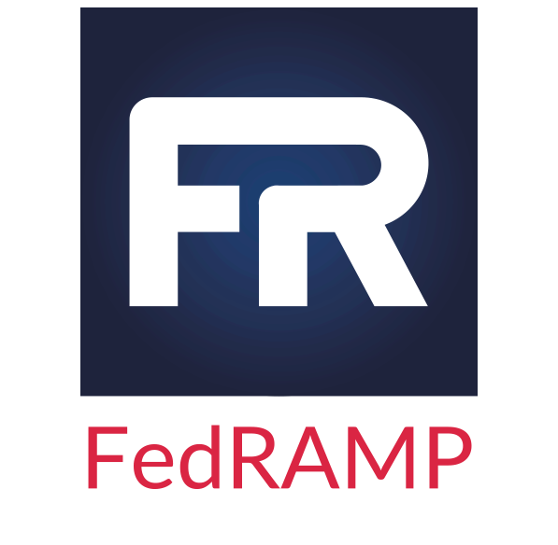

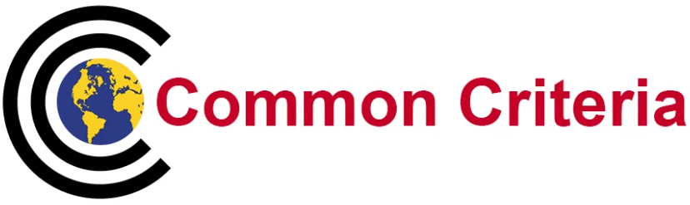
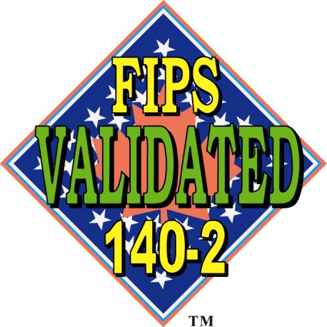
Illumio is the leader in Zero Trust Segmentation
Founded in 2013
KEY DEPARTMENT OF DEFENSE CUSTOMERS
FEDERAL CERTIFICATIONS
Enterprise Security Management - Policy Management
FedRAMP Moderate
Source:
The Forrester Wave™: Microsegmentation Solutions, Q3 2024

Slide 3
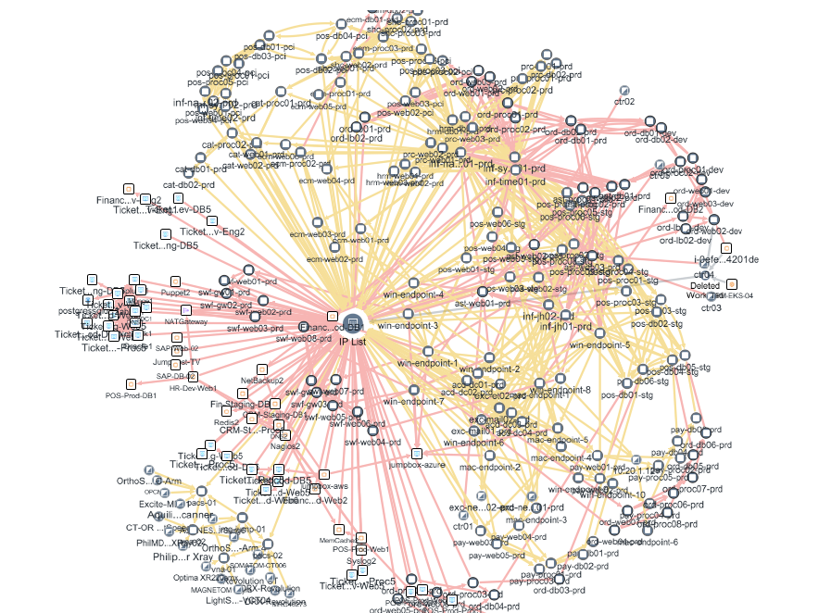
The reality of what we face…

Slide 4
Why are attacks successful?
Prevention and detection fails
Attack spreads
Critical assets compromised
Undetected + unauthorized intrusion
Attackers lurk for months – dwell time
AI is increasing the effectiveness of attacks
Lateral movement
allows attackers full network access
Flat networks with
no segmentation
are defenseless
Malware locks systems and demands ransom
Risk of exfiltrated data and regulatory violations
In a hyperconnected, hybrid, multi-cloud world, lateral movement is THE biggest risk

Slide 5

5-Step Methodology for Deploying Zero Trust
1
2
3
4
5
Define
Protect Surface
Map
Transaction Flows
Architect a
Zero Trust Environment
Create a
Zero Trust
Policy
Monitor
& Maintain

Slide 6
Illumio
ZTS Platform
  The first platform for
  breach containment
Understand risk
1
Visualize all communication and traffic, both known and unknown, between workflows, devices, and the internet.
Illumio
Zero Trust Segmentation Platform
2
Define security controls
With every change, automatically set granular segmentation policies to control unnecessary and unwanted communications.
3
Contain the attack
Proactively isolate high-value assets or reactively isolate compromised systems during an active attack to stop the spread of a breach.

Slide 7
Visibility Across All Environment
Zero Blind Spots, all Segments Visible & Enforced
Endpoints
Data Center 1
Data Center 2
Cloud 1
Cloud 2

Slide 8



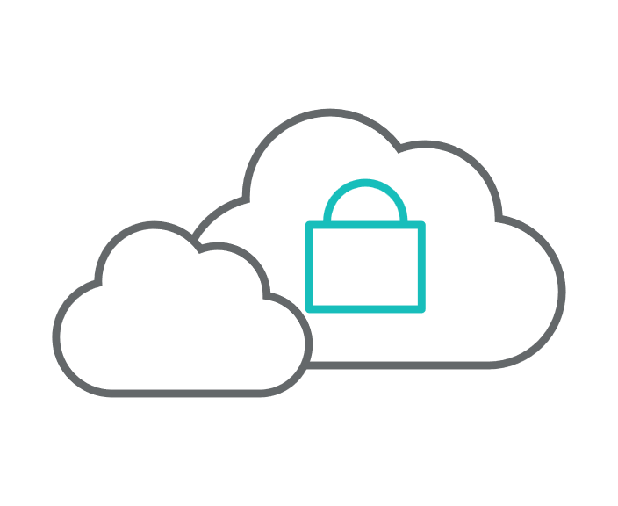


Illumio ZTS Platform
The first platform for breach containment
Eliminate blind spots
Prevent lateral movement
Ringfence high-value assets
Visualize all communications and traffic between workloads across on-prem and cloud environments.
Lower risk of adversaries accessing sensitive information by controlling
east-west traffic.
Proactively control communications
and isolate business-critical applications and environments.
Move securely to the cloud
Ensure continuous protection
Control information sharing
Whether a “lift and shift” or
re-architecture, visibility and protection follow for mission continuity.
Maintain protection in disconnected
and air-gapped networks, even if access
to Illumio is lost.
Restrict third-party access to only
allow what is necessary and wanted
within the environment.

Slide 9
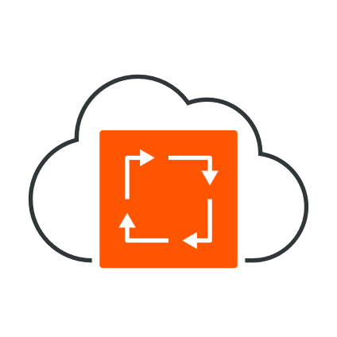

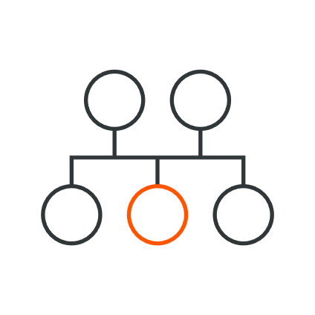



Illumio Architecture and Components
User Space
workload info & traffic / metadata
VEN
UI – Visibility/Policy
policy: human ➔ machine
API - Integration
policy: encryption
Applications
FedRAMP
SaaS PCE
On-Prem PCE
Kernel
Space
Virtual Enforcement Nodes (VENs)
Network
Stack
Native OS APIs
node 1
node 2
enterprise network
ipsec
OS Stateful
Firewall
k8s services network
NIC
IPsec ESP Transport
services
k8s pods network

Slide 10
Illumio Mapping to DoD Zero Trust
Reference Architecture
9 of 28
Activities
15 of 24
Activities
35 of 39
Activities
15 of 31
Activities
13 of 18
Activities
22 of 25
Activities
14 of 20
Activities
88%
Target 88%
88%
Advanced 20%
63%
Advanced 25%
72%
Target 67%
Target 68%
70%
Advanced 10%
Target 60%
48%
Advanced 23%
32%
Advanced 11%
Target 38%
Target 21%
Target 25%
User
Device
Application
&
Workloads
Data
Network
&
Environment
Automation
&
Orchestration
Visibility
&
Analytics

Slide 11
Thank you for your time

Slide 12
Whether you're protecting critical infrastructure or securing hybrid environments, our team is ready to help you take the next step. www.illumio.com/solutions/government
Gary Barlet
Gary.barlet@illumio.com
Public Sector CTO
Illumio
Kevin Reed
Kevin.reed@illumio.com
Vice President, Public Sector
Illumio
James Emmons
James.emmons@illumio.com
Federal Sales Director, DoD
Illumio

Slide 13
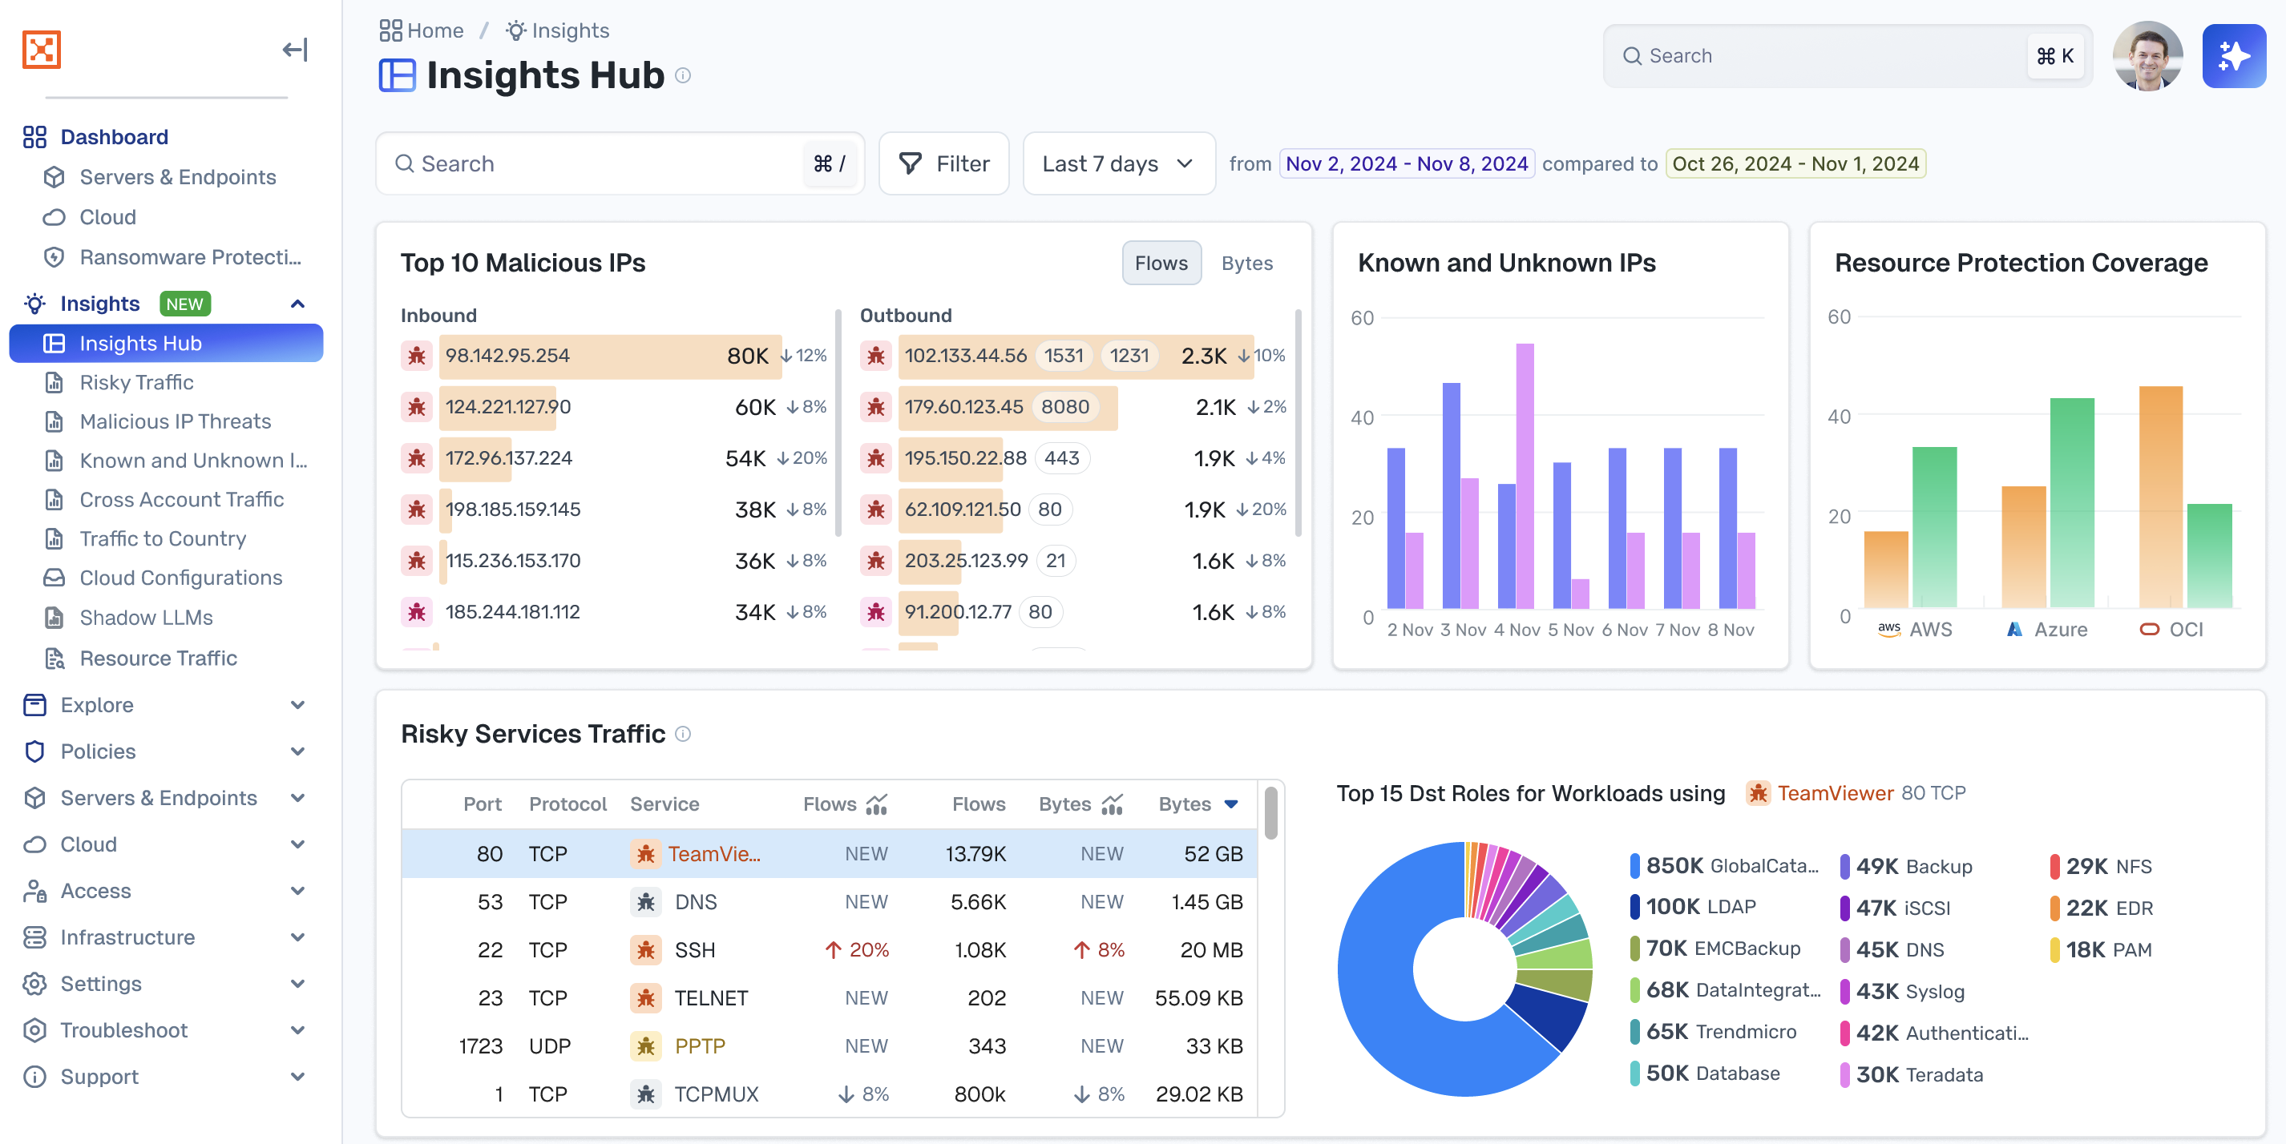
Introducing Insights
Notes:
Illumio Insights: A Game-Changer in Breach Containment
Illumio Insights is an AI CDR. It is the world’s first CDR built on an AI security graph. It offers the following benefits:
Rapid Cloud-Scale Deployment: Agentless deployment in minutes, with just read-only access required, immediately delivers AI security graph-powered insights across millions of cloud workloads.
Unmatched Threat Detection with AI Observability: Significantly reduces the mean time to detect (MTTD) by uncovering unseen threats and attack paths.
One-Click Attack Containment: Immediately neutralizes potential risks and reduces the mean time to respond (MTTR) with one-click containment.
Push-button, agentless deployment delivers AI security graph-powered insights across millions of workloads in minutes.

