Slide 1
Department of Defense
Defense Information Systems Agency
Technical Exchange Meeting
ForeSite360: Enterprise-Scale Observability and Decision Support Platform
July 24, 2025, 11:00 AM
Mission First. Disciplined Software Delivery. Trusted Expertise.

Slide 2
Table of Contents
Slide 1: Next Phase DISA TEM - Cover Slide
Slide 2: Table Of Contents
Slide 3: Company Overview (1)
Slide 4: Company Overview (2)
Slide 5: IT Capabilities Overview
Slide 6: Acquisition & Compliance Ready
Slide 7: ForeSite360 in the DISA Environment
Slide 8: DISA's Observability Challenge & Mission Impact
Slide 9: The AIOps Trust Gap in High-Stakes Operations
Slide 10: The Mission Consequences of the Observability Gap
Slide 11: Introducing ForeSite360
Slide 12: ForeSite 360: From Context to Action
Slide 13: Our Proven Blueprint for Government Enterprise Success
Slide 14: Summary: Connecting Capabilities to Mission Outcomes
Slide 15: Demonstration Placeholder
Slide 16: Q&A Placeholder
Slide 17: Contacts

Slide 3




Company Overview (1)
Proven Capabilities
DevSecOps, Agile, SAFe
Data science and advanced data management
Digital modernization and Full-scope Chief Data Office Services
Artificial intelligence & machine learning
Accelerators and rapid prototyping/MVPs / Challenge-based procurement
RF Spectrum Engineering and Mechanical Design Services
Certifications
8(a) SBA Program
EDWOSB
SB
ISO 9001
ISO/IEC 20000
ISO/IEC 27001
CMMI ML3 for DEV
CMMI ML3 for SERVICES
Federal Customers

Slide 4
Company Overview (2)
Contracts
GSA MAS
8A STARS III (supports directed 8A procurements)
OASIS+
Government / Industry Partnerships
Digital WOSB Alliance
ACT-IAC
GTSC
Digital Services Coalition ( Applicant)
Clearance + Primary NAICS
Top Secret Facility Clearance
Primary NAICS = 541511, 541512,541519, 518210

Slide 5
IT Capabilities Overview
API
Advanced Data Mgmt (ADM)
Complex and secure data solutions, with high volumes and numerous sources. Automate and modernize enterprise processes for business agility using highly scalable and serverless technologies. Enabling agency-level data governance and data democratization.
Data Science (DS)
Tools, frameworks, and expertise. Trained Data Scientists, Data Analysts and Data Engineers with expertise in Healthcare, Science, Research, and CyberSecurity
Digital Modernization (DM)
Transitioning from legacy systems to modern technologies like Cloud platforms, big data analytics, and AI/ML to unlock the full potential of data
Accelerators (IP)
Enabling technologies such as IoT, Advanced Analytics, and Machine Learning through Rapid Prototyping/MVPs.

Slide 6
Acquisition & Compliance Ready
ForeSite360
Prepared for ATO / RMF Process
Designed for Classified Environments (IL5/IL6 Capable)
Supports Data Sovereignty Policies
STIG-Compliant Architecture

Slide 7
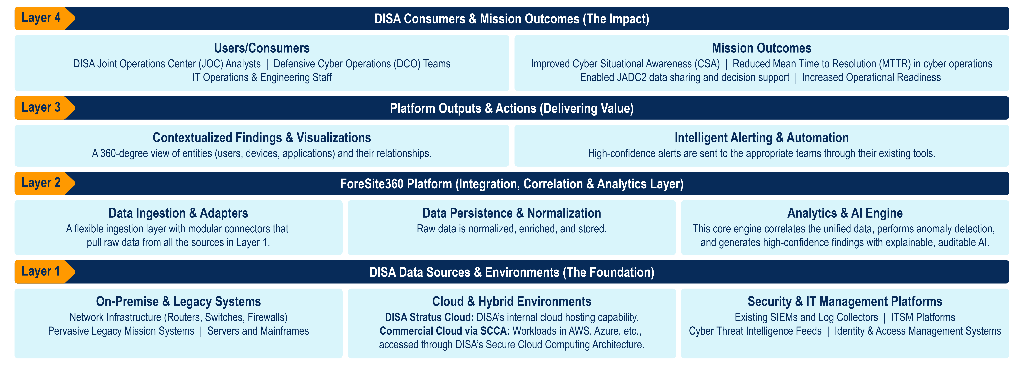
ForeSite360 in the DISA Environment

Slide 8
DISA's Observability Challenge & Mission Impact
Tool and data siloes, driven by contract boundaries and segregated networks, create blind spots that directly hinder JADC2 enablement and Cyber Situational Awareness.
Overwhelming alert noise and tool complexity dramatically increase Mean Time to Resolution (MTTR), slowing the pace of Defensive Cyber Operations.
Compliance hurdles, like the ATO process and restrictive STIG policies, can slow the adoption of modern tools, delaying key initiatives like the Zero Trust rollout and impacting operational readiness.

Slide 9
The AIOps Trust Gap in High-Stakes Operations
The Challenge:
  Many organizations have AIOps tools, but 42% of leaders don’t trust the AI's outputs.
  The gap is clear: 85% of leaders trust traditional BI dashboards, while only 58% trust AI/ML models.
Why This is Critical for DISA:
  The Need for Explainable AI (XAI): Recommendations for DCO or JADC2 cannot come from a “black box”; they require auditable, explainable evidence to be trusted by operators.
  Mission Failure vs. System Downtime: In this environment, the cost of a wrong AI recommendation isn’t just downtime—it’s mission failure.
  Distinguishing Faults from Attacks: An effective platform must help distinguish a system fault from a nation-state attack, a capability that is critical for true Cyber Situational Awareness.
  Maintaining Data Sovereignty: Solutions must respect strict data sovereignty and classification policies, ensuring sensitive data is processed and models are trained only within accredited boundaries.

Slide 10
The Mission Consequences of the Observability Gap
Increased MTTR for Cyber Operations: A dramatically increased Mean Time to Resolution (MTTR) directly hinders the speed and effectiveness of Defensive Cyber Operations (DCO).
Degraded Cyber Situational Awareness (CSA): Blind spots from uncorrelated data prevent security teams from effectively detecting and responding to threats at mission speed.
Delayed Mission-Critical Initiatives: The inability to effectively monitor new and legacy systems delays key deployments and strategic goals like the full adoption of Zero Trust.
Degraded DCO Effectiveness through Skill Attrition: Critical analyst burnout from tool complexity and alert fatigue leads to the loss of expertise, directly degrading the capacity of Defensive Cyber Operations teams.

Slide 11
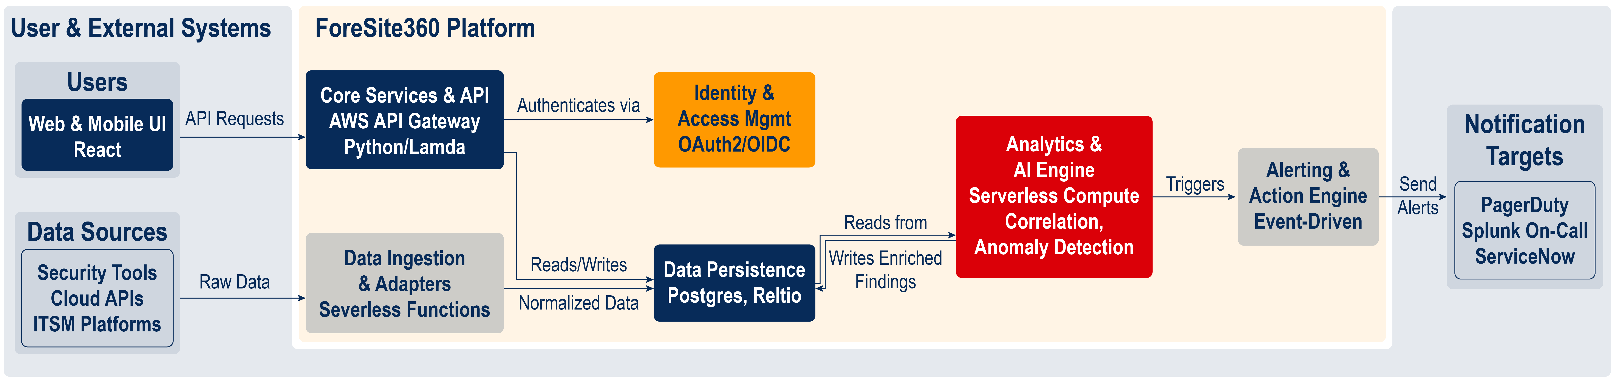
Introducing ForeSite360
Optimized Tool Count: Rationalizes and optimizes tools that support EITaaS initiatives.
Brings Context and Trust: Provides traceable alerting for trusted DCO decision support.
Built for Hybrid Scale: Enables hybrid observability across on-prem, cloud (Stratus), and tactical edge.

Slide 12
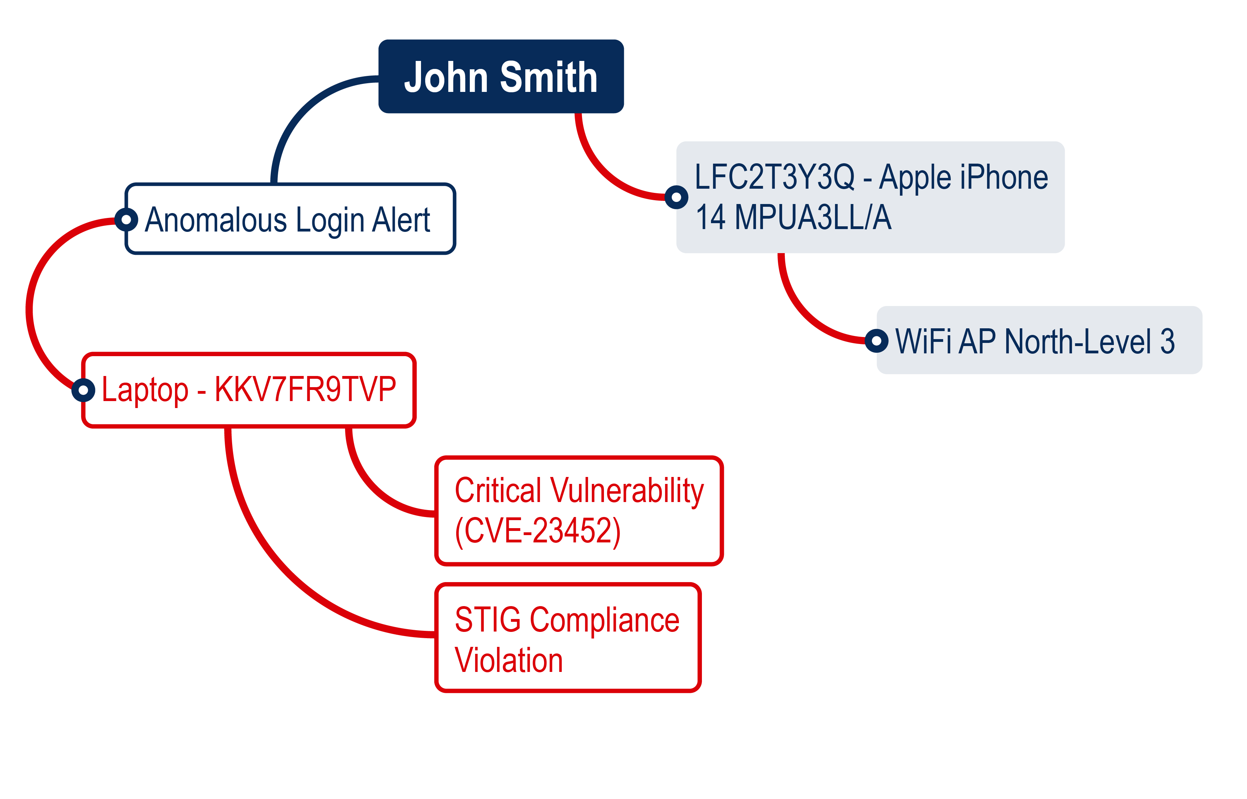
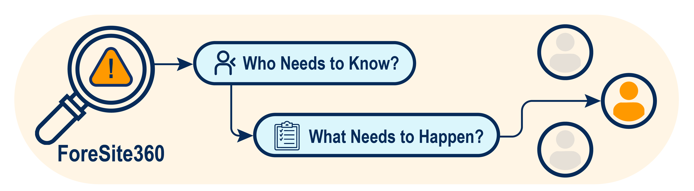
ForeSite 360: From Context to Action
Feature: 360° Enterprise Context
Captures the relationships between all entities—users, hardware, applications, and missions.
Feature: Intelligent Alerting Workflow
Transform thousands of raw events into a few high-confidence findings with clear, recommended actions.

Slide 13
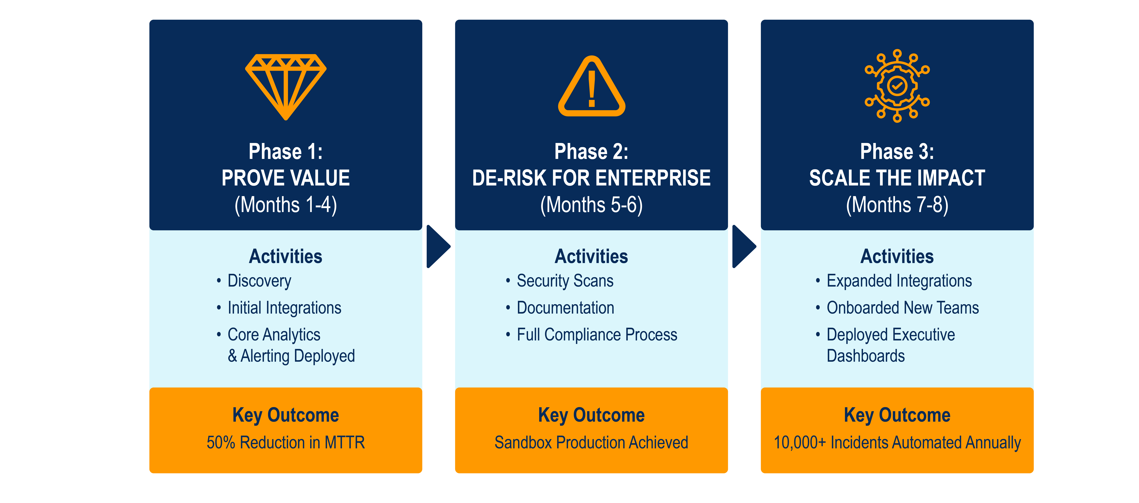
Our Proven Blueprint for Government Enterprise Success

Slide 14
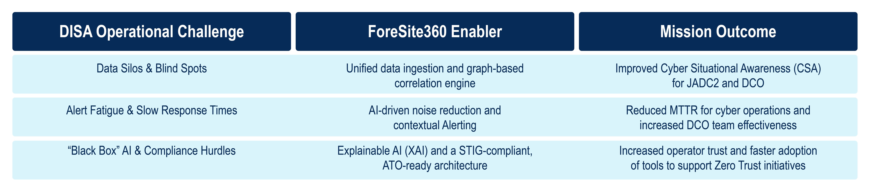
Summary: Connecting Capabilities to Mission Outcomes

Slide 15
Demonstration Placeholder

Slide 16
Q&A Placeholder

Slide 17
Contacts
Lisa Wolff, Next Phase CEO, lwolff@npss-inc.com
Raghu Bemgal, Next Phase CTO, rbemgal@npss-inc.com
Warren Miller, Next Phase Chief Architect, wmiller@npss-inc.com
Liz McNamara, Next Phase Health IT Innovation Officer, emcnamara@npss-inc.com
Kyle Hogan, Next Phase Product Manager, khogan@npss-inc.com
Avery Muse, Senior Advisor and CEO of The Muse Group, avery.muse@themusegroup.net

