Slide 1
Secure SD-WAN

Slide 2

Nasdaq 100 & S&P 500 Indices
Nasdaq: FTNT
13.2M+ Devices Shipped
>50% Global Firewall Shipments
Fortinet
Publicly Traded, Sunnyvale, CA
Large Scale
805,000+
Customers Worldwide
$6.53B
2024 Billings
Massive Customer Input
Double digit yr/yr revenue growth
#7 on Forbes Most Trusted Companies in America in 2025
Trusted Supplier
Independent
Separate Board of Directors
Independently vetted supply security
Separate systems, process, people
Fortinet
Federal
USG Certs
Past Performance
All Executive and DoD Branches
FIPS, DISA APL / STIG, & more
Deployed in Every Climb and Place
Notes:
Fortinet's vision is to make possible a digital world you can always trust with our mission to secure people, devices, and data everywhere.
Over the last several years, Fortinet has experienced rapid growth – consistently growing faster than the industry average.
Fortinet's Security Fabric platform is resonating with enterprise customers resulting in outstanding financial results.
For Q4, 2021, Fortinet generated a record $1.2 billion of free cash flow and we reported our 13th consecutive year of GAAP profitability.
Fortinet is the only cybersecurity vendor listed on both the NASDAQ 100 and the S&P 500
We offer the broadest portfolio of products in the industry, providing protection across the entire attack surface
Our patented ASIC SPU technology, developed from the ground up is a key competitive advantage – Overall our we have 3X more patents than our nearest competitor.

Slide 3










































Complexity is Slowing Digital Initiatives
Today’s Challenges
Public Cloud
Internet
Data Center
SaaS
Edge Compute
Applications are distributed
Users are working from anywhere
More devices are attaching to applications
Too many IT and security stacks
Too many vendors
Cybersecurity skills shortage
Users and Device Security
Network Security
Cloud Security
Security Operations
+
+
+
+
Home
Travel
Campus
Branch
Factory
Users and Devices

Slide 4
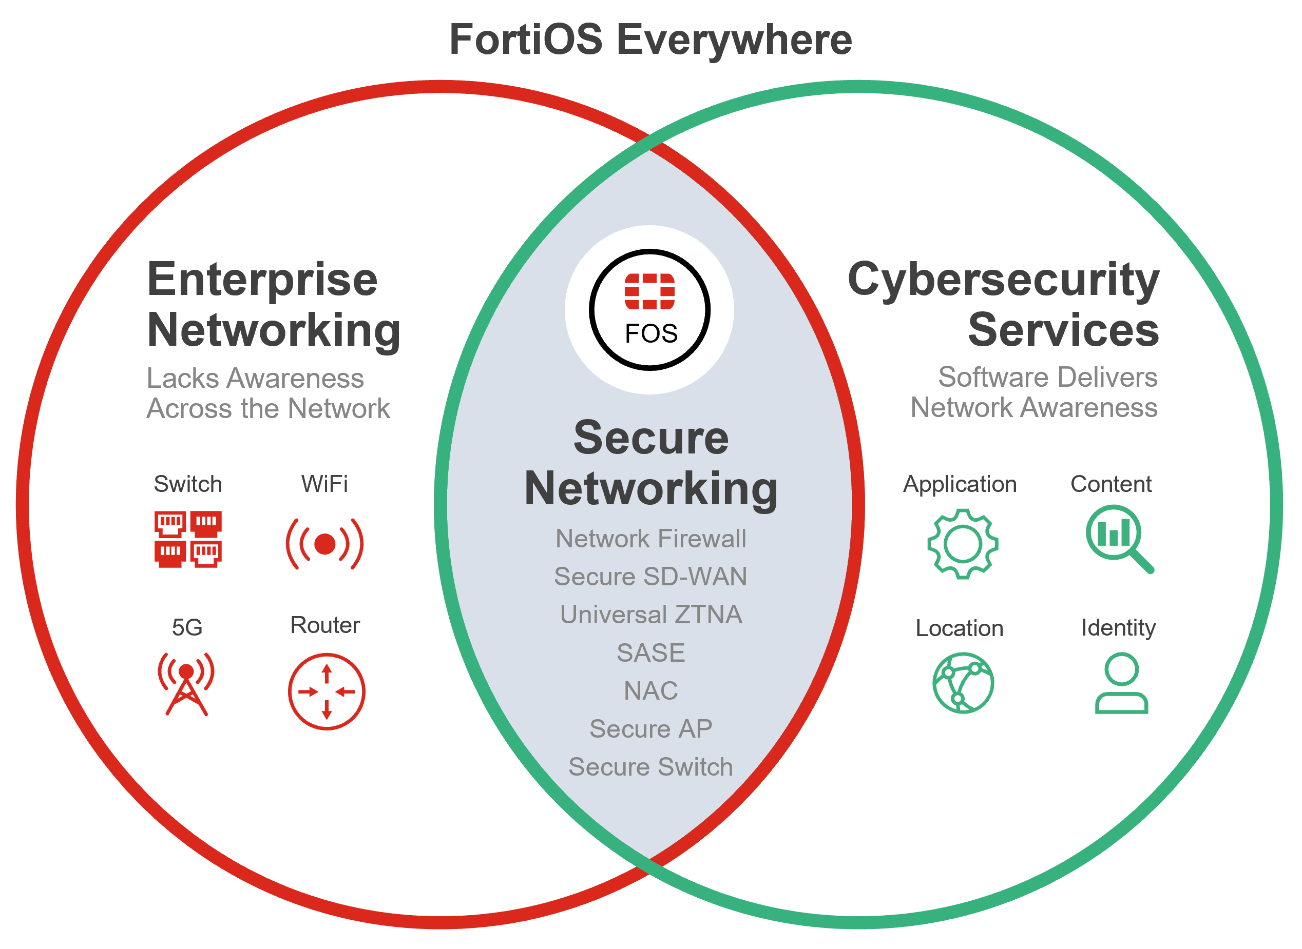
Converging Network and Security
Reduces complexity and increases performance
5X
8X
Better performance through our ASIC technology
The industry average for SSL inspection throughput
36%
  Higher threat protection than similar models of Palo Alto
67%
3X
Higher threat protection throughput than the industry average
The industry average for firewall throughput
The average of SSL Inspection throughput for all Fortinet firewall models for the data center versus an aggregate average of published SSL Inspection of similar competitive models

Slide 5










FortiGuard Services
Every minute, our automated threat protection and real-world threat intelligence
FortiGuard Security Services
12.8M+
9.1M+
Botnet and C2 attempts thwarted
Network intrusions blocked
6.15M+
180K+
Malware programs neutralized
Phishing attempts stopped

Slide 6
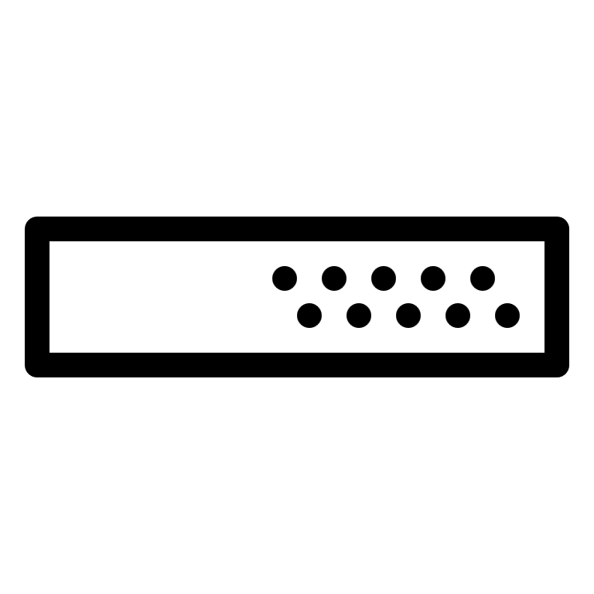




A Journey of Innovations
Securing Our Customers by Providing Secure Products
Hardware Resiliency
OS Resiliency
SP5
SP5 ASIC
TPM
Integrity Checks
Virtual Patching
Provides secure
boot functionality
Ensures authentic signed FortiOS image
Boot process stops if any step fails to authenticate
Protects sensitive
data in configuration file
Physical security mechanisms for
tamper resistance
Kernel / User
space protections
Periodic verification
of kernel and user
space modules
Security Posture vulnerability alerting
Automate patching
on external facing interfaces
Quickly isolate
vulnerable devices

Slide 7
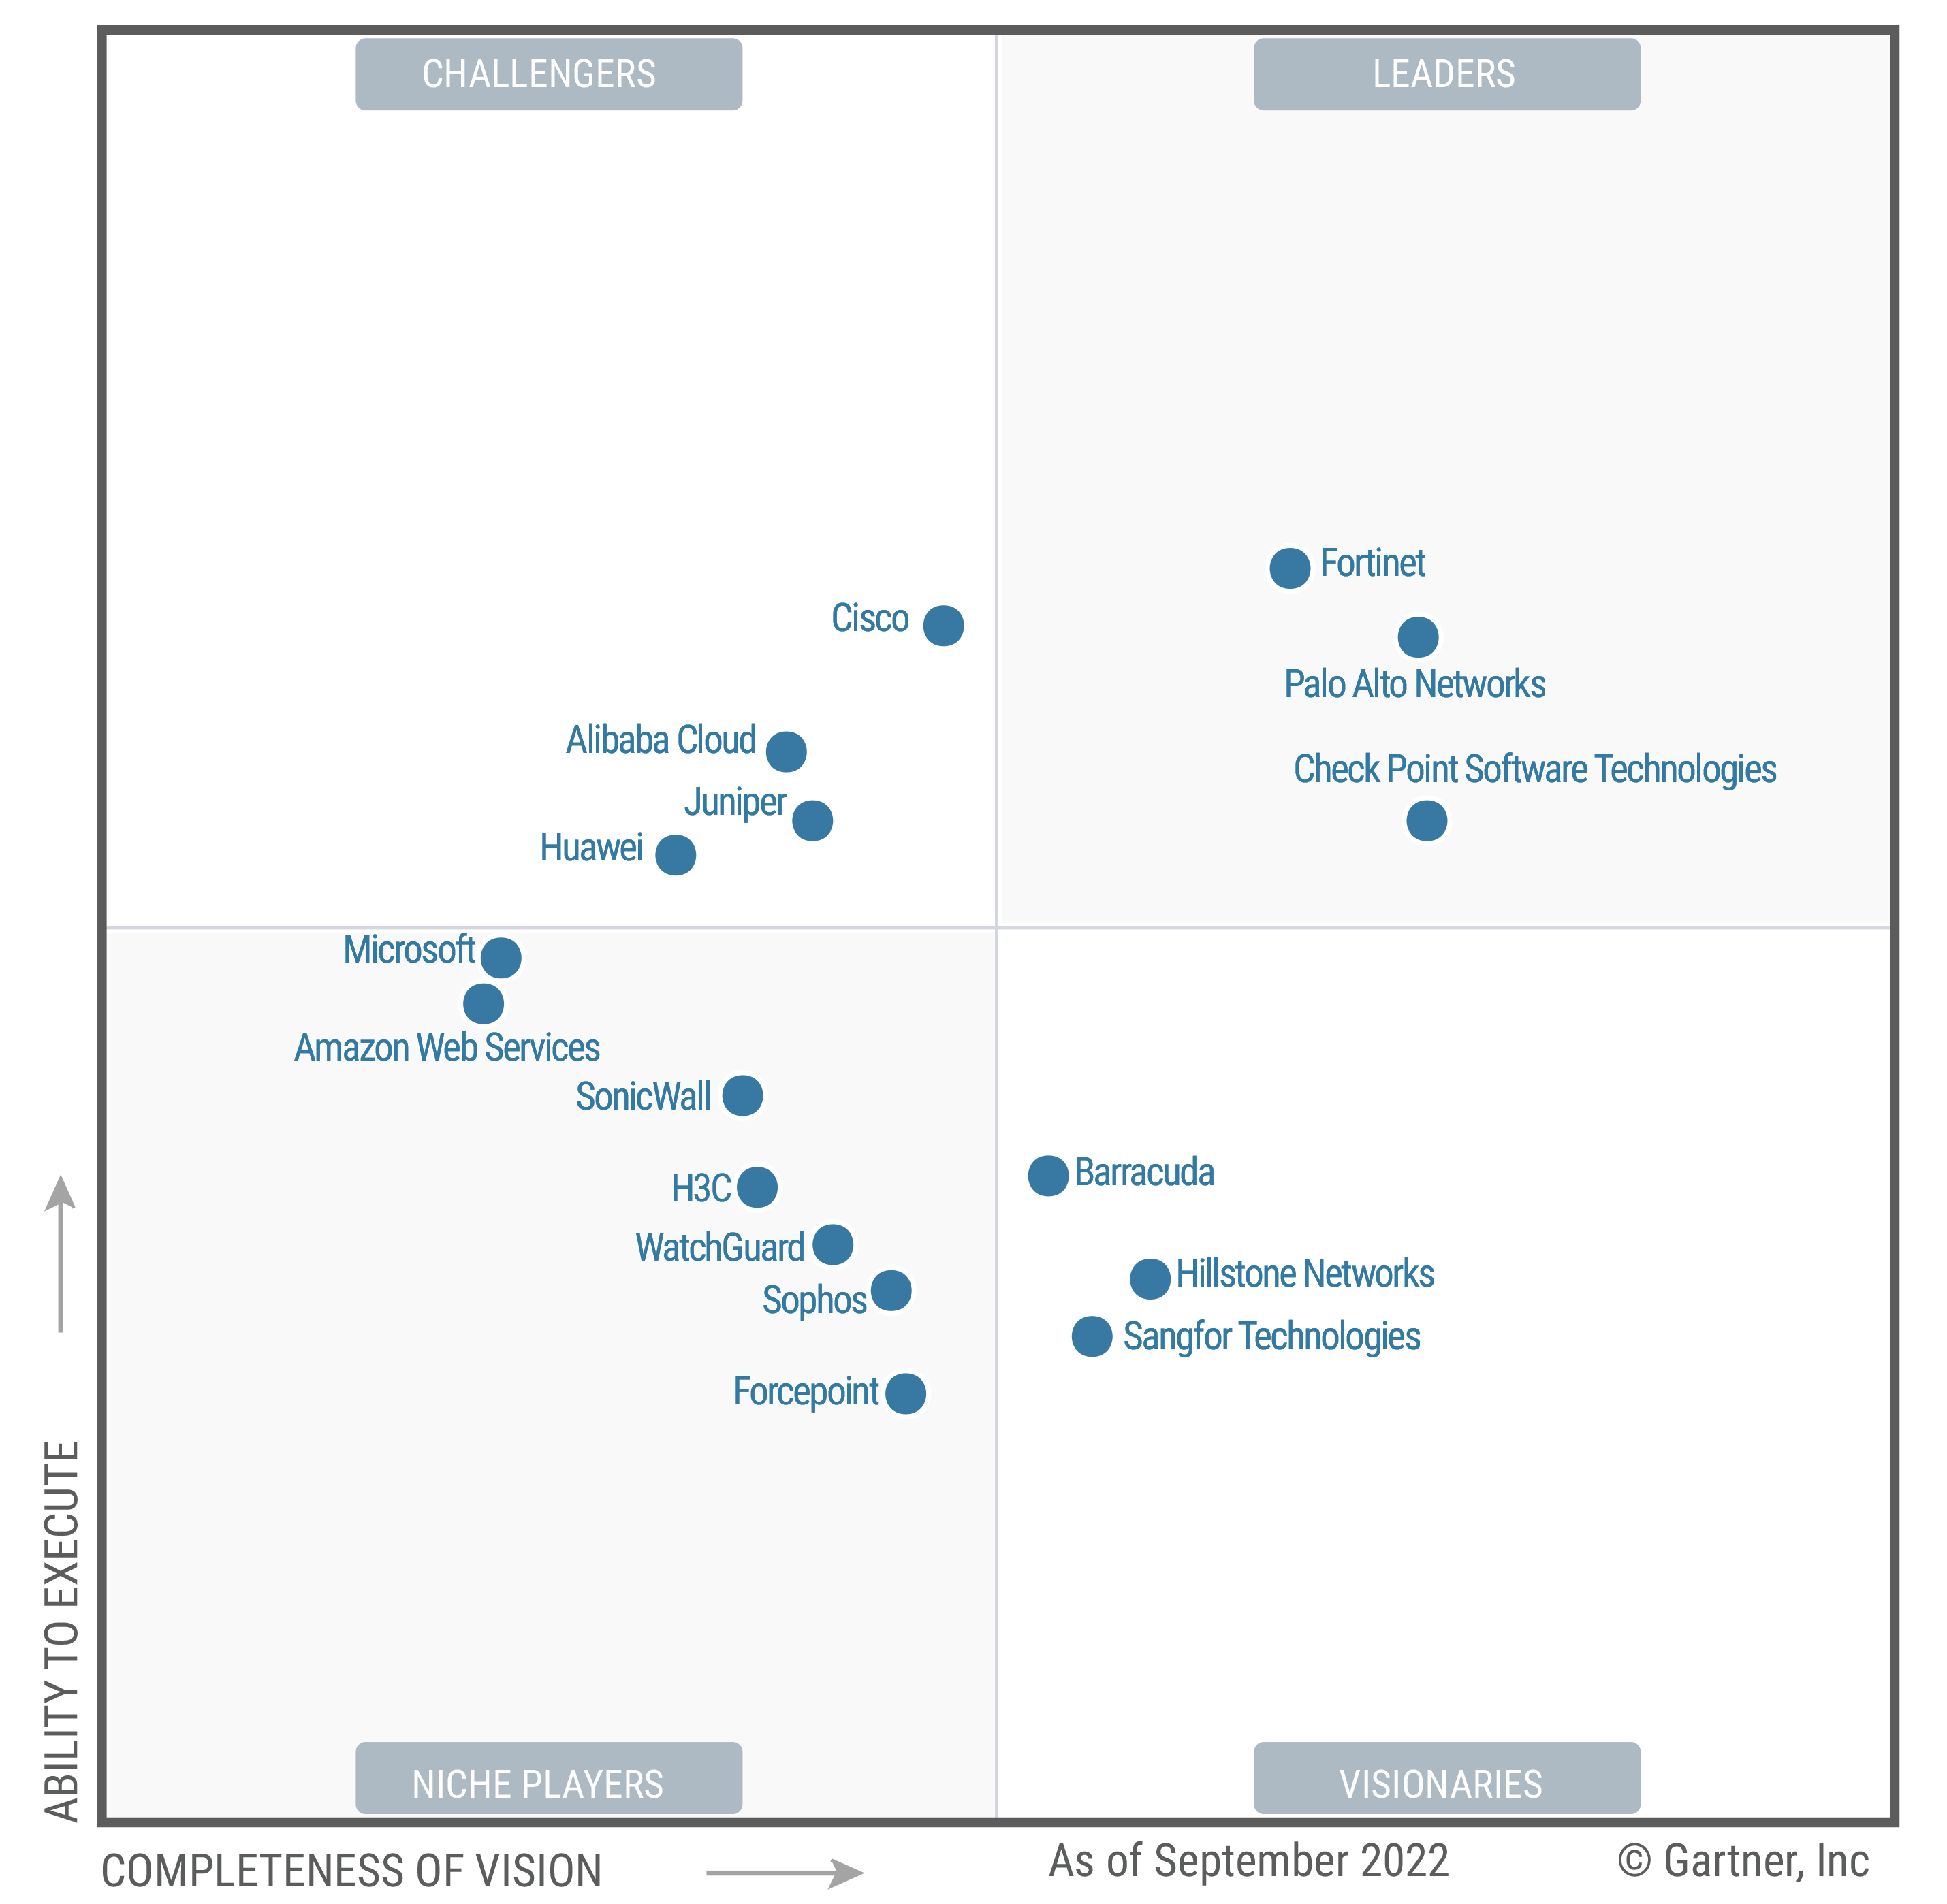
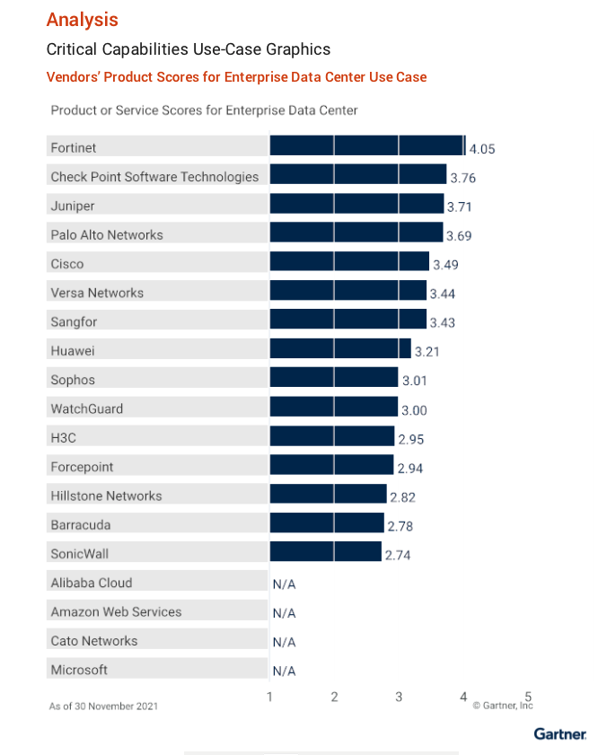
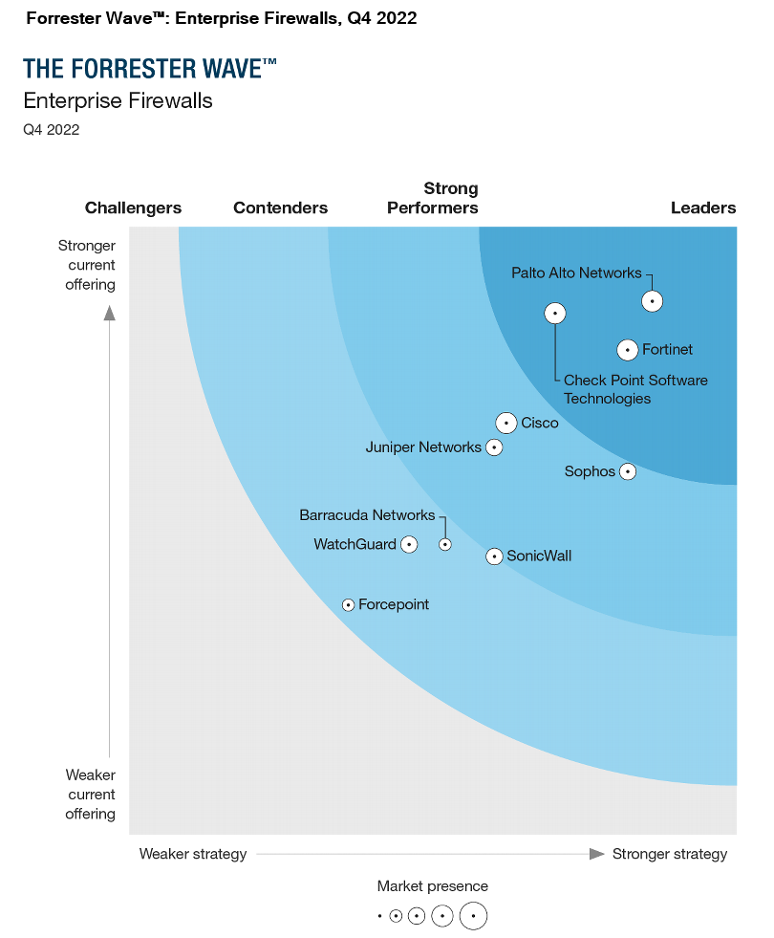
A Recognized Leader Across Top Analyst Content
Gartner® and Forrester Evaluations for Network Firewall
Dec. 2022 Gartner® Magic Quadrant™ for Network Firewalls
Jan. 2022 Gartner® Critical Capabilities for Network Firewalls
Oct. 2022 The Forrester Wave™: Enterprise Firewalls
Fortinet Recognized as a Leader positioned Highest in Ability to Execute. Marks 13th time included in this Magic Quadrant™
Fortinet is ranked Highest for the Enterprise Data Center and the Distributed Enterprise Use Cases
Fortinet Named a Leader in the Forrester Wave™
Gartner, Magic Quadrant for Network Firewalls, Rajpreet Kaur, Adam Hils, Tom Lintemuth, 19 December 2022. Gartner, Magic Quadrant for SD-WAN, Jonathan Forrest, Naresh Singh, Andrew Lerner, Karen Brown, 12 September 2022. GARTNER is a registered trademarks and service mark, and MAGIC QUADRANT is a registered trademark of Gartner, Inc. and/or its affiliates in the U.S. and internationally and are used herein with permission. All rights reserved. This graphic was published by Gartner, Inc. as part of a larger research document and should be evaluated in the context of the entire document. The Gartner document is available upon request from Fortinet. Gartner does not endorse any vendor, product or service depicted in its research publications, and does not advise technology users to select only those vendors with the highest ratings or other designation. Gartner research publications consist of the opinions of Gartner's research organization and should not be construed as statements of fact. Gartner disclaims all warranties, expressed or implied, with respect to this research, including any warranties of merchantability or fitness for a particular purpose.
The Forrester Wave™ is copyrighted by Forrester Research, Inc. Forrester and Forrester Wave™ are trademarks of Forrester Research, Inc. The Forrester Wave™ is a graphical representation of Forrester’s call on a market and is plotted using a detailed spreadsheet with exposed scores, weightings, and comments. Forrester does not endorse any vendor, product, or service depicted in the Forrester Wave™. Information is based on best available resources. Opinions reflect judgment at the time and are subject to change.

Slide 8










Layered Approach to Transformation
Colleagues
Zero Trust Policy
Customers
Automation
Visibility
Sites
Regional office
Applications
Devices
Users / Things
Branches
SD-WAN
Connectivity
Applications
SoHo Edge/Home
Infrastructure

Slide 9
Value of Fortinet Secure SD-WAN Solutions - Convergence
Four Functions / Products Consolidated into 1 platform
Zero Trust Network Access
Advanced Routing
SD-WAN
NGFW
One WAN Edge
One WAN Edge Powered by One OS, One Management

Slide 10
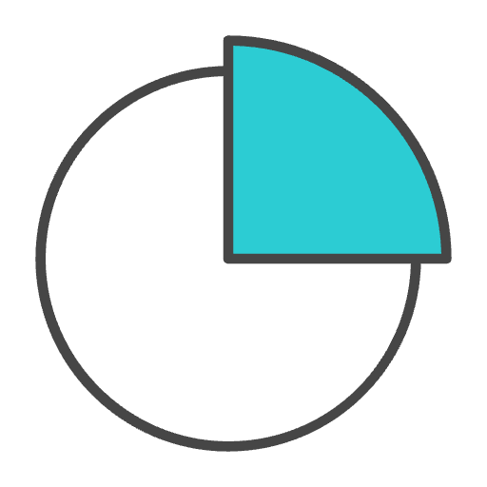





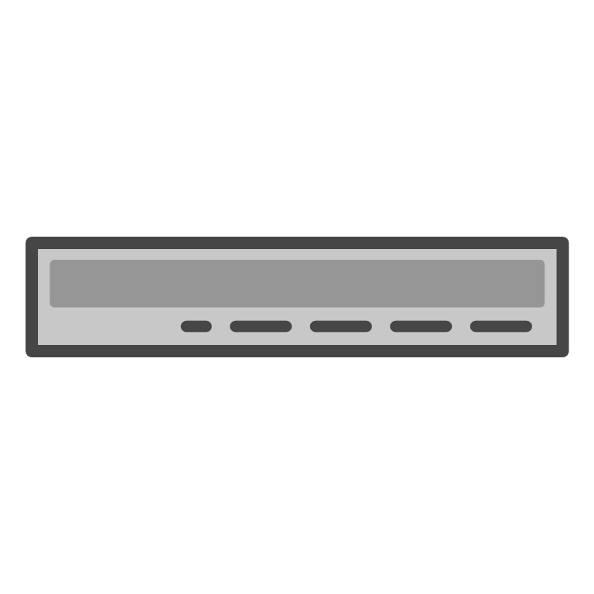











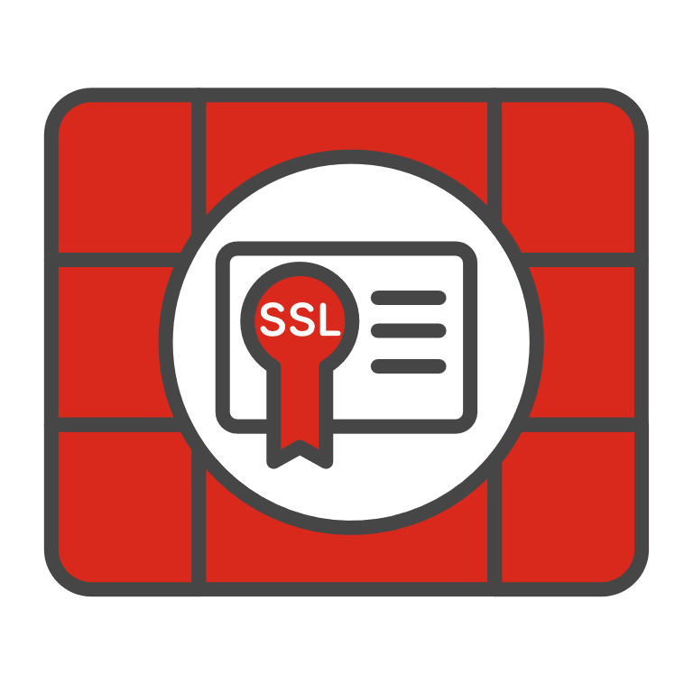
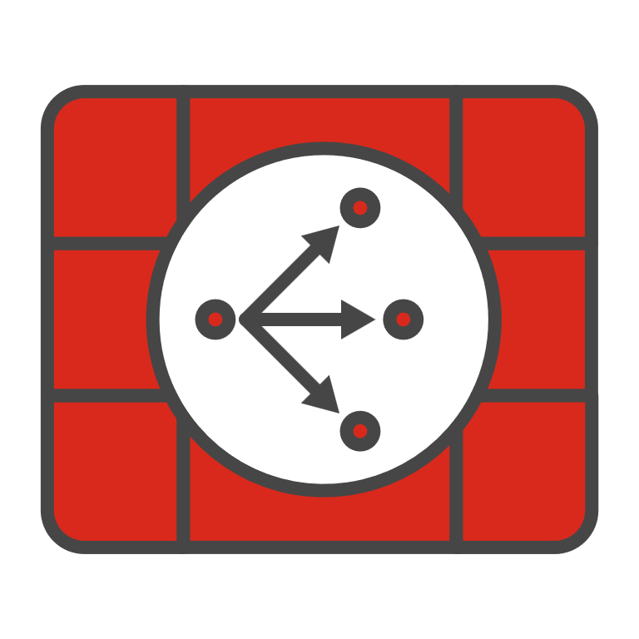









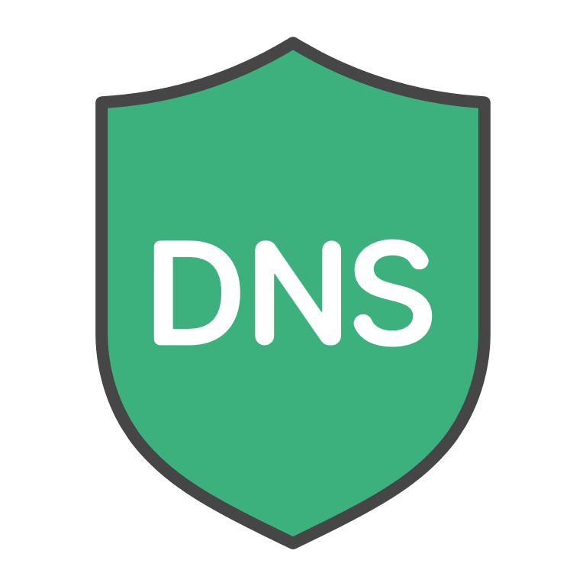





Fortinet’s SD-WAN NGFW Solution
Management & Analytics
FortiAnalyzer
FortiManager
Branch
Campus
Data Center
VM / Cloud
FortiGate
40-90 Series
FortiGate
100-900 Series
FortiGate
1000-7000 Series
FortiGate VM
FortiCNF
Networking Operating System Everywhere
Firewall
VPN
NGFW
Segmentation
Distributed
NGFW
DDoS
Low Latency
Integrated
W/LAN
5G/LTE
HW SSL
Inspection
Secure
SD-WAN
Hyperscale
ZTNA
Network and File
Security
Zero-Day Prevention
Web
Security
SaaS & Data Security
Security
FortiGuard Labs
AI-Powered Threat Intelligence
Detect Malicious Files
SSL Inspection
Inline Malware prevention
Stop DNS and Bot Attacks
Block Malicious URLs
Stop Data
Exfiltration
Spam & SaaS
Threat Protection
IoT Security &
Security Best
Practices
Notes:
MULTIPLE FORM FACTORS TO COVER ALL USE CASES
CONVERGED OS, SAME FEEL ACROSS FORM FACTORS
AI THREAT INTELLIGENCE POWERED BY AI NEURAL NETWORK FOR OVER 20 YEARS
CHECKED BY HUMANS
POWERS THE SECURITY POLICY TO PREVENT A LARGE RANGE OF THREATS

Slide 11
What is Fortinet Secure SD-WAN?
It is not a product
It is included in FortiOS – at no additional cost
Flexible integration with existing environments
Multiple WAN Interface types
WAN Path Control Real-time SLA Quality criteria
measurements for jitter, latency and packet loss
Low Touch Provisioning
Single pane of glass management
It’s a feature which allows FortiGate to simply use the best paths in order to reach an application, applying QoS, overlay networking and NGFW Security.
ASIC-accelerated IPsec VPN tunnels
Application awareness Internet DB Service
FortiGate NGFW Features & SSL Inspection
Traffic shaping
Notes:
Transport Agnostic
Improve User Experience via Application optimization
Intelligent Path Control
Secure Connectivity
I CAN GIVE YOU A FORTIGATE TODAY, AND THAT’S ALL YOU WOULD NEED TO START DOING SD-WAN

Slide 12
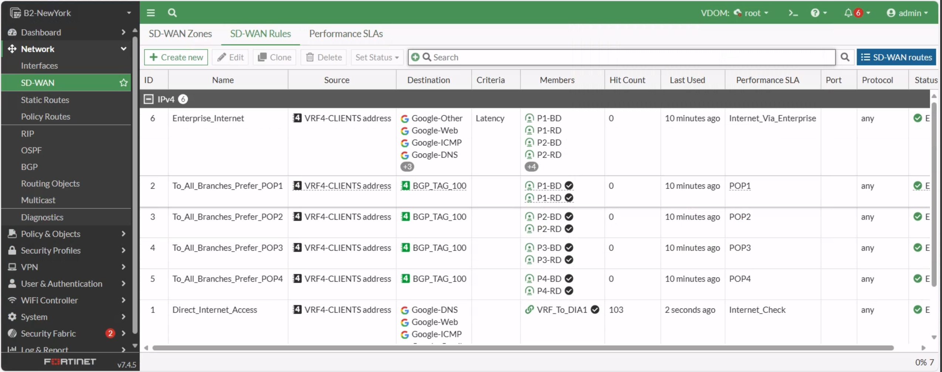
SD-WAN Integration
Notes:
Robust steering features with minimal learning curve
As you know I have experience working with both products
This is beneficial because engineers should feel confident in their abilities to understand the solution
Easy to learn and lab compared to other products
Easy to understand for both NET/SEC Eng – Essentially firewall policies for routing with added intelligence

Slide 13







SD-WAN – Main Components
FortiGate (Physical/VM/Cloud)
  NGFW
  Advanced Routing and SD-WAN
  Branch or Hub
  FortiAP/FortiSwitch/FortiExtender controller
FortiManager
  Management server
  Configuration management
  Provisioning and templatization
FortiAnalyzer
  Log aggregation server
  Monitoring network traffic and threats
  Reporting
SP5
FortiManager
FortiAnalyzer
Enterprise
Cloud
SP5
Single OS for converged networking and security
SP5
SP5
SP5
Branch Office 1
Branch Office 2
Branch Office n
Notes:
Support for common Federal initiatives:
M-21-07 (IPv6) – Dual stack and transition technologies-
Native IPv6
IPv6to4 and IPv4to6
M-19-26 (TIC 3.0) – Secure local Internet breakout -
SD-WAN rules for per application breakout
Secure by default, augmented with firewall policies and inspection
Hybrid Architecture and Cloud support -
VMs and Cloud devices can be seamlessly integrated into the architecture
Cloud locations could be branches or hub devices on the network
M-21-31 – Investigation and Remediation Capabilities
Advanced logging and threat hunting with FortiAnalyzer
Remediation capabilities such as event playbooks

Slide 14





Key SD-WAN Capabilities
Application SLA
WAN Resiliency
Visibility and Operations
Secure local Internet breakout; 5,000+ Application Identification
[Adaptive] FEC & packet duplication
Single management/dashboard, unified view for NOC & SOC
Customizable Service Level Agreements (SLAs)
Sub-second link failover
Per-application real-time monitoring, visibility, analytics
Numerous steering options
L3/L7/Identity Based
Load Sharing Capabilities
Customizable reports
Distributed and Flexible Architecture
Simplified orchestration & LTP at large scale
Notes:
EXTENSIVE STEERING OPTIONS BASED ON LARGE APP DB
ACTIVE/PASSIVE SLAs
STEERING OPTS
FEC/PACKET DUPE
DISTRIBUTED ARCH BASED ON NO CONTROLLER
INTEGRATED INTO EXISTING ROUTING ARCH

Slide 15
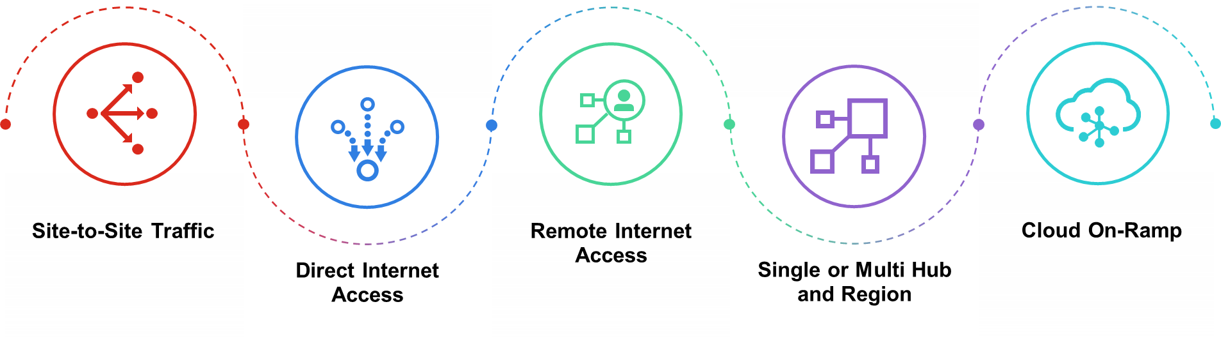
Use Case: Large Enterprise
Network Architecture
  Multiple methods of network transport
    Segregated Transports (MPLS / Internet / Wireless mixtures)
  High availability requirements
  Any-to-Any communication
  Low touch deployment and scripting
  Analytics and reporting on network health
  Integration with existing environments
    Deployment not reliant on controller architectures
    Possible to implement as you go
Initiatives
  M-21-07 (IPv6)
  M-19-26 (TIC 3.0)
  M-21-31 (Analytics and Logging)
  Cloud First
Sizing:
  Any size (1-1000s)
  Multiple data centers
One Solution for All Use Cases

Slide 16





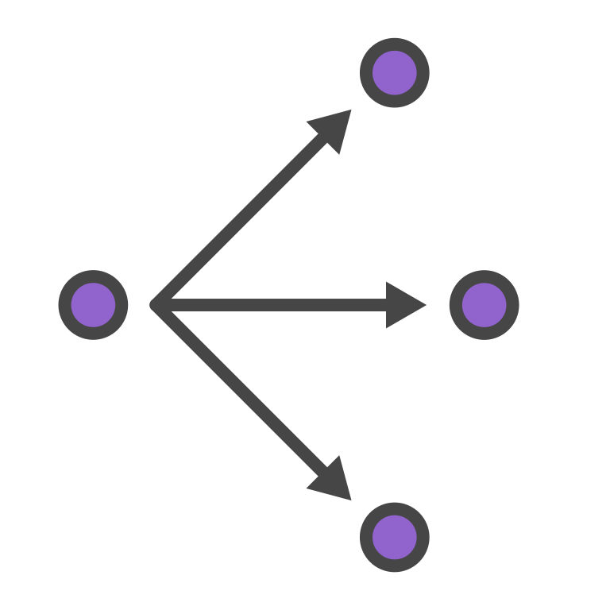



Secure SD-Branch
Securing and Simplifying Distributed Enterprise Through Convergence
SD-WAN secure business outcome driven WAN
Simplifies traditional WAN complexity
Better cloud application performance
5G/LTE Wireless WAN
Unified Management
Secure Connectivity protecting the access edge
Consolidation through convergence of
security and network access
Device
Edge
LAN
Edge
WAN
Edge
NAC protecting the device edge
Discovery, classification, and secure onboarding of IoT devices
Corporate Client
Switch
Secure
SD-WAN
User
Contractor
Mobile BYOD
NAC
FortiLink
NGFW
AI driven Management and Automation
Single pane of glass management
Guest
Wireless
5G Gateway

Slide 17
Demo

Slide 18
Contact Fortinet Federal:
Will Hagan – DISA Account Manager
Mobile: 571.562.1682
Direct: 571.786.8553
whagan@fortinetfederal.com
Tony Janita- DISA Solution Engineer
Mobile:571-562-1513
tjanita@fortinetfederal.com
David Peed- Director of DoD
M: 443-421-2078
Direct: 571.786.6043
dpeed@fortinetfederal.com

Slide 20




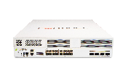













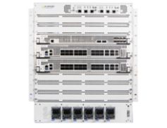
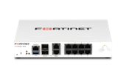







FortiGate Network Firewall Appliance Portfolio
Industry’s broadest NGFW portfolio for the industry-leading threat protection
Branch
(40-90 Series)
Campus
(100-900 Series)
Data Center
(1000-4000 Series)
Large Data Center
(6000-7000 Series)
FG-40F Series
0.6 Gbps
Threat Protection
FG-100F Series
1.0 Gbps
Threat Protection
POE
SSD
FG-1000F Series
13 Gbps
Threat Protection
FG-3200F Series
45 Gbps
Threat Protection
FG-6300F Series
60 Gbps
Threat Protection
DSL
LTE
FG-60F Series
0.7 Gbps
Threat Protection
FG-200F Series
2 Gbps
Threat Protection
FG-3500F Series
63 Gbps
Threat Protection
FG-6500F Series
100 Gbps
Threat Protection
FG-1800F Series
15 Gbps
Threat Protection
WI-FI
Bypass
FG-80F Series
0.9 Gbps
Threat Protection
FG-400F/ FG-600F Series
9-10.5 Gbps
Threat Protection
FG-3700F Series
75 Gbps
Threat Protection
OT Deployments
FG-2600F Series
15 Gbps
Threat Protection
FG-90G Series
2.2 Gbps
Threat Protection
FG-900G Series
20 Gbps
Threat Protection
FG-4000F Series
45 – 70 Gbps
Threat Protection
FG-7000F Series
50 - 520 Gbps
Threat Protection
Bypass
Rugged
Broad-based variants for wider use cases
Highest threat protection throughput up to 520 GBs
Integrated SD-WAN
Up to x5 SSL inspection
4X industry avg threat protection
Integrated ZTNA
VXLAN Deployment
<2 us Ultra-low latency
400GE Built-in Ports
Operates up to 88% less power consumption powered by ASIC
Notes:
Advanced network segmentation and granular policies for comprehensive threat prevention
Industry-leading AI/ML-driven NGFW with inline L7 inspection and SSL encryption in ASIC-based appliances
Operates with 88% less power consumption than industry-standard CPUs
Single platform to implement firewall or proxy architecture
Granular policies for east-west traffic management
Session Rate for data center to support ecommerce

Slide 21
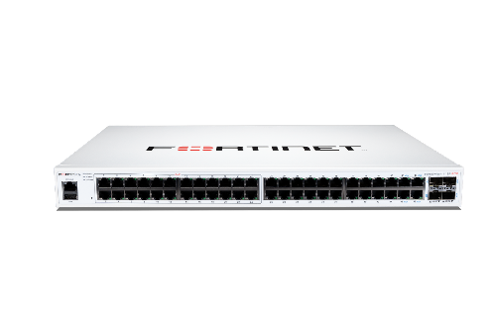
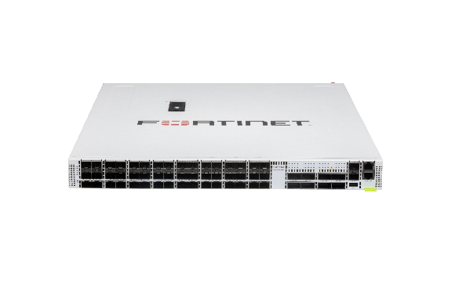
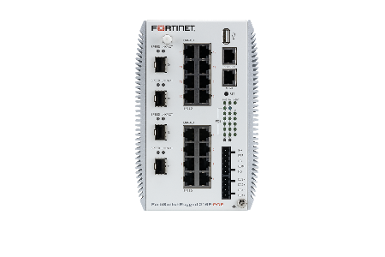
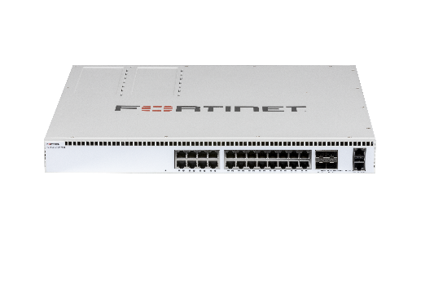
FortiSwitch Portfolio
Secure Access
Campus
Campus Core Data Center
Rugged
1 GE Access
8, 24, and 48 port options
PoE+ capable
Up to 10GE uplinks
Branch, SMB and Medium office deployments
1 GE and Multi GE Access
24 and 48 port options
802.3bt 90w PoE options
Up to 40GE uplinks
Campus, high end branch deployments
10GE 25GE and 100GE
24, 32 and 48 port options
Up to 100GE Uplinks
Core aggregation and Data Center deployments
1 GE and Multi GE Access
8,12,16 and 24 port
802.3bt 90w PoE options
Up to 40GE uplinks
OT and challenging environment deployment

Slide 22
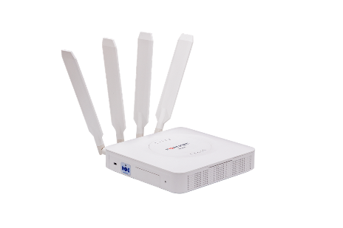

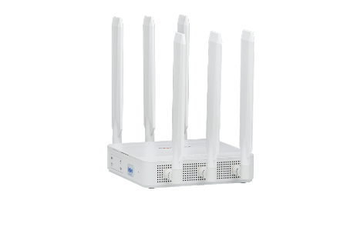
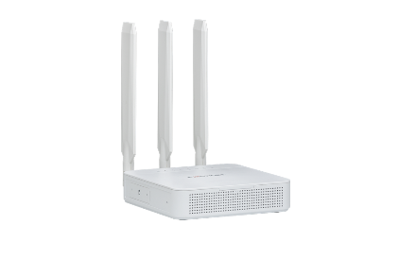
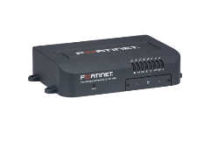
FortiExtender Gateways
NEW!
Dual SIM
Dual Modem
Vehicle
 | FEX-101F | FEX-201F | FEX-311F | FEX-511F | FEX-202F | FEX-212F | FEV-211F
LTE | CAT6 | CAT7 | CAT16 | CAT20 | CAT7 | CAT12 | CAT12
5G | - | - | - | Sub 6 | - | - | -
Max D/L (Mbps) | 300 | 300 | 1000 | 2500 | 300 | 600 | 600
Ports | 5 x GE RJ45 Ports (WAN + LAN) | 5 x GE RJ45 Ports (WAN + LAN) | 1 x GE SFP, 5 x GE RJ45 Ports (WAN + LAN) | 1 x GE SFP, 5 x GE RJ45 Ports (WAN + LAN) | 5 x GE RJ45 Ports (WAN + LAN) | 5 x GE RJ45 Ports (WAN + LAN) | 5 x GE RJ45 Ports (WAN + LAN)
Wi-Fi | - | - | - | - | - | - | Yes
Use Case | Branch | Branch | Branch | Branch | Branch | Branch | Vehicle/IoT
Region | AM/EA+ | AM/EA | Global | Global | AM/EA | Global | AM/EA
Notes:
CAT7+ = Band14 support

