Slide 1

MANAGE YOUR MAIL – SAVE A TREE!
WFM OptOut Technology
Removing Unwanted Mail (UM)

Slide 2
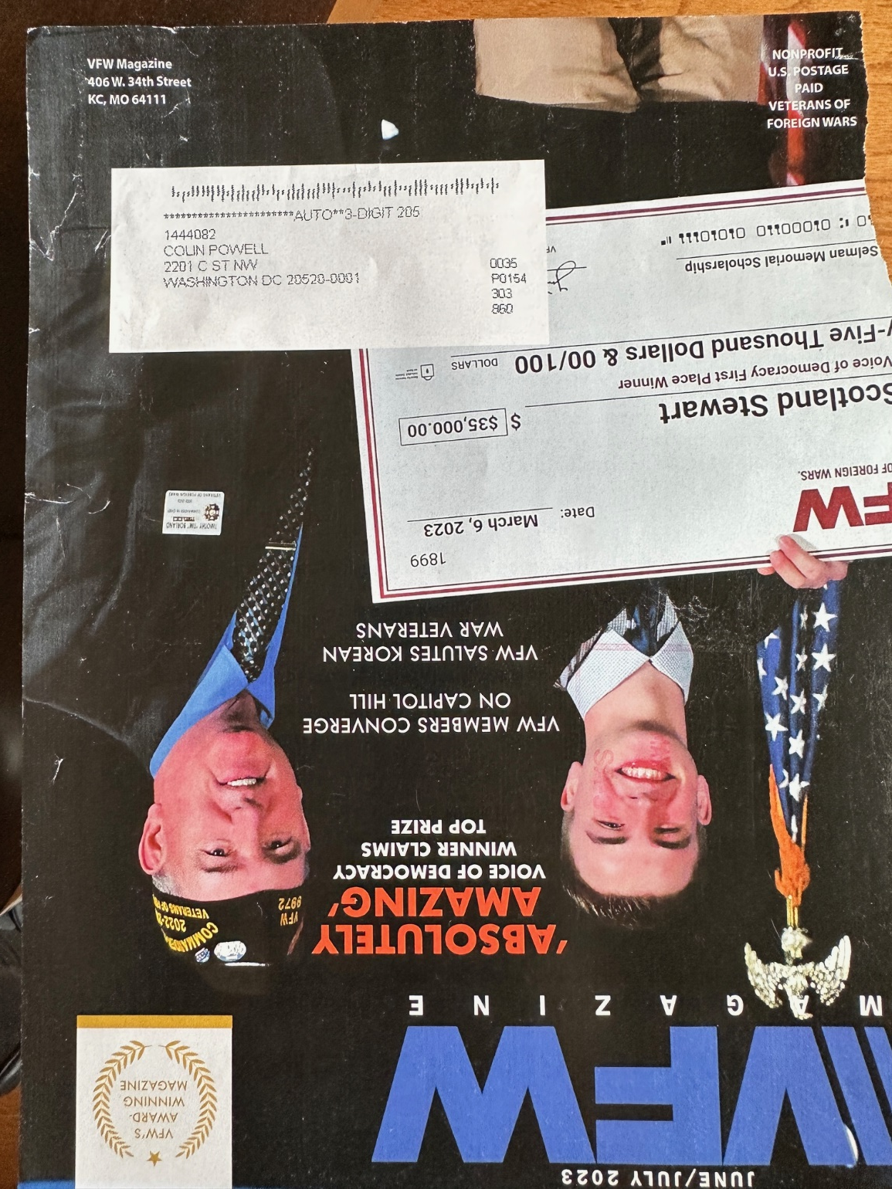
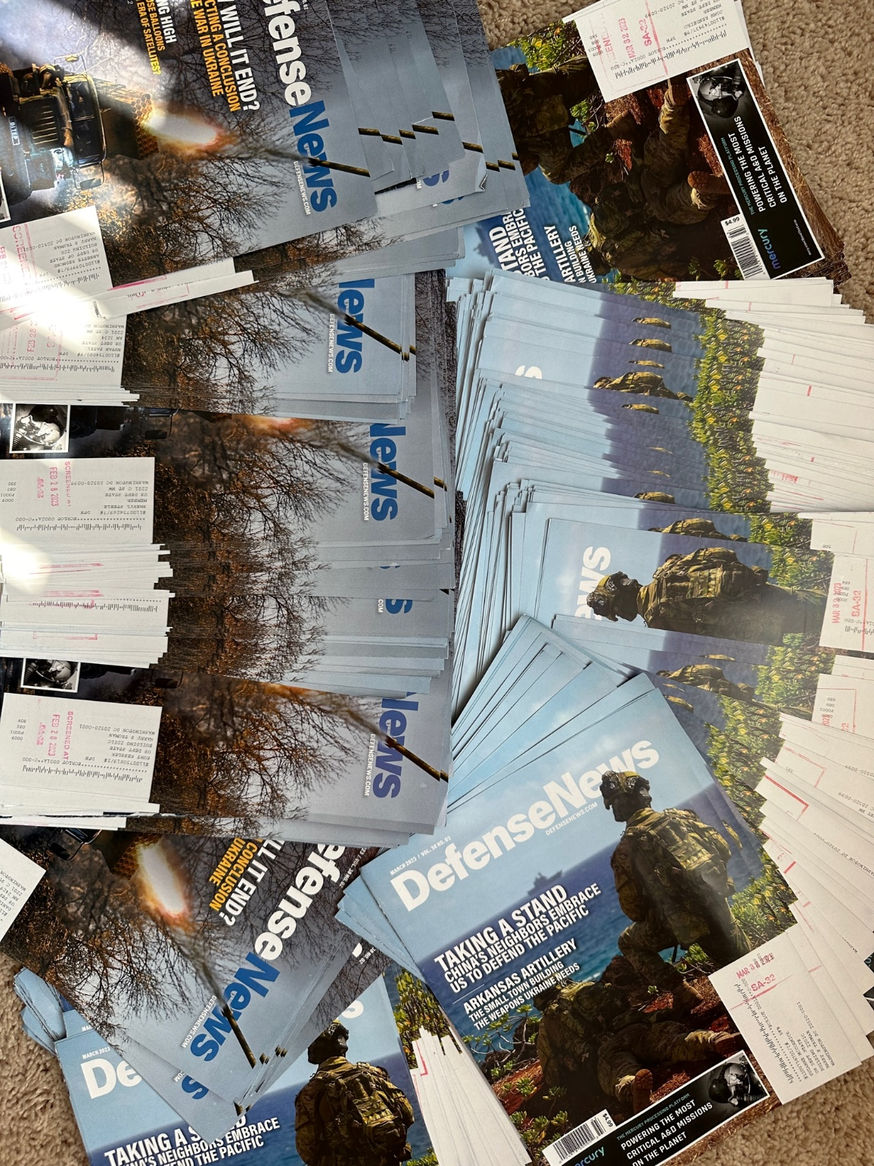
Unwanted and Undeliverable Mail
Colin Powell
Screening for Hazardous Material
6
2

Slide 3
WFM Videos
WFM OptOut – Cost Efficiencies and Zero Waste Opportunity:
https://www.youtube.com/watch?v=ztSjdnpMEqI)
WFM OptOut User Guide:
https://www.youtube.com/watch?v=pLSjbUlxec4
3

Slide 4
MANAGE YOUR MAIL – SAVE A TREE!
SA32 data as of February 2025
WFM OptOut Technology at
U.S. Department of State
Impact of Removing Unwanted Mail (UM)
4

Slide 5
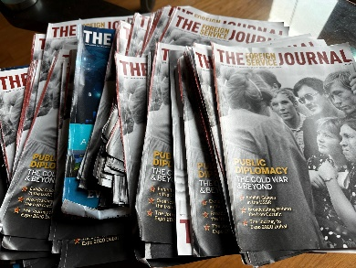

Cost Savings Breakdown Across Categories
Category | Cost Savings
Productivity¹ | $427,255.33
Shipping to Embassies² | $1,241,031.62
Recycling³ | $18,612.27
Screening for Hazardous Materials⁴
Total Cost Savings | $1,686,899.22
Removed
511,071
Mail Pieces
      ¹ Productivity ($.836) – used USPS Variable Cost for Flat/Catalog mail type
      ² Shipping Cost to Embassies (avg. $7.35 per kilo) – prior to WFM, most was recycled prior to shipping
      ³ Recycle Cost (avg. $100 per ton) – used industry cost
      ⁴ Screening for Hazardous Material - fewer cages to detect hazardous substances
Operational Sustainability: “Companies tend to focus on dealing with products at their end of life, e.g., recycling or safe disposal. While this is good, being sustainable at the start of products’ lives — such as reducing materials during production — can be far more sustainable than the end-of-life approach.”
Vishal Agrawal is Henry J. Blommer Family Endowed Chair in Sustainable Business and Professor of Operations Management at the McDonough School of Business, Georgetown University
5

Slide 6
SA-32 Letter Mail (Years: 2022, 2023, 2024, and 2025)
Letter mail volume dropped by 36% from 2022 to 2023. By connecting SA-32 to nearly 928 commercial mailers, an additional 20% reduction in letter mail volume was achieved in 2024.
6

Slide 7
SA-32 Flat Mail (Years: 2022, 2023, 2024, and 2025)
Feb 2025 SPLY Cut 56%
While Letter Mail experienced significant reductions, Flats only decreased by 11% from 2022 to 2023. However, by connecting 928 commercial mailers, WFM Technology achieved a 56% year-over-year reduction in SPLY Flat Mail volume in February 2025. Flat mail types are heavier and cost approximately $0.836 per piece to process (according to USPS 2023 Revenue Analysis), also contribute the most waste.
7

Slide 8
SA-32 Number of Cages (Years: 2022, 2023, 2024, and 2025)
SA-32 receives cages from USPS containing approx. 8 letter trays and 6.5 flat tubs. Letter trays hold up to 500 pcs. Flat tubs hold up to 155 pcs. However, letters weigh significantly less than flats. Therefore, removing unwanted flats/catalogs/journals saves a lot more money .
8

Slide 9
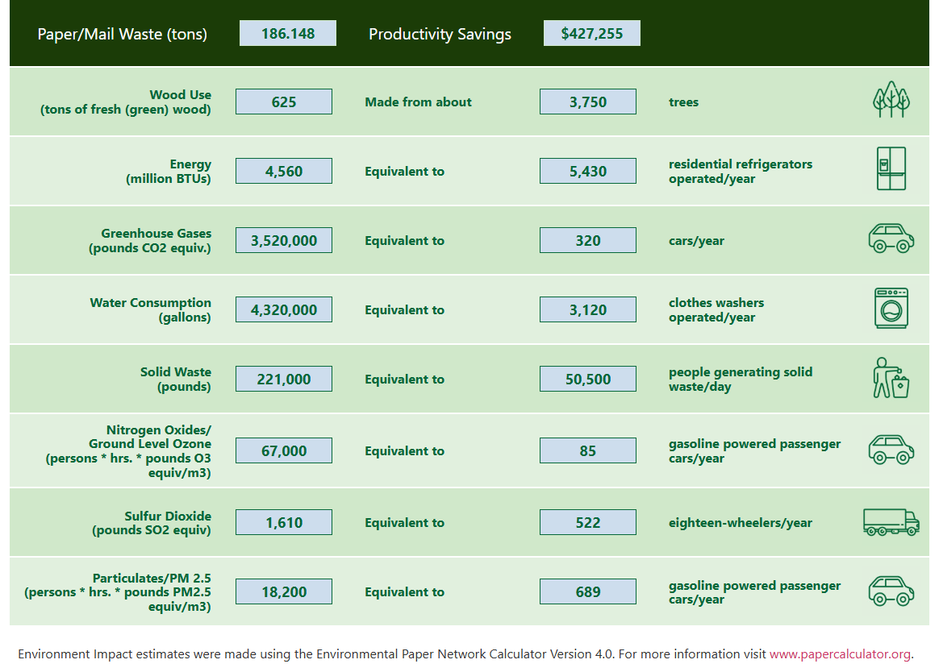
Environmental Impact & Productivity Savings
(volume processed during WFM testing and for 11 months)
SA-32 and HST Mail Center
9

Slide 10


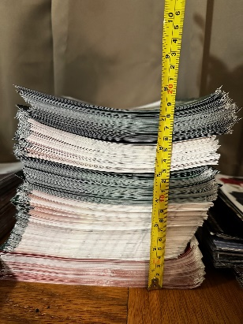


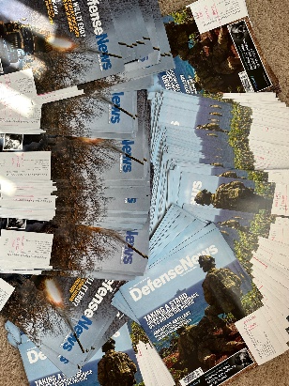
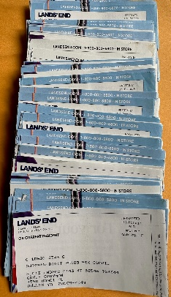



Other Accomplishments
Connected SA-32 and HST Mail Center to 928 Commercial Mailers.
Stopped 40 Large Mailers from marketing to US Department of State.
Stopped Resell of names to HUNDREDS of Mailers.
HST Mail Center is now using the WFM App and highlights its user-friendly nature.
10

Slide 11

Opt-Out Strategies: Manual vs. Automated
AMPS
WFM
¹
Automated System
Reach the right person
Scalability - All Departments and Individuals
Tracking & Reporting Capability
Captures Mail Preferences
Strategic Engagement
Streamlines Screening
No Measurable Impact in Mail Reduction
²
³
⁴
⁵
⁶
Automated Military Postal System (AMPS) is designed for managing and tracking mail operations. While powerful for logistics, it does not support managing
mail preferences or stopping the 90% of unwanted mail at the source. Military Postal Service Agency (MPSA) - Serve as the single mail manager within the military services.
¹ - 1) Print Opt-Out Letters 2) Print Mailing Labels 3) Stuff Envelopes 4) Type each contact info 5) Call Mailers (if needed) 6) Mail the Request
² - Tracks and Reports User Info, Mail Preferences, Activity by mailer, Unwanted Mail Volumes, Mail Images, Environmental Impact, Productivity Savings
³ - Captures Mail Preferences - No Longer There, Unsubscribe, Prefer Electronic/Digital, Correct Addresses
⁴ - Agencies can request high-volume mailers (“carpet bombers”) to stop sending marketing materials to specific locations
⁵ - Removing 90% of unwanted mail means fewer items to scan, sort, and inspect for hazardous materials.
⁶ - Implemented at the U.S. Department of State and successfully tested at Sheppard, Davis-Monthan, Keesler, Maxwell, and Patrick Space Force Bases—removed
more than 70% of unwanted mail at Patrick Space alone.
11

Slide 12

CONTACT INFORMATION
Michael Sanders, President
Main Office: 703-892-MAIL (6245)
Email: michael.sanders@wastefreemail.com
Company website: https://www.wastefreemail.com
WFM
Helmut E. Brokamp | Director
Office of Diplomatic Pouch and Mail | A/GO/OPS/DPM
Phone: +1 (771) 204-0792
Email: BrokampHE@state.gov
State Department
SALVADOR OROZPE, GS-13, DAFC
AFIMSC Official Mail and Postal Program Manager
Air Force Installation and Mission Support Center
Cell: (210)849-1573
Email: salvador.orozpe.1@us.af.mil
Air Force
12

