Slide 1

The Data Protection Company
Innovation in High-Speed Data Transfer powered by AI
=
Thursday,15th May 2025
David Trossell – CEO/CTO
Antony Reynolds – CRO, Global Channels Leader
Jason Wakeling – Technical Pre-Sales & Support

Slide 2













Who are Bridgeworks?
1982
Digital Interfaces Ltd
2000
Current CEO/CTO David Trossell joins
2002
Name changes to Bridgeworks to more accurately reflect the product portfolio
2008
Bridgeworks start developing AI powered Data Acceleration products WANrockIT & PORTrockIT – 18 Patents!
2012/25
Global OEM agreements with IBM and Dell – tech and market validation for all 3 core platforms
)UK /EMEA +44 1590 615 444 )USA/Canada +1 888 238 1805 https://www.4bridgeworks.com
Notes:
The company is based in the UK with the HQ in Lymington, Hampshire and the existing and new solutions are sold through partners and OEM’s Worldwide.
Founded in 1982 as Digital Interfaces Ltd, they were a leading innovator a number of tape and disk solutions for connecting Servers and tape devices such as Pertec, STK and other tape devices. The company worked with Alcatel and BELL Telecoms to produce a Pertec to SCSI controller for their thousands of telecom switches across the world. Other OEMs such as ICL, IBM and other OEM used their products for unique solutions.
Acquired by the current owners in 1999 with David Trossell, the current CEO, joining in 2000. The company name was changed to Bridgeworks Ltd. in 2002 to accurately reflect the nature of the business and the product portfolio. During the period 2001 to date Bridgeworks has developed a series of groundbreaking products for OEM such as DELL, Quantum for their tape Libraries. Since 2008 Bridgeworks have continued the development of the SAN Bridge solutions culminating in the first company in the World, to introduce a 100Gbs iSCSI to SAS Bridge to market .
In addition to continuous development of SAN Protocol Bridges , Bridgeworks has developed once again world beating WAN Acceleration products for the transmission of SAN and or IP protocols over long distance WAN without being affected by Latency and or Packet Loss. This products unique feature is the embedded AI program that automatically configures and optimises the performance of the traffic flow across the WAN.
Existing clients of note are the National Security Agency, Atlassian Williams Racing, Allianz, Investec and IBM.

Slide 3
Data Protection by Bridgeworks
SAN Connectivity
Data Acceleration
Connects disparate SCSI protocols
Fibre Channel, iSCSI and SAS
Patented AI Data Acceleration Engine
Mitigates the effects of Latency & Packet Loss
Zero Data Touch
SAN Protocol Bridges
WANrockIT
PORTrockIT
Oresund
FC to iSCSI & ISCSI to FC (10Gb, 40Gb & 100Gb)
Tamar
FC to SAS (8Gb to 6Gb & 16Gb to 12Gb)
Potomac
iSCSI to SAS (10Gb, 40Gb & 100Gb)
In-Flight Data Protocol Conversion
Protocol Optimisation
Devices appear as locally connected
Accelerates encrypted data
Works with any software that utilises the TCP/IP protocol
Pass Through functionality
Seamless integration into existing networks
)UK /EMEA +44 1590 615 444 )USA/Canada +1 888 238 1805 https://www.4bridgeworks.com

Slide 4
Don't ask us what we do!
Ask us what problems we solve!
(Moving big data over big distances need not be a big problem)
)UK /EMEA +44 1590 615 444 )USA/Canada +1 888 238 1805 https://www.4bridgeworks.com

Slide 5
Data Acceleration and Bridgeworks
3 Fundamental problems to solve:
Latency
Packet Loss
Data Flow
)UK /EMEA +44 1590 615 444 )USA/Canada +1 888 238 1805 https://www.4bridgeworks.com

Slide 6
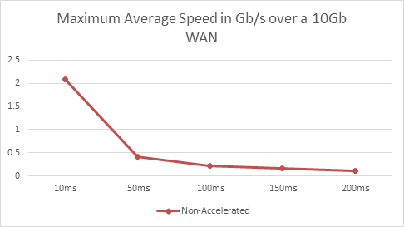
Latency and Data Transfer Speeds
)UK /EMEA +44 1590 615 444 )USA/Canada +1 888 238 1805 https://www.4bridgeworks.com

Slide 7
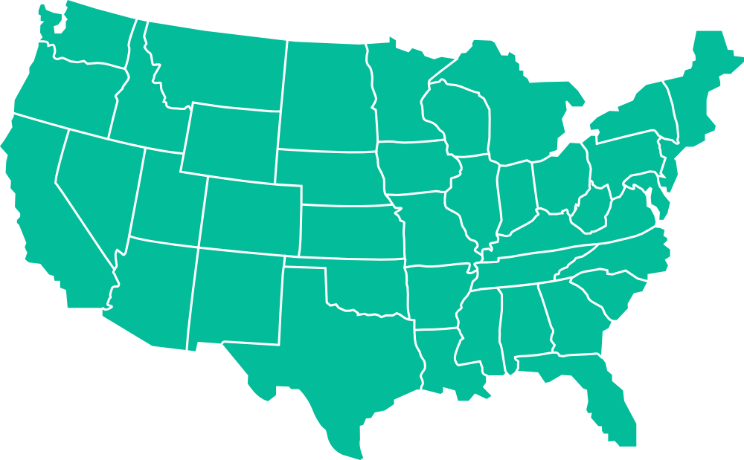
Data Acceleration and Bridgeworks
CVS Pharmacy - largest pharmacy chain in the United States
Struggled to meet HIPPA and FDA compliance measures due to a variety of data management issues.
Backup challenges and disaster recovery objectives over a vast geographical area of over 2.8k miles.
Two VTLs purchased to eliminate Iron Mountain, reduce backup and restore times;
Rhode Island
Daily backups 450GB
Weekly backups 500GB
600Mb Dedicated WAN link
Backup Window 12hrs
iSCSI protocol
80ms Latency 0.5% packet loss
Arizona
)UK /EMEA +44 1590 615 444 )USA/Canada +1 888 238 1805 https://www.4bridgeworks.com

Slide 8
Data Acceleration and Bridgeworks
CVS Pharmacy - largest pharmacy chain in the United States
Struggled to meet HIPPA and FDA compliance measures due to a variety of data management issues.
Backup challenges and disaster recovery objectives over a vast geographical area of over 2.8k miles.
Two VTLs purchased to eliminate Iron Mountain, reduce backup and restore times;
Rhode Island
Daily backups 450GB
Weekly backups 500GB
600Mb Dedicated WAN link
Backup Window 12hrs
iSCSI protocol
80ms Latency 0.5% packet loss
Arizona
Actual Performance 50GB = 12 -15 HOURS
)UK /EMEA +44 1590 615 444 )USA/Canada +1 888 238 1805 https://www.4bridgeworks.com

Slide 9
The Problem!
80ms Latency and 0.5% Packet Loss!
Only able to transfer 50GB of data within backup window!
Unable to complete a full backup in time!
Unable to implement an achievable Disaster Recovery plan!
)UK /EMEA +44 1590 615 444 )USA/Canada +1 888 238 1805 https://www.4bridgeworks.com

Slide 10
Typical Solutions Suggested
Purchase more bandwidth
Upgrade the infrastructure
Use Data Compression and De-Duplication
Optimise the protocols
Cache the data
)UK /EMEA +44 1590 615 444 )USA/Canada +1 888 238 1805 https://www.4bridgeworks.com

Slide 11

Data Acceleration and Bridgeworks
No WANrockIT
50GB = 12 -15 HOURS
With WANrockIT
50GB = 45 MINUTES
Rhode Island
Bridgeworks solution was implemented within 15 minutes, and resulted in:
94% reduction in backup of 50 GB (15 hours reduced to 45 minutes)
Daily backups (450GB) reduced to less than 4 hours
Disaster recovery tests completed in less than 5 hours
Eliminated Iron Mountain costs
Eliminated physical tape media
Mitigated latency and packet loss
Reduced manpower hours
Removed audit, compliance risks
Arizona
)UK /EMEA +44 1590 615 444 )USA/Canada +1 888 238 1805 https://www.4bridgeworks.com

Slide 12

What is unique about Bridgeworks and their solution to the problems of WAN performance?
)UK /EMEA +44 1590 615 444 )USA/Canada +1 888 238 1805 https://www.4bridgeworks.com

Slide 13
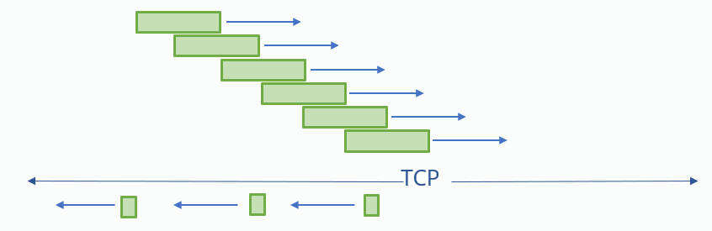
How we solved the problem?
Cause of Problem
Solution
Outcome
What We Can’t Change:
The Speed of Light
Packet Loss
TCP/IP Latency/Ack
What we can do, is exploit TCP/IP:
Parallelise the data stream into multiple virtual connections
We Use AI to :
Control the multiple connections
Control Payload size
Balance Ingress and Egress
)UK /EMEA +44 1590 615 444 )USA/Canada +1 888 238 1805 https://www.4bridgeworks.com

Slide 14
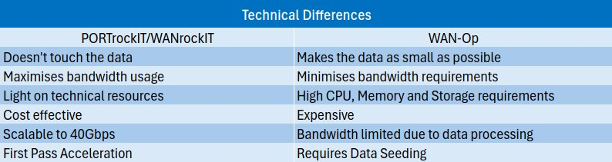
Alternatives
)UK /EMEA +44 1590 615 444 )USA/Canada +1 888 238 1805 https://www.4bridgeworks.com

Slide 15
Installation Options
SAN Bridges
WANrockIT
PORTrockIT
Hardware only
Physical (1U or 2U Server)
Cloud
  AWS
Physical (1U or 2U Server)
Virtual
  VMware
  ProxMox
  HyperV
  Docker
Cloud
  AWS
  Google
  Azure
)UK /EMEA +44 1590 615 444 )USA/Canada +1 888 238 1805 https://www.4bridgeworks.com

Slide 16
Integration
PORTrockIT nodes are designed to integrate seamlessly into your existing networks with minimal disruption to your current services.
Basic operations and acceleration can be configured and enabled in approximately 30 minutes.
Advanced configuration for VLANs, integration with monitoring software via SNMP, WAN Scheduling, Link Aggregation, Task Scheduling etc.
)UK /EMEA +44 1590 615 444 )USA/Canada +1 888 238 1805 https://www.4bridgeworks.com

Slide 17
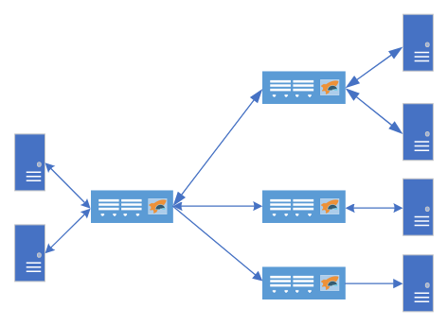

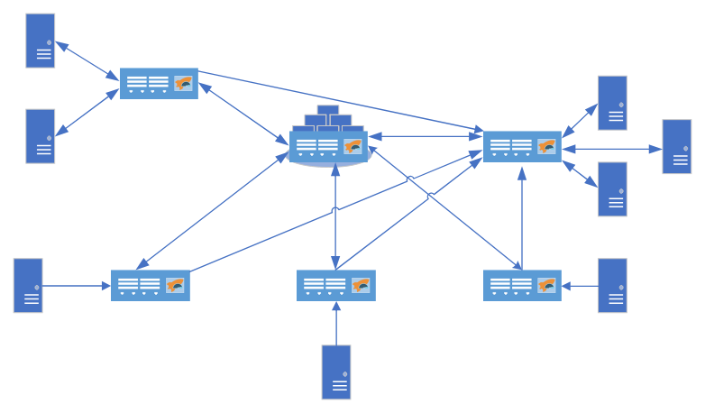
Topologies
P2P
Fan In/Fan Out
Multi-Site, Multi Protocol
)UK /EMEA +44 1590 615 444 )USA/Canada +1 888 238 1805 https://www.4bridgeworks.com

Slide 18
Demonstration
)UK /EMEA +44 1590 615 444 )USA/Canada +1 888 238 1805 https://www.4bridgeworks.com

Slide 19
Q&A Session
)UK /EMEA +44 1590 615 444 )USA/Canada +1 888 238 1805 https://www.4bridgeworks.com

Slide 20
Contact Details
David Trossell - David.trossell@4bridgeworks.com
Antony Reynolds - Antony.reynolds@4bridgeworks.com
Jason Wakeling – Jason.wakeling@4bridgeworks.com
)UK /EMEA +44 1590 615 444 )USA/Canada +1 888 238 1805 https://www.4bridgeworks.com

Slide 21
Thank You
)UK /EMEA +44 1590 615 444 )USA/Canada +1 888 238 1805 https://www.4bridgeworks.com

