Slide 1
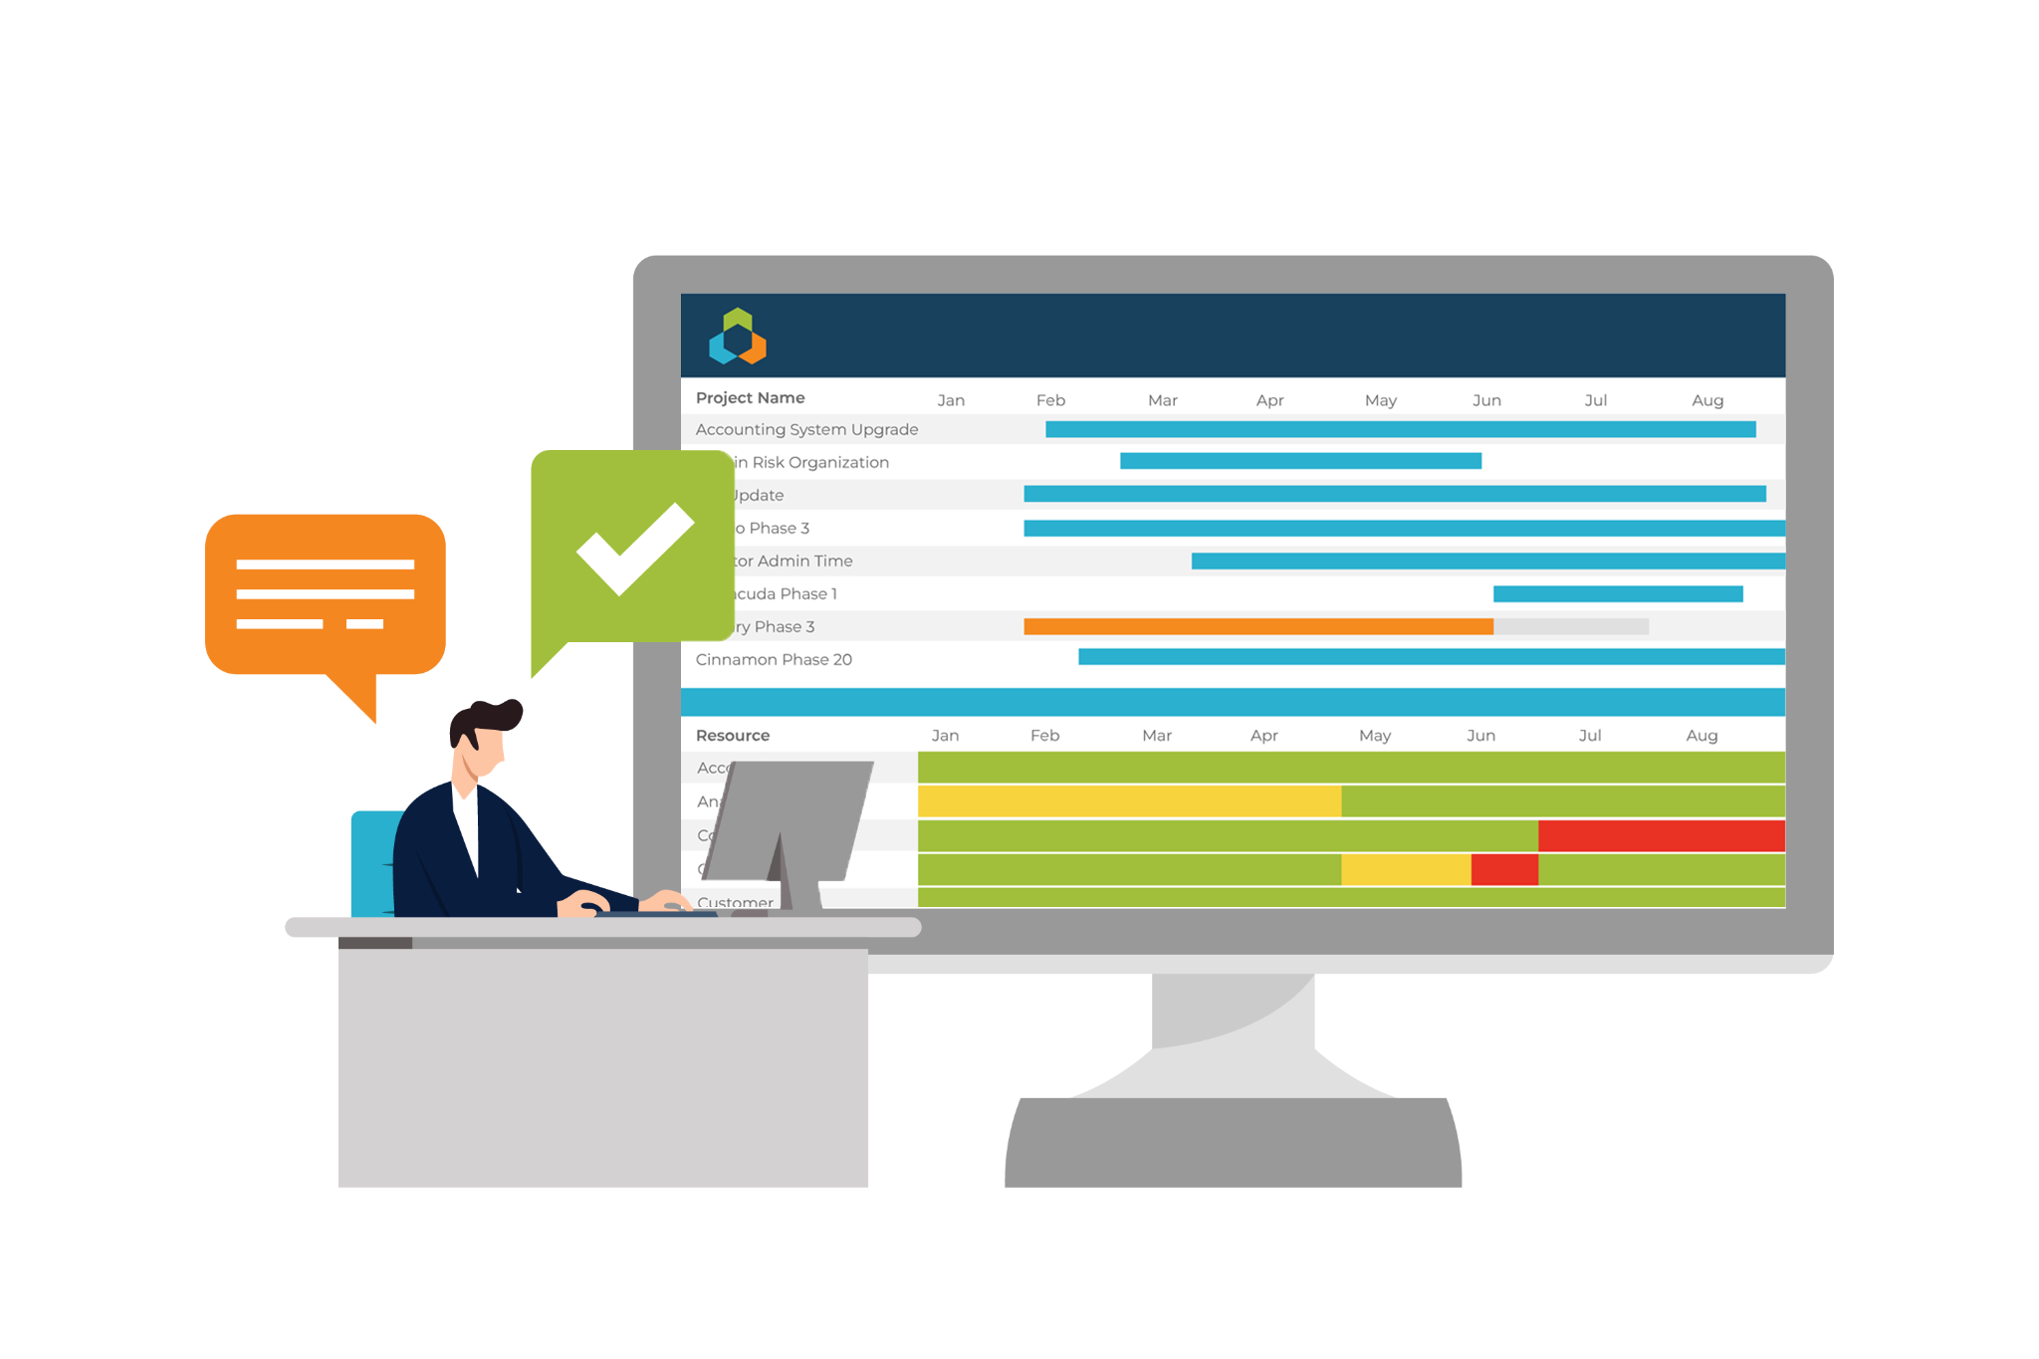
U.S. DISA Technical Exchange Meeting
Optimizing the Allocation of Skills to Portfolio Work Under Changing Business Conditions
Lloyd Norman
Lnorman@ProSymmetry.com

Slide 2
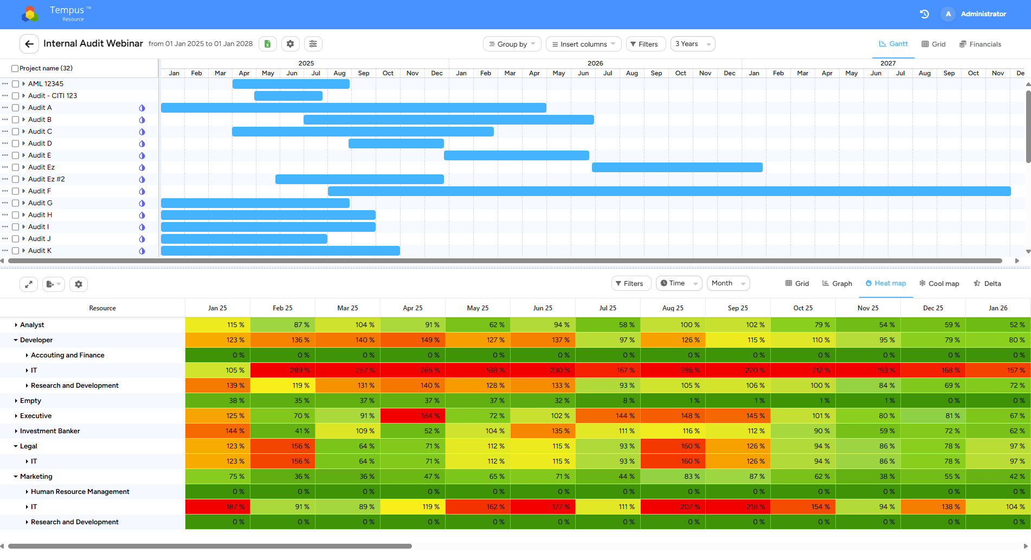
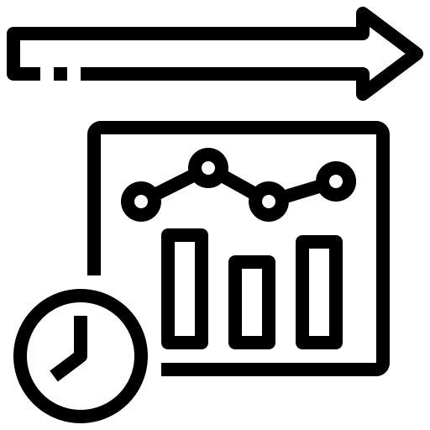
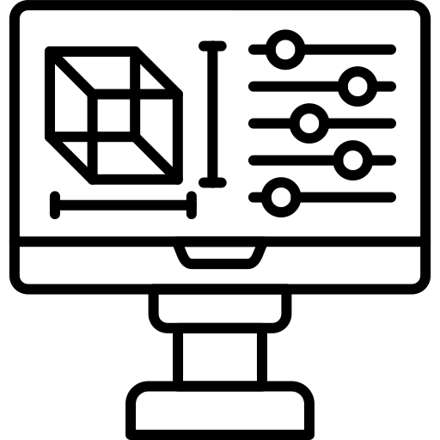
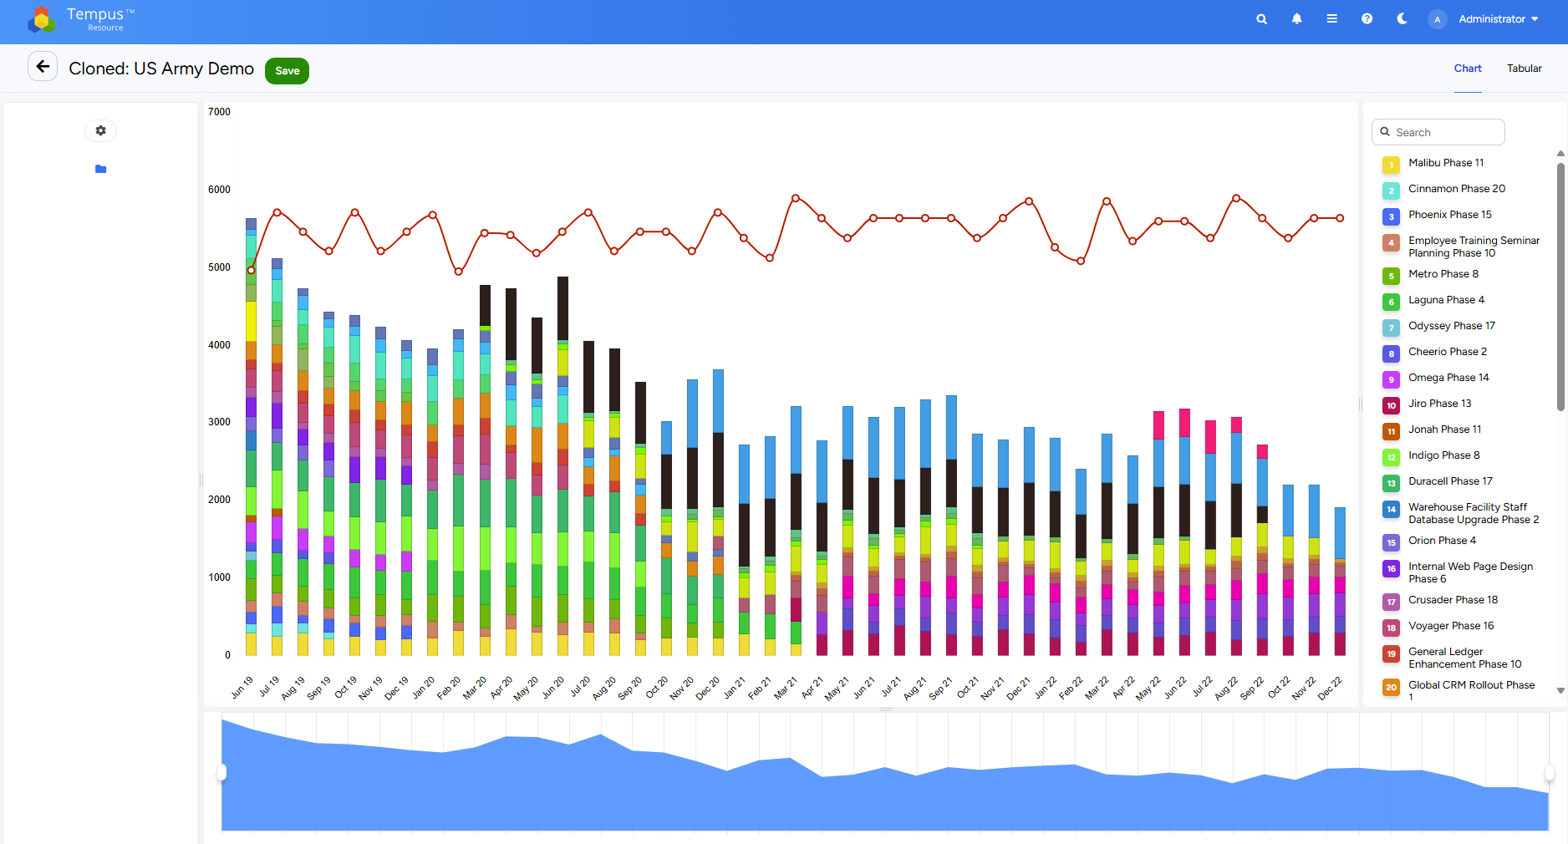
Tempus Resource | Transforming Mission-Critical Planning and Forecasting
Mission-Ready Forecasting Adaptively models future workforce needs, roles, and capabilities across shifting mission demands and classified priorities.
Operational Agility at Scale Enables real-time scenario planning and rapid response to changing objectives, threats, or funding shifts.
Precision Resource Allocation Provides deep visibility into skillsets, teams, and readiness—down to the individual—across time, roles, and units.

Slide 3
Live Demo
Notes:
CHOOSE THIS ONE OR THE CONTACT INFO

Slide 4
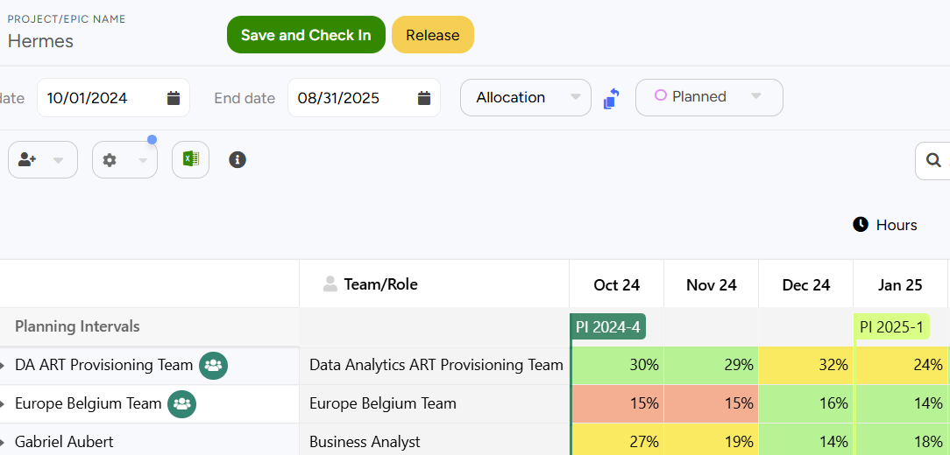
Sequence & Reserve Capacity Early to Optimize Portfolio Flow
Team & Role
Availability
Notes:
Limited human capital is the most common constraint to portfolio delivery. Coordinating epic, project, and ops delivery by transparently identifying and mitigating skill and team availability risks is the most effective way to optimize outcomes within capacity, cost, and governance guardrails.
The technology we are demonstrating today allows organizations to easily plan and coordinate portfolio delivery by coordinating team, skill, or person capacity.

Slide 5
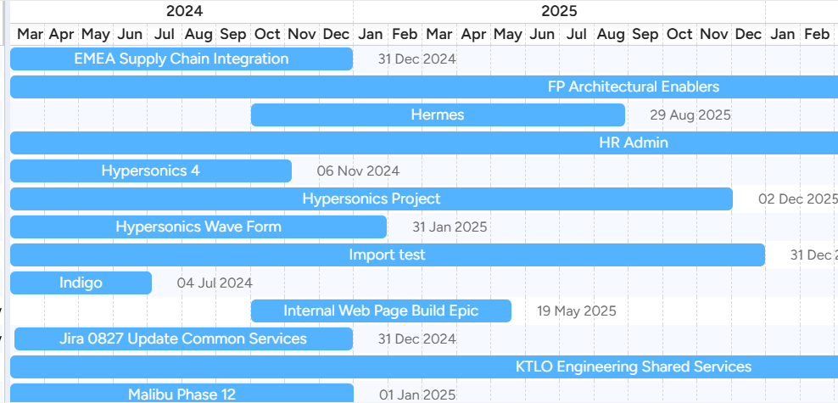
…Within Capacity & Governance Constraints
Financials
Benefits/Costs/CAPEX
Guardrails
% Run/Grow/Transform
New Work
Align to Outcomes
Strategy, Imperatives
Interdependencies
Enablers, Tech Debt
Available Skilled People & Teams
Within Allocation & WIP Limits
Notes:
Coordinating the availability of skilled teams and people catalyzes coordinated portfolio flow. However, the interrelated impacts on all portfolio governance must be evaluated simultaneously to optimize enterprise value flow.

Slide 6
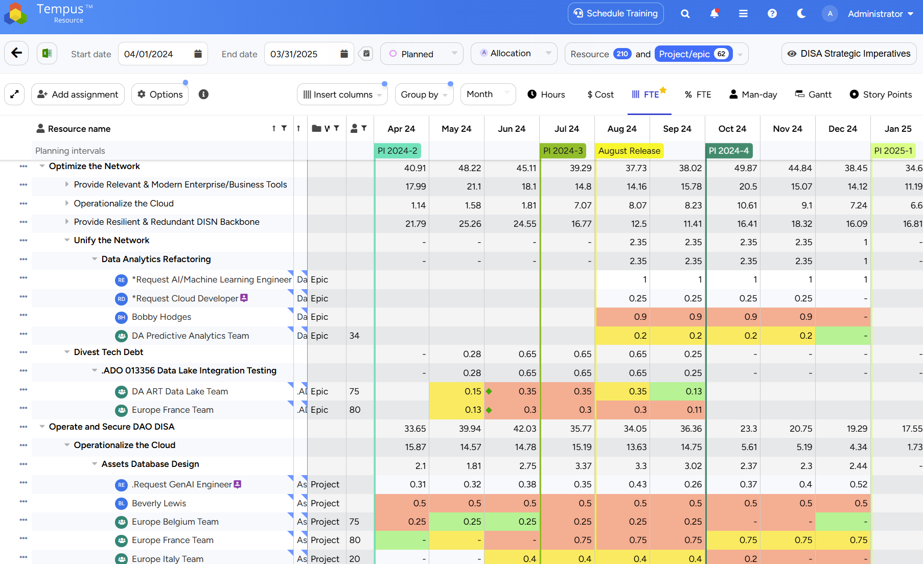
Real-Time Capacity Scanning Across Strategy/Teams/Roles/Work
Notes:
Tempus Resource allows portfolio planners to predictably forecast all types of resources across all types of delivery methodologies. Teams of different velocities can be planned on a common timeline with named resources and generic role-based resources. This greatly simplifies the alignment of disparate team backlogs across pending project, epic, or feature work.
Capacity can be planned by team or person using any metric simultaneously. For example, a product manager could forecast a team in story points, man hours, man days, by percentage, or even costs. The timing of this demand could be aligned by a project manager or epic owner with shared services resources forecasting demand in FTE, or hours.
This powerful and unique capability simplifies planning in agile, waterfall, or hybrid portfolio planning ecosystems.
Tempus continually scans all planned resource capacity for potential risks including over allocations, WIP limit breaches, required approvals in real time.
Alerts and notifications can be sent via MS Teams, email, or in Tempus.

Slide 7
Team Resources Streamline Planning & Improve Predictability
Partially assign people across multiple teams
Easily adjust team velocity over time.
Rate per story point or hour auto calculates
Notes:
Our proprietary team resource planning technology streamlines planning and improves cost and delivery predictability. Teams are easily configured by selecting different people from the resource pool. People can be partially assigned across multiple teams, for example when a scrum master needs to be shared across teams. Rates are auto calculated based on team composition. Velocity in story points or hours is easily configured and adjusted with rates being dynamically calculated.

Slide 8
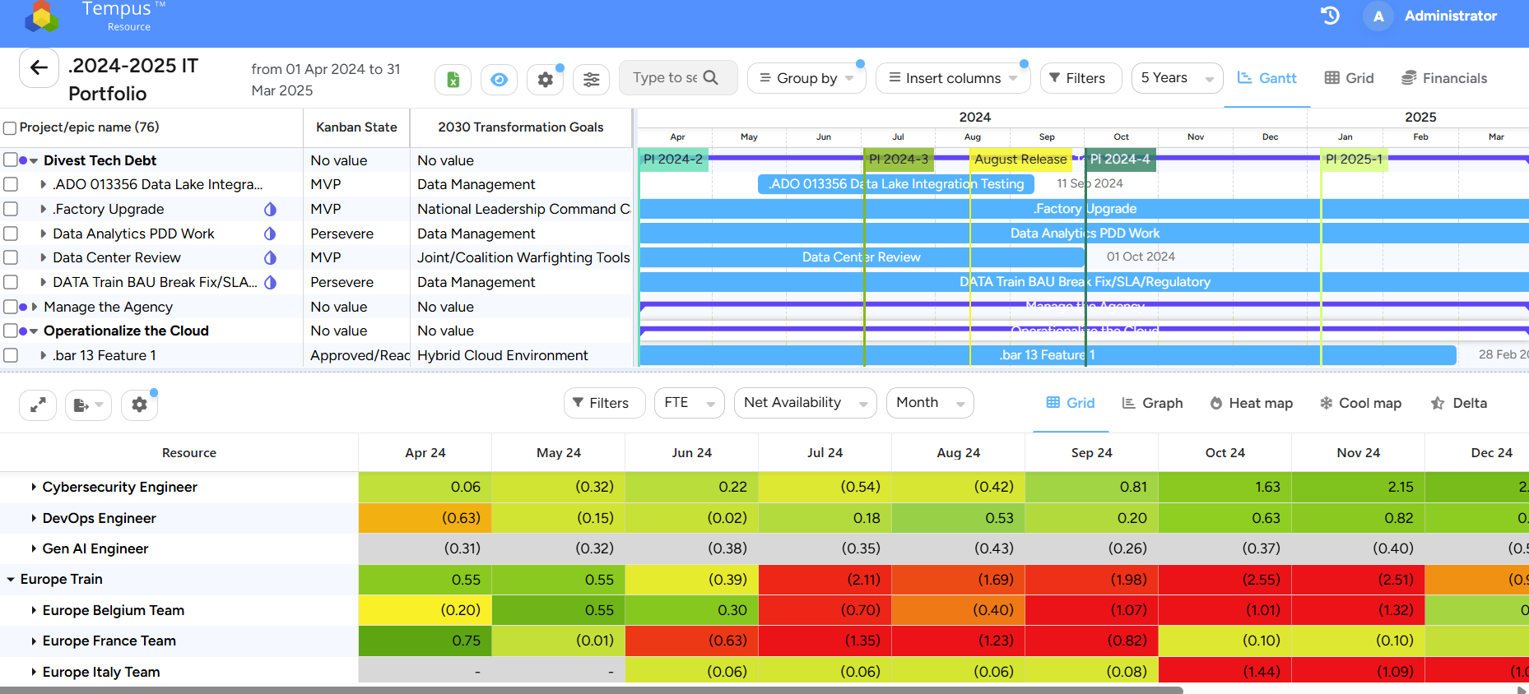
Design/Adapt Delivery Roadmaps for Best Flow, Least Risk
Interactively Model Alignment of Work, Teams & Skills, Guardrails to Strategy…Then Adapt Production Roadmaps
Notes:
Tempus Resource allows planners to design their future portfolio delivery in a digital twin of their portfolio. Any authorized user can create as many scenario models as desired. Tempus models are fully interactive. Users can simulate any number of proposed additions or changes to the portfolio and immediately see the interrelated impacts to all affected teams, skills, people, and financials.
This predictable, flexible, risk free planning exemplifies business agility.
Tempus can automatically recommend best start dates for epics, projects, or operational work based on estimated effort and availability of teams and skills needed.
Planners can evaluate many scenarios including immediately seeing the effects of:
Shifting, crashing, or cloning initiatives
Determining best time to start implementing a new epic, feature, or project
Adding Teams, Roles, or expanding a team.
Deferring all related initiatives (i.e. stopping all discretionary work)
Repurposing people or teams to higher priority work
Tempus Resource models will:
Tie business strategy to resource availability and all other portfolio guardrails
Show impact in FTE, hours, or $
Tie dashboard reports to models for comparing current plan to various business alternatives in real time

Slide 9
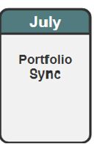
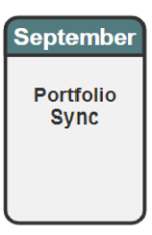
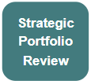
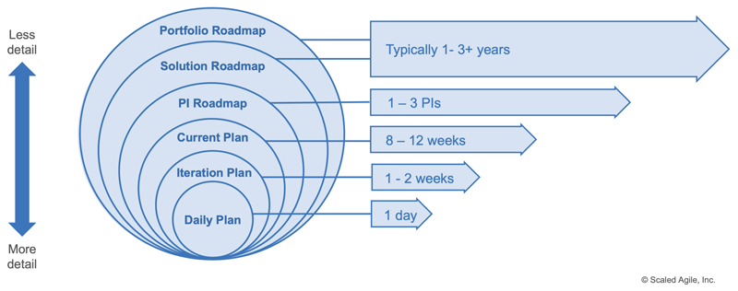
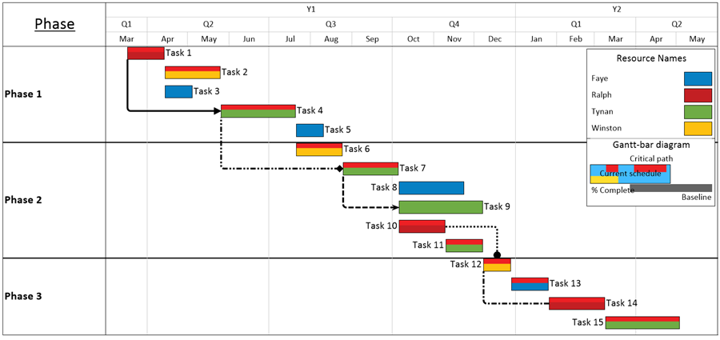
Easily Align & Reserve All Teams/People on One Timeline
Fixed Forecasts
Flexible Forecasts
Fluid Forecasts
Azure DevOps
PPM
PI 1
PI 2
PI 3
PI 4
PI 5
2025
Rolling Wave Capacity Forecasts Continually Coordinate
All Work, Resources, & Financials on One Common Timeline
Teams & People Deliver per Roadmap Project/Epic Sequence
“Organizations that can reallocate talent in step with their strategic plans are more than twice as likely to outperform their peers” – McKinsey & Co.
Notes:
Tempus technology can be exploited without distracting agile or project delivery teams. Those teams can continue to do detailed planning in agile or PPM tools while product, project, and portfolio managers align roadmaps to strategy and available capacity. Backlogs and project delivery timelines are then easily synchronized with portfolio roadmap timelines.
Tempus technology does the holistic capacity planning that agile and task based ppm tools can’t. It finally allows planners to follow the recommended best capacity planning practices from Scaled Agile Inc., the Project Management Institute, and the Resource Management Institute.

Slide 10
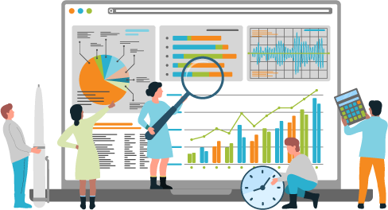
1 Hour/Month Planning Capacity to Benefit DISA & Workforce
Data-Driven Decisions
Capacity-Coordinated Roadmaps & Agility
Better Work Life Balance
Talent Retention & Supply Chain
Notes:
The unique technological capabilities of Tempus Resource allow our clients to optimize portfolio value flow without burning out their people. Our clients get real time capacity scanning, enterprise transparency to planned capacity usage, predictable roadmap delivery, interactive scenario models while typically spend less than 1% of time monthly on capacity planning.
All product and portfolio roadmap funding and sequencing meetings can be informed by capacity to produce realistic plans and adequately inform executive decisions. Capacity planning facilitates transformations!

Slide 11
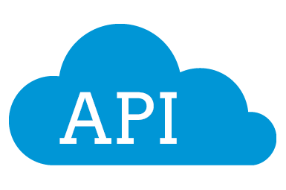
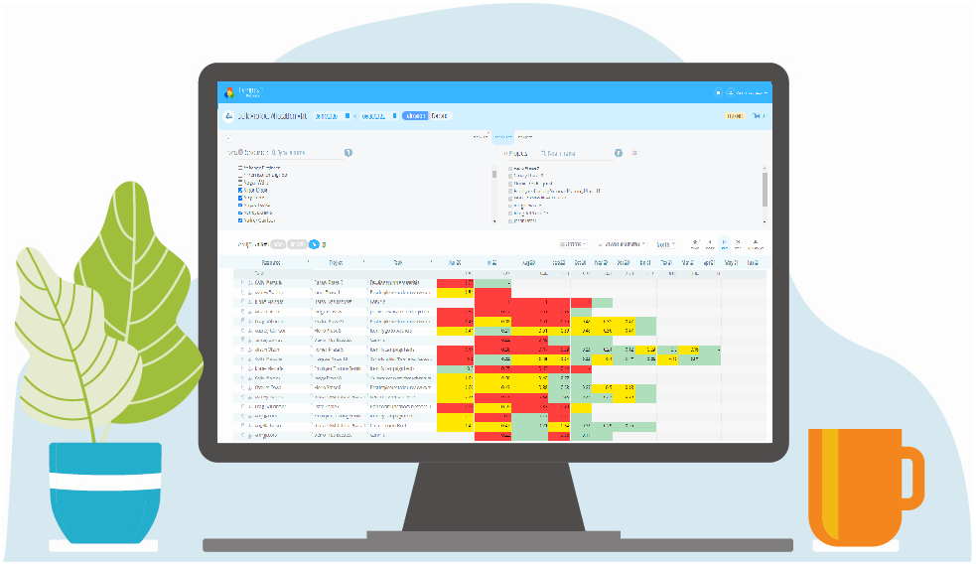
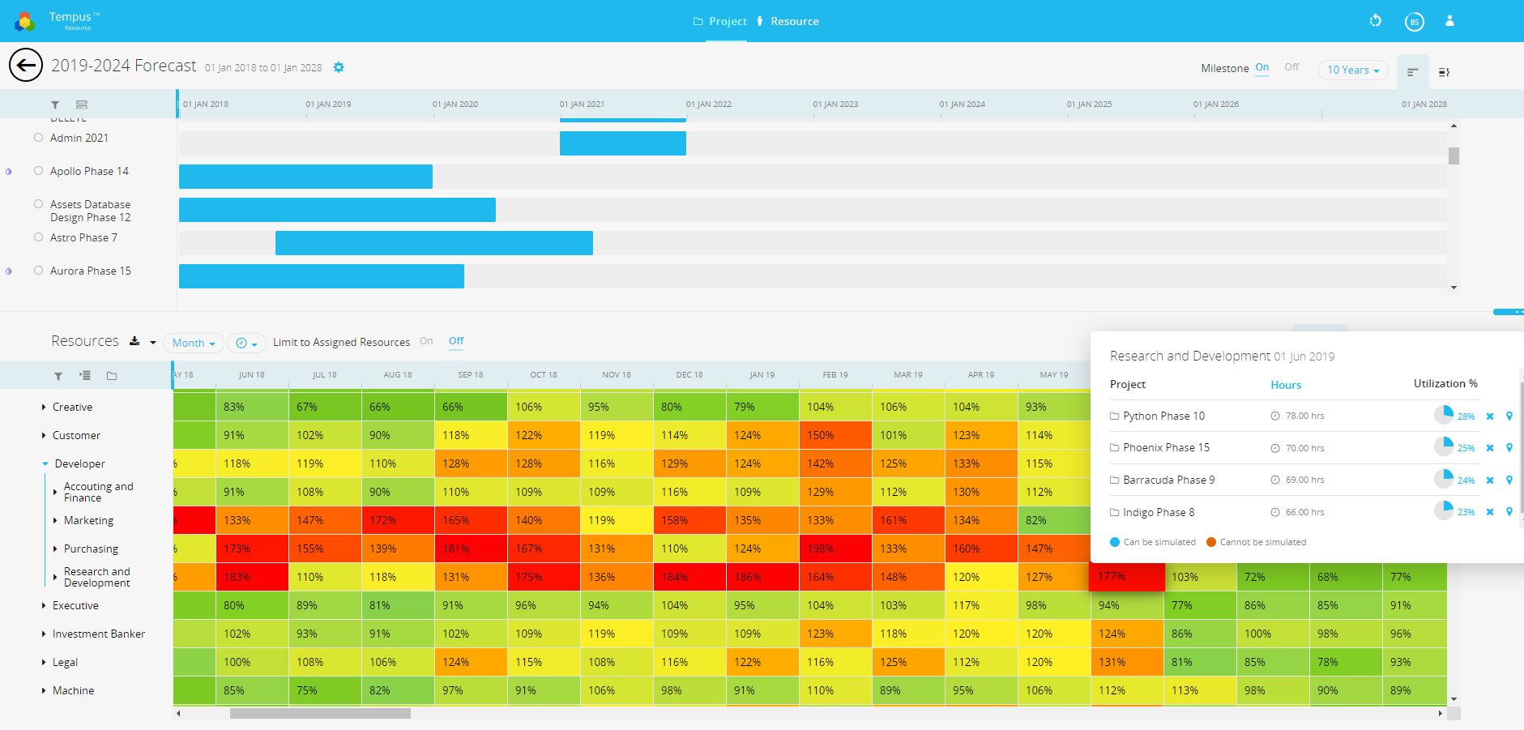
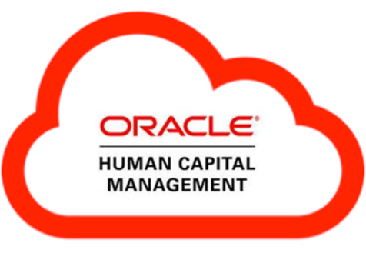
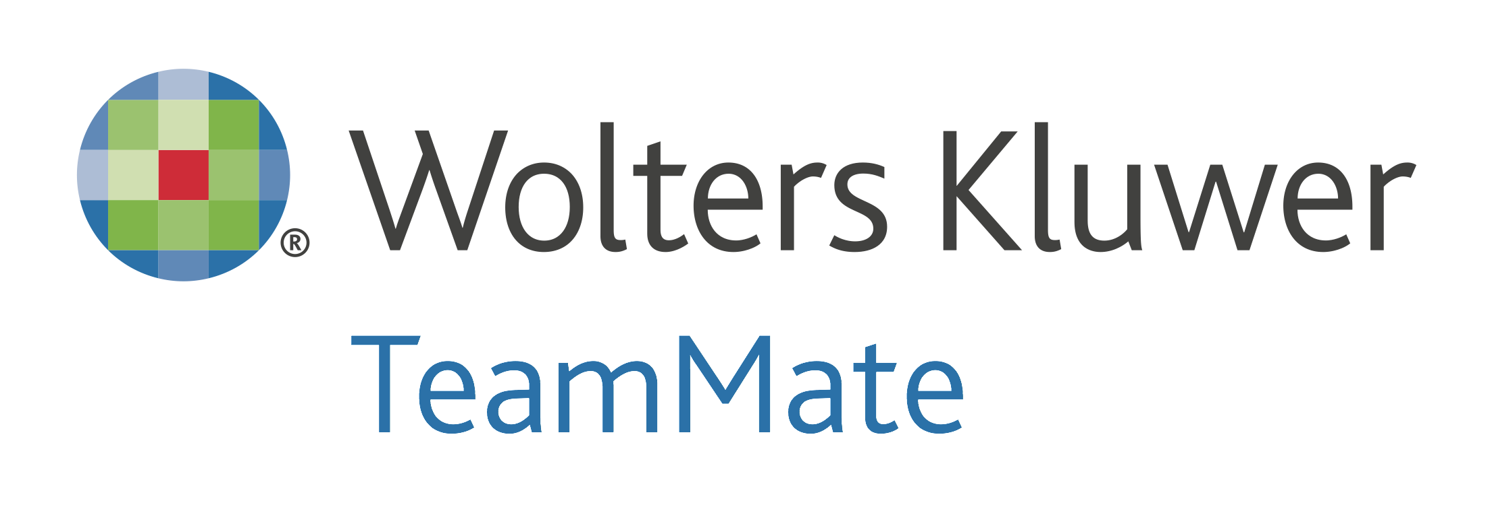
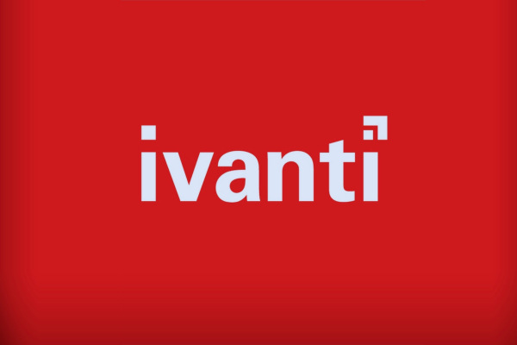
Integrations Can Streamline Adoption & Execution
Unify Data from Various Source Systems
Plugins
Notes:
If desired, project, epic, or operational initiative data and status can flow into Tempus from existing systems. Tempus has a fully documented REST API that allows for easy and reliable system integrations.
Skills and other key resource attributes can flow into your resource planning tool through proper integration with your HR or HCM system. Actual hours tracked in a different system can also be integrated at a project or epic level. Tools like JIRA, ADO, or PPM tools can integrate effectively with Tempus to enhance adoption, avoid duplicate data entry, and improve data quality.

Slide 12
Thank You!
For more information, demos, trials
Lnorman@Prosymmetry.com
Or
Gbailey@PrsSymmetry.com
Visit us at
Prosymmetry.com
Notes:
CHOOSE THIS ONE OR THE QR CODE

