Slide 1
Nucleus Security
Bill McInnis, Nucleus GOV | bmcinnis@nucleussec.com
Doug Drew, Nucleus GOV – Lead Solutions Architect | ddrew@nucleussec.com
Brian Garmey, Nucleus GOV – Head of Strategic Initiatives | bgarmey@nucleussec.com
NUCLEUS PROPRIETARY

Slide 2
Overview
MISSION
Automate vulnerability management for large enterprises to enable risk-based decision making, achieve faster vulnerability remediation, and prevent breaches.
WHO WE ARE
Software company founded in 2018
Currently 85 employees
2 products: Risk-based Vulnerability Management Platform, Vulnerability Intelligence Platform
Focus on large enterprises (G2000 + DoD/IC + FedCIV+SLTT)
TIMELINE & FUNDING
2018: Nucleus launched to private sector
2020: Series A VC Funding ($3M)
2021: SBIR Phase 1 Awarded (AFWERX)
2022: Nucleus FedRAMP in-process Status (May 2022)
2023: Series B VC Funding ($40M)
2023: Additional Funding with participation from In-Q-Tel
2024: Nucleus FedRAMP Moderate authorized Feb 2024
NUCLEUS PROPRIETARY

Slide 3
What is your Current State of VM?
How do you currently coordinate data from disparate tools on network? ​
How do you normalize data from various tools ?
Is there a single repository to look for data when needed or variety of tools?
How long does it take to create reports? Are you comfortable with accuracy?
How is work distributed across the team?
Are false positives common? How do you deal with them?
How are mitigations tracked now?
If you score Vulns now, can you re-score based on new intel? If so, what would process be?
Do you incorporate the KEV list from CISA ? If so, how?
How are you currently meeting requirements of BOD 23-01?
How do you utilize SSVC ?
How do you track device compliance status?
NUCLEUS PROPRIETARY
Notes:
These questions speak to just some of the current issues with the VM process … very hard to manage all the data about vulns especially considering only 6% get exploited

Slide 4
How Nucleus Works
Aggregate
Analyze
Monitor
Vulnerability and asset inventory
Risk-based prioritization
Reporting
and metrics
Enrich
Remediate
Threat intel and business context
Automated workflows and ticketing
NUCLEUS PROPRIETARY AND CONFIDENTIAL
NUCLEUS PROPRIETARY

Slide 5
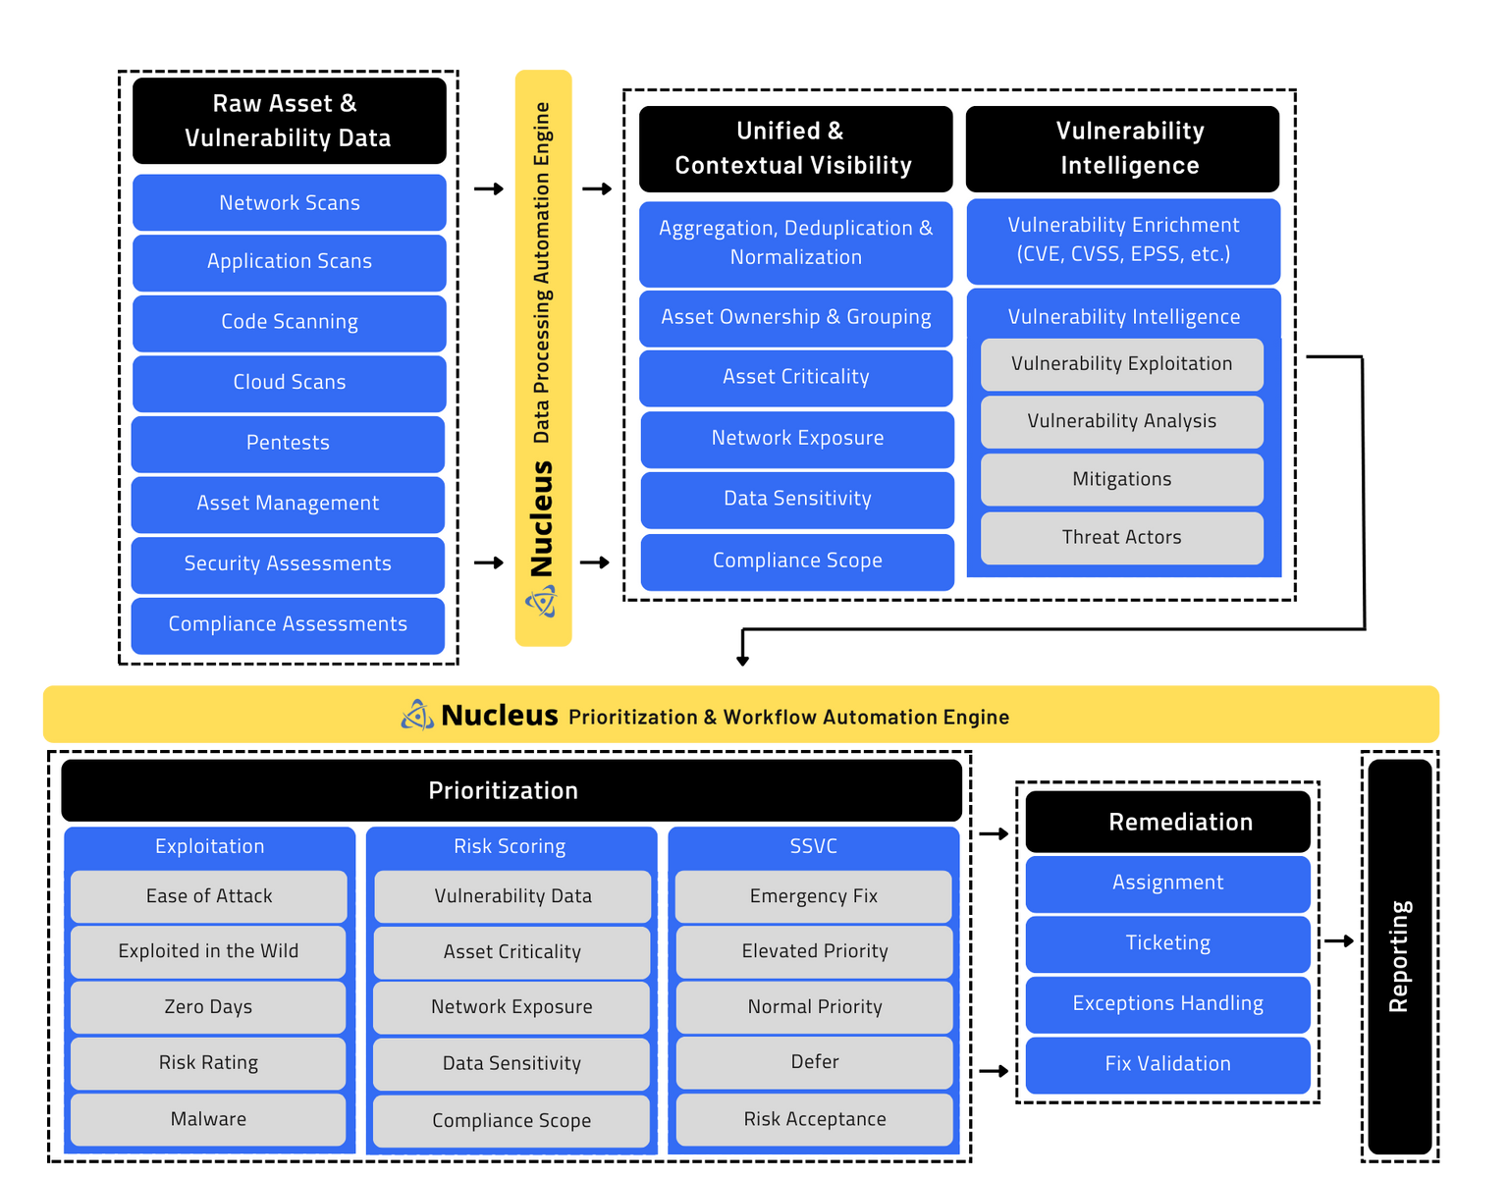
Unified
Vulnerability
Management
At-a-Glance
NUCLEUS PROPRIETARY

Slide 6
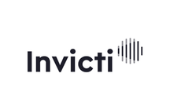
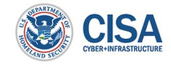
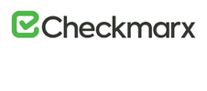
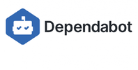
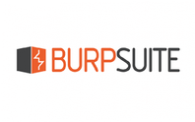
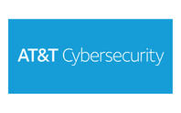
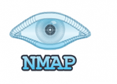
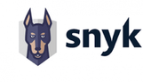
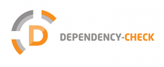
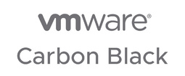
Get More Out of the Tools You're Already Using
Threat Intelligence
Application Scanners
Coming soon: Greynoise Intelligence & Intel 471
Intelligent
Network Scanners
Asset Inventory, Discovery
Container, Cloud, SCA Scanners
Ticketing, Issue Tracking, ITSM
Pen Testing, Bug Bounties
Alerting, Notification
Endpoint, SIEM
Last update: 03.2023
NUCLEUS PROPRIETARY

Slide 7
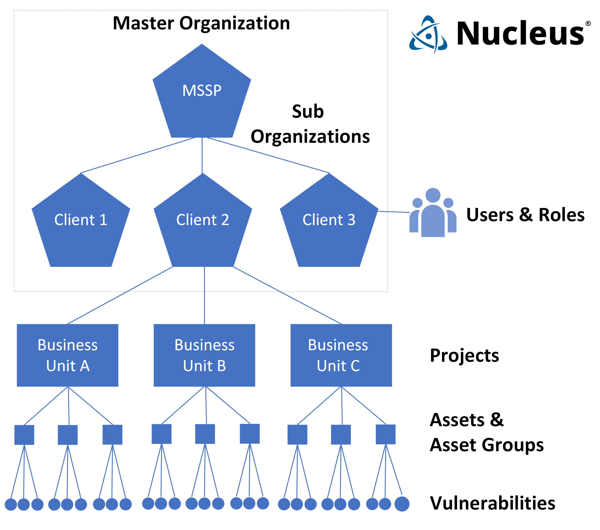
Nucleus Architecture Advantage
NUCLEUS PROPRIETARY
Notes:
Change this slide to questions – pain questions for customer…

Slide 8
The Nucleus Advantage
Multi-Tenant system allows all Agencies/Sub-Agencies own operational environment (Project)
Risk visibility rolls us to Parent (HQ)
Parent can set / enforce policy SLA across all Agencies
Simplify Risk Reporting
Reduction in data calls related to assets and vulnerabilities across Enterprise
Simplify / automate compliance reporting
Automated POA&M processing and reporting
Significant Operational efficiencies gained for VM teams
Teams measure 10x more efficiency
Cost Competitive vs Subagency purchase and stove pipe usage
NUCLEUS PROPRIETARY
Notes:
Change this slide to questions – pain questions for customer…

Slide 9
Precision and speed to immediately reduce risk of exploit
Use vulnerability threat intel and business context to quickly prioritize with precision...
Risk Rating
Used by Malware
+
Asset Status
Critical
True
Public Facing
High
False
Private
Low
and get from millions of vulnerabilities to the handful that matter in minutes...
by aggregating, correlating and enriching all vulnerability and asset data from your existing tools in Nucleus.
Pictured: Tenable Nessus, Crowdstrike
NUCLEUS PROPRIETARY AND CONFIDENTIAL
NUCLEUS PROPRIETARY

Slide 10
Nucleus Maps to the following NIST Controls
NIST 800-53
RA-5: Vulnerability Scanning
SI-2: Flaw Remediation
CM-8: Information System Component Inventory
SA-11: Developer Security Testing and Evaluation
SI-5: Security Alerts, Advisories, and Directives
IR-4: Incident Handling
CA-7: Continuous Monitoring
CM-3: Configuration Change Control
NIST 800-171
3.11.2: Scan for Vulnerabilities in Organizational Systems and Applications Periodically and When New Vulnerabilities Affecting Those Systems and Applications are Identified.
3.14.5: Identify, Report, and Correct Information and Information System Flaws in a Timely Manner.
3.4.6: Monitor Security Alerts and Advisories and Take Action in Response.
3.4.7: Update Malicious Code Protection Mechanisms When New Releases are Available.
3.14.1: Identify System Flaws.
3.12.1: Periodically Assess the Security Controls in Organizational Systems to Determine if the Controls are Effective in Their Application.
3.14.6: Provide Security Protection Updated as Needed to Limit Harm from Information System Flaws.
NUCLEUS PROPRIETARY

Slide 11
Why Nucleus
Product Security & DevSecOps
Aggregate vulnerability scan data generated during CI/CD
Triage, track & report by service, dev team, application owner
Automate issue creation, alerting, ticketing & reporting
Network & Infrastructure Security
Automate vulnerability prioritization, trigger remediation workflows, monitor SLAs
Enrich vulnerability data with threat and vulnerability intelligence feeds
Sync with CMDB tools for a consolidated asset inventory
Security Assessments & Continuous Monitoring
Consolidate and compartmentalize vulnerability information for systems
Track and report vulnerability remediation progress (e.g. POA&Ms)
Collaboration between security and IT/software teams
Supply chain monitoring (e.g. infrastructure, software, etc)
NUCLEUS PROPRIETARY

Slide 12
Getting to Nucleus
Currently on NASA SEWP V, ITES SW2, CDM APL
Nucleus is an SBIR portfolio company via SBIR Phase 1 with AFWERX in 2021
Partners such as Thundercat, Carahsoft, Guidepoint, SHI, Norseman and many others
Customers – About 200 Customers – Gov-Related examples include Dept of Energy Labs, Commonwealth of Virginia VITA.
SBIR Phase 3
NUCLEUS PROPRIETARY

Slide 13
DEMO TIME
We’re happy to answer any additional questions you may have.
NUCLEUS PROPRIETARY

Slide 14
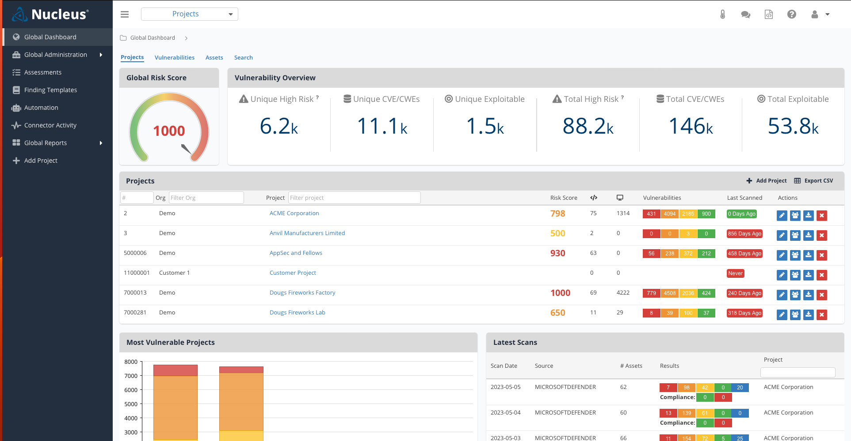
Global Dashboard
NUCLEUS PROPRIETARY
NUCLEUS PROPRIETARY

Slide 15
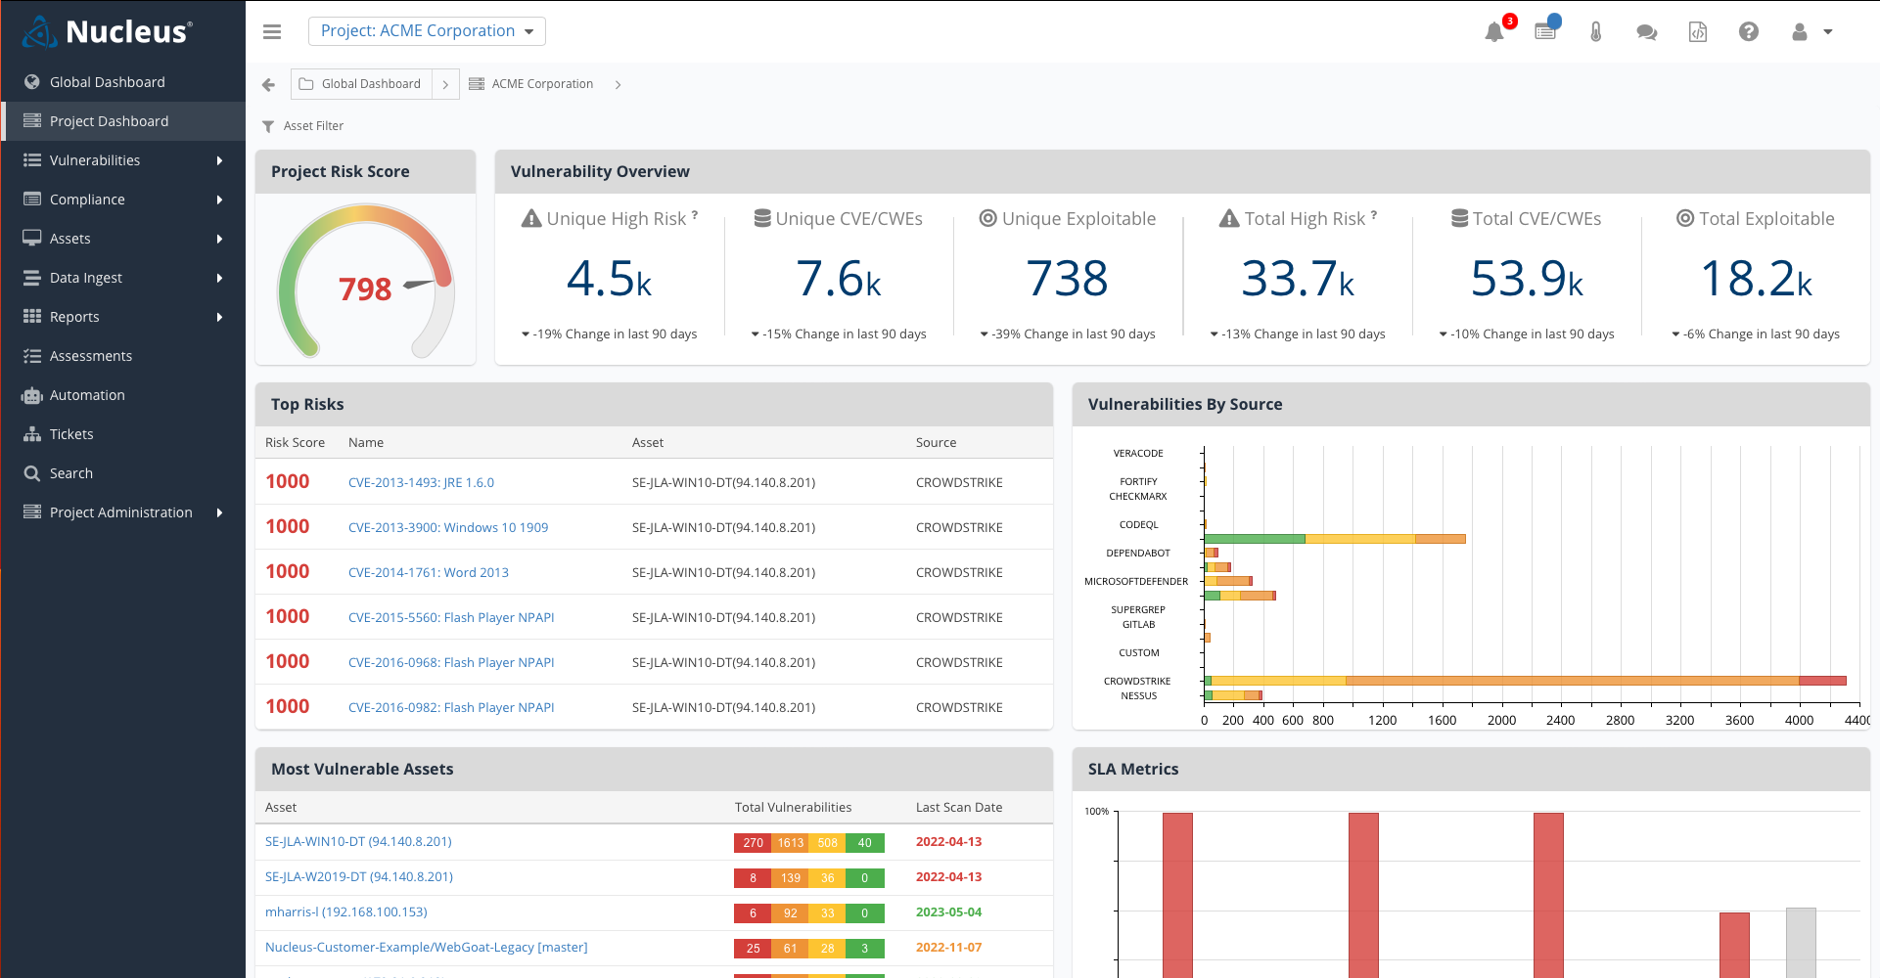
Project Dashboard
NUCLEUS PROPRIETARY
NUCLEUS PROPRIETARY

Slide 16
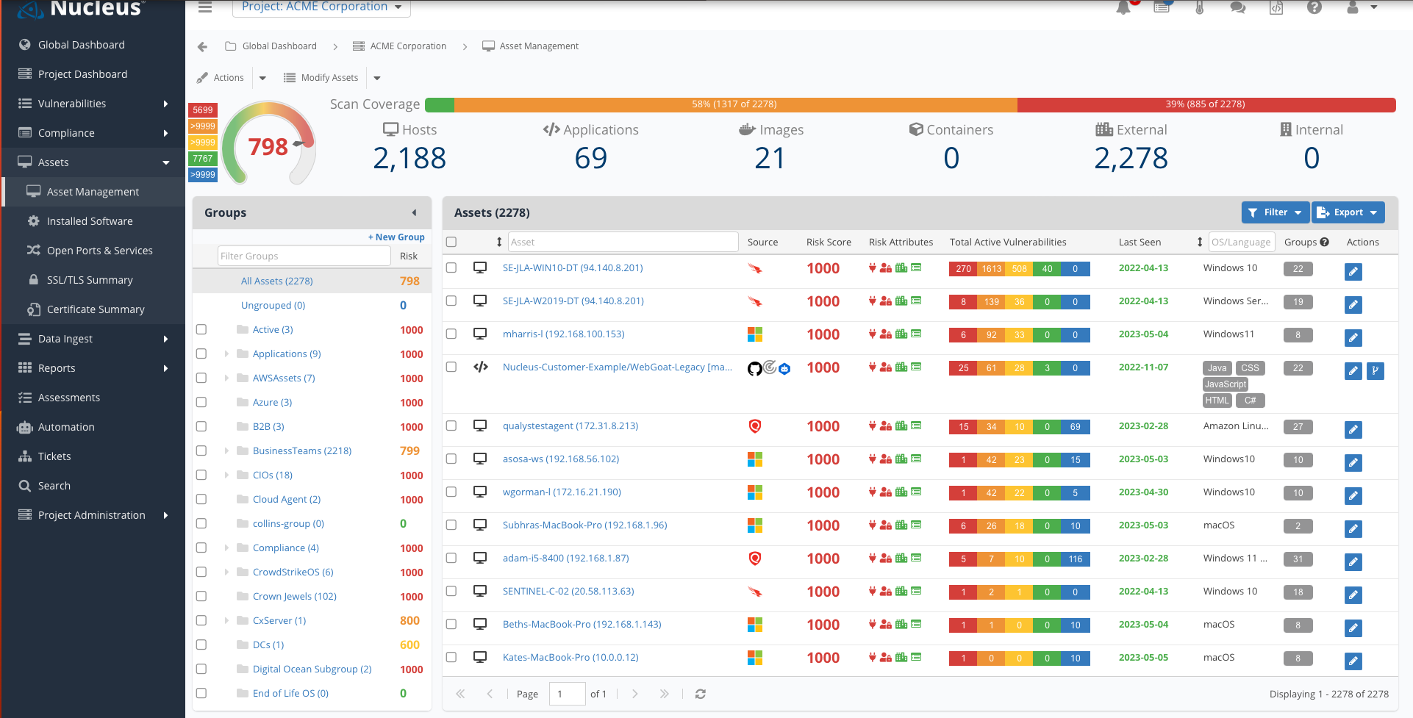
Asset Dashboard
NUCLEUS PROPRIETARY

Slide 17
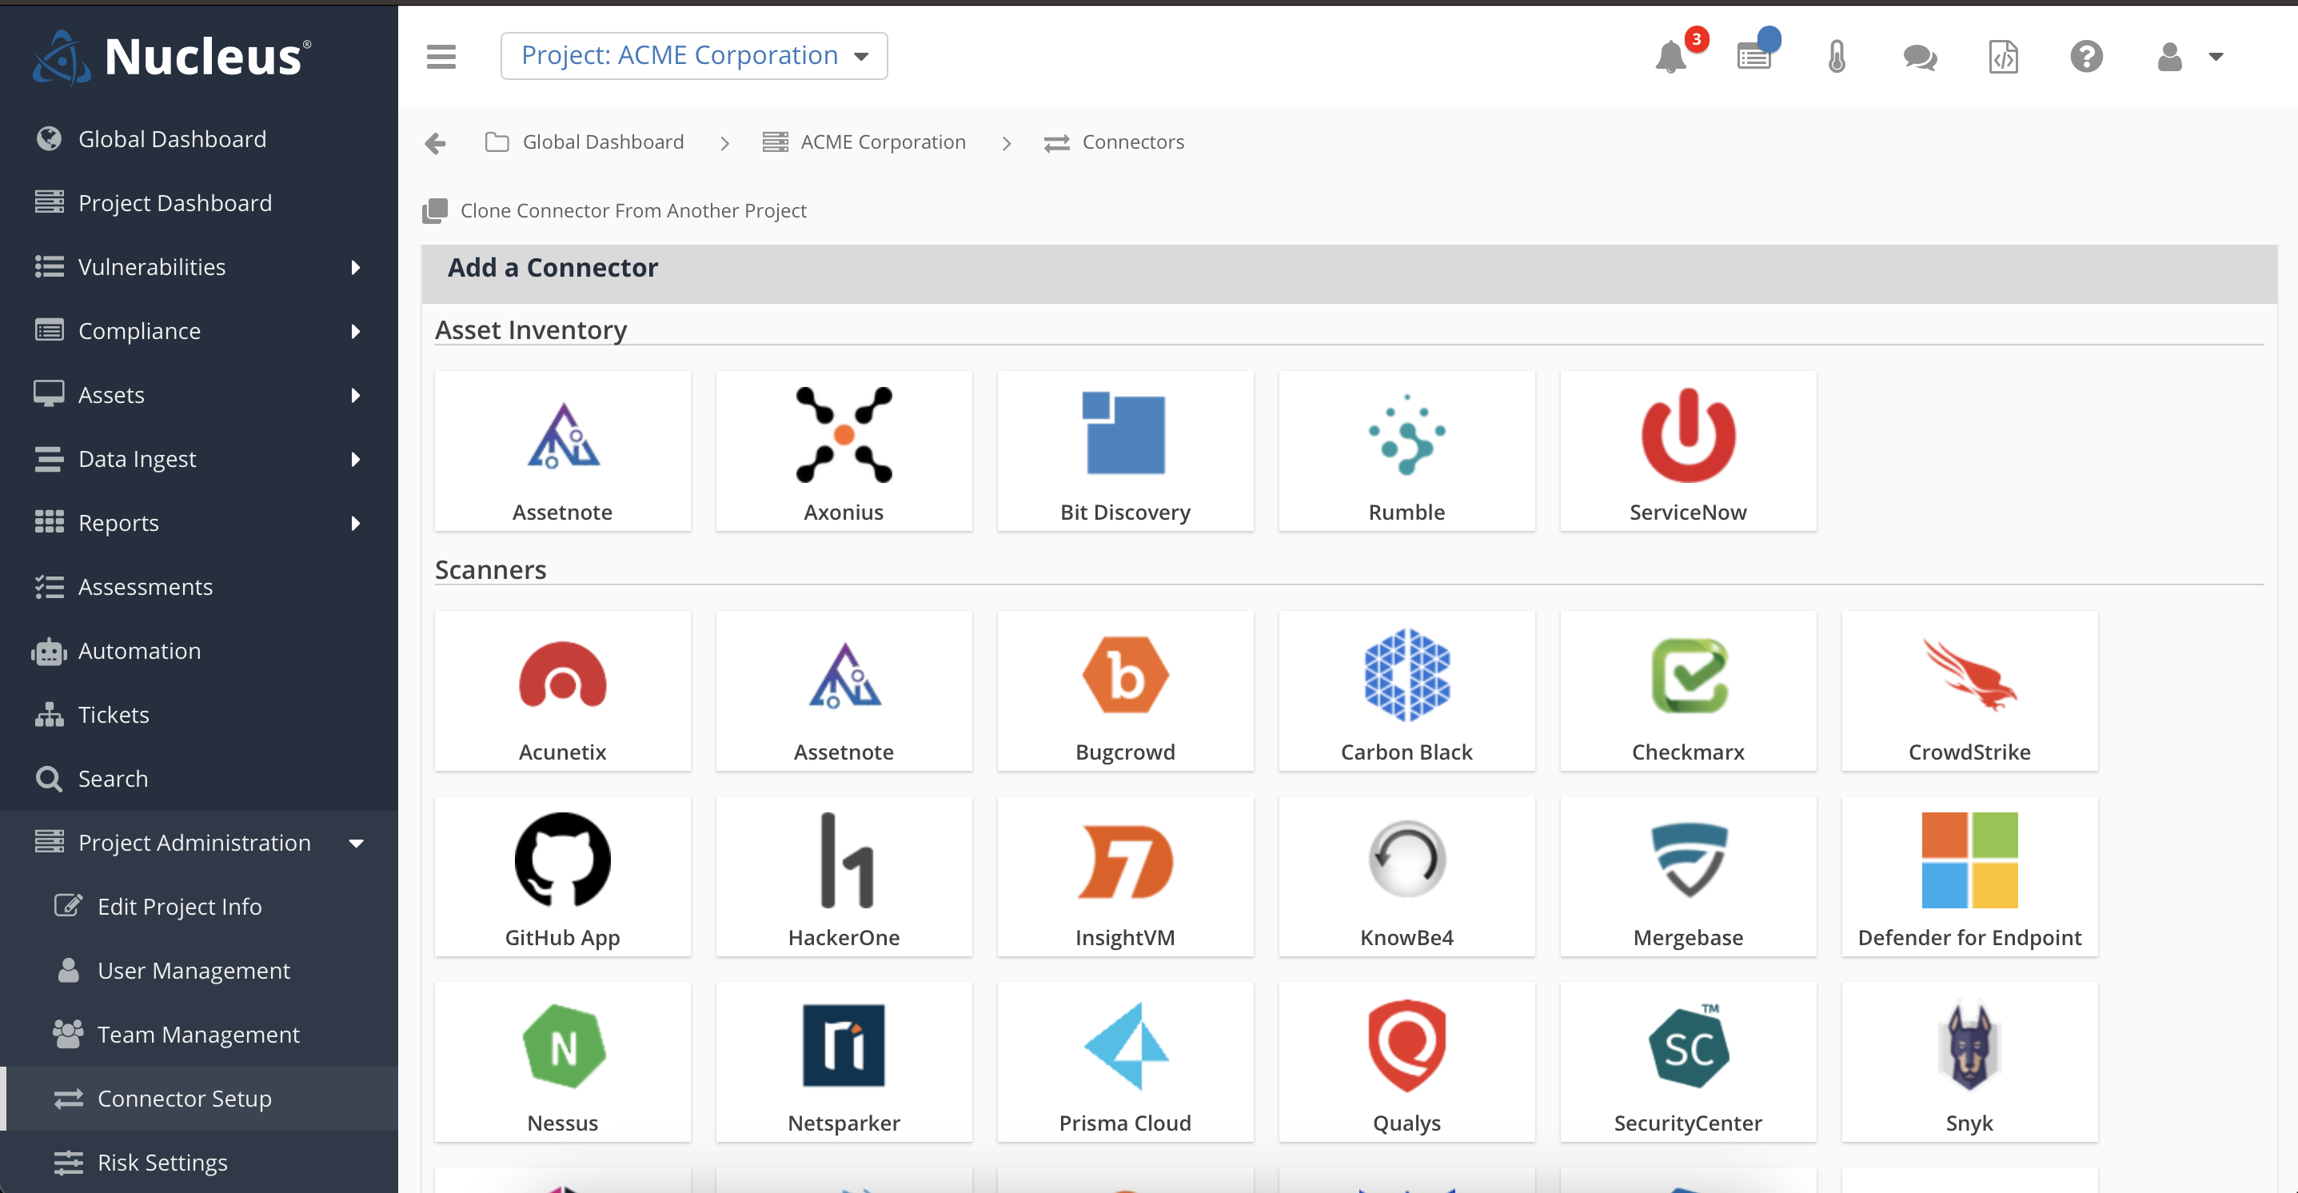
Connector Setup
NUCLEUS PROPRIETARY
NUCLEUS PROPRIETARY

Slide 18
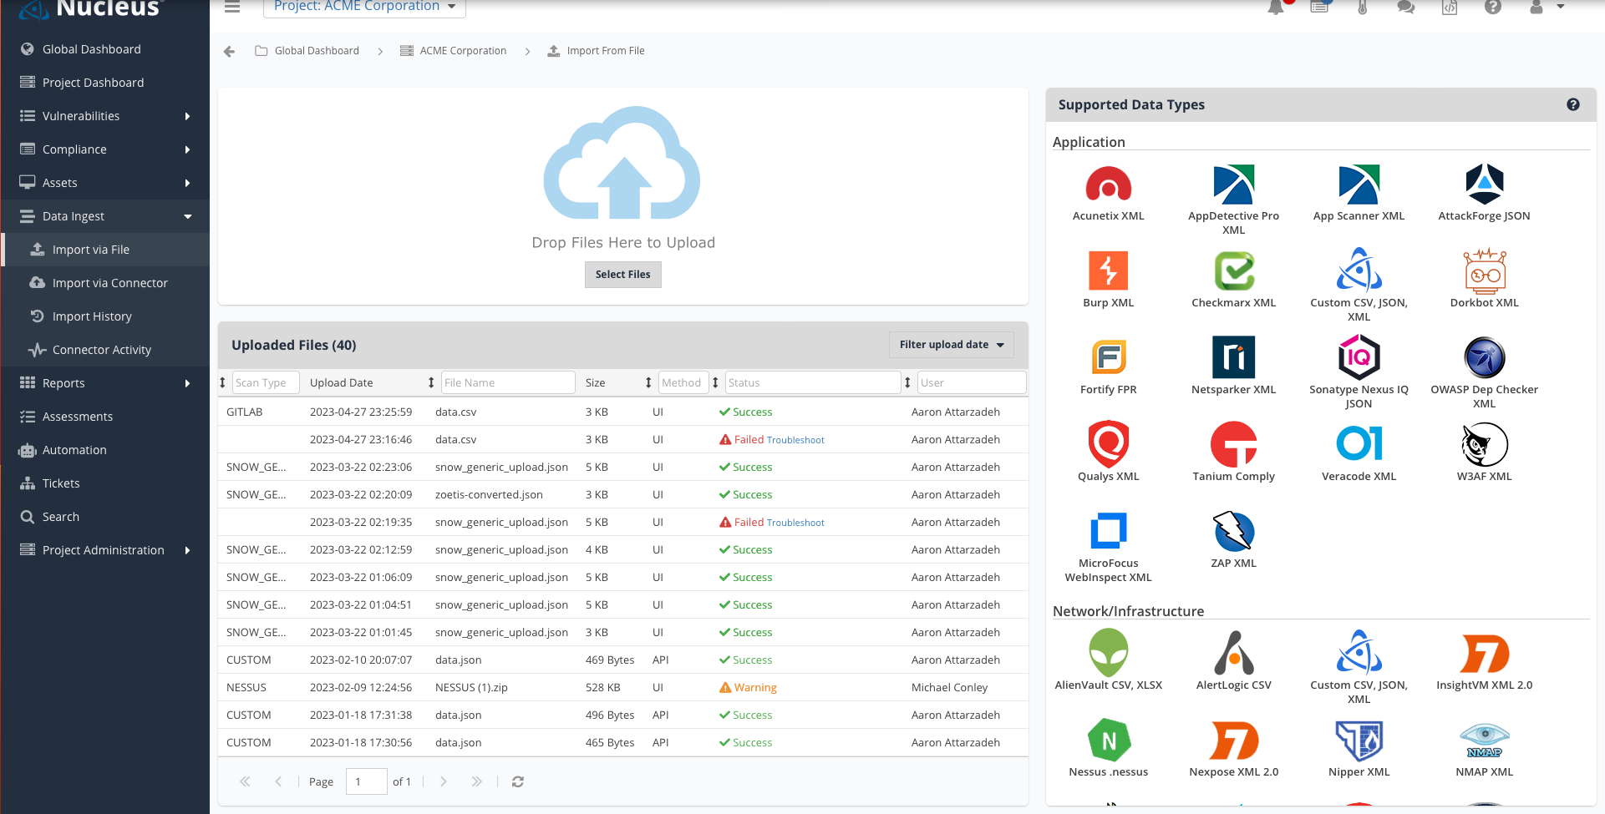
File Import
NUCLEUS PROPRIETARY

Slide 19
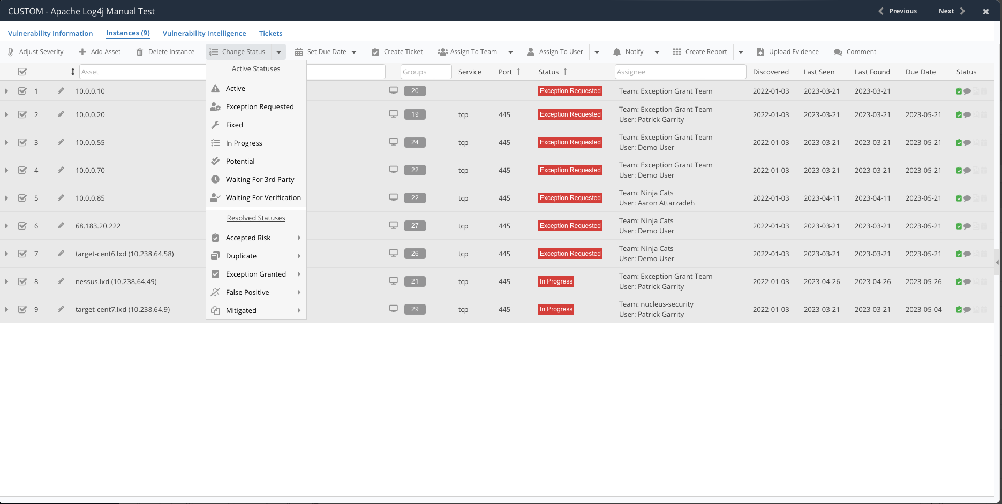
Vuln Instance View
NUCLEUS PROPRIETARY

Slide 20
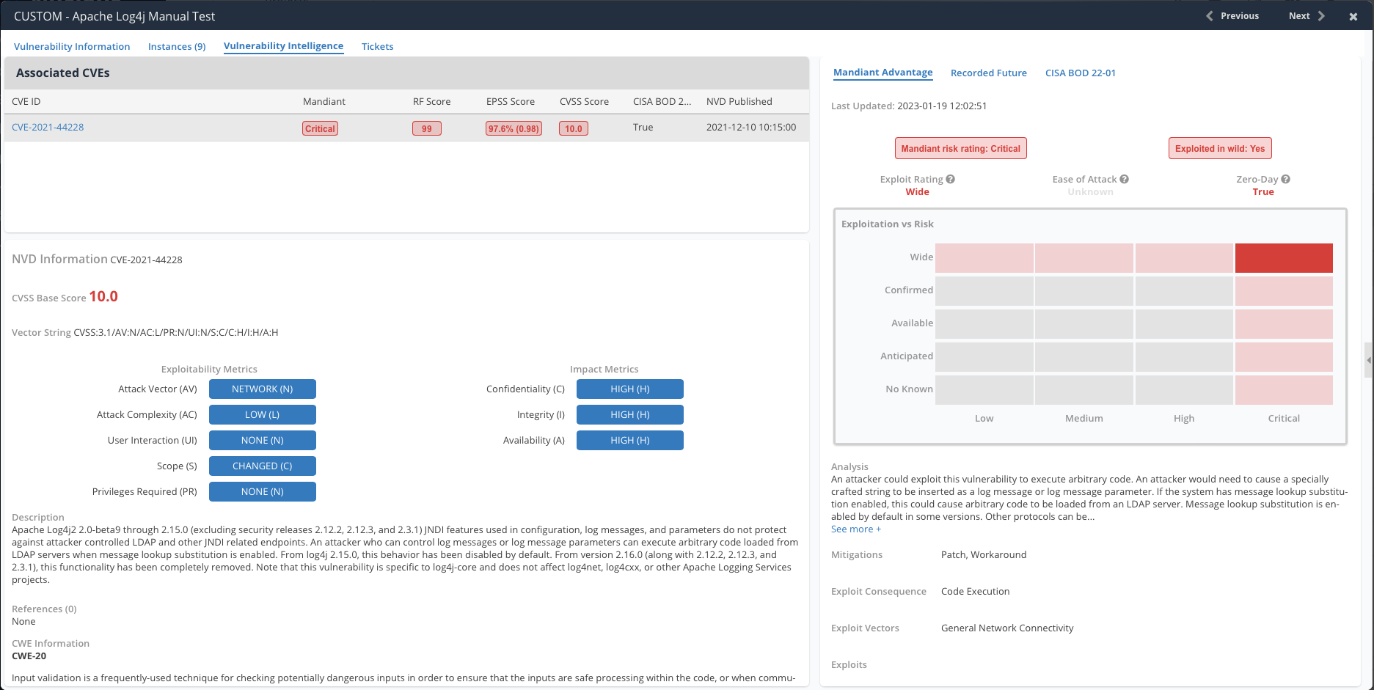
Vuln Intel View
NUCLEUS PROPRIETARY

Slide 21
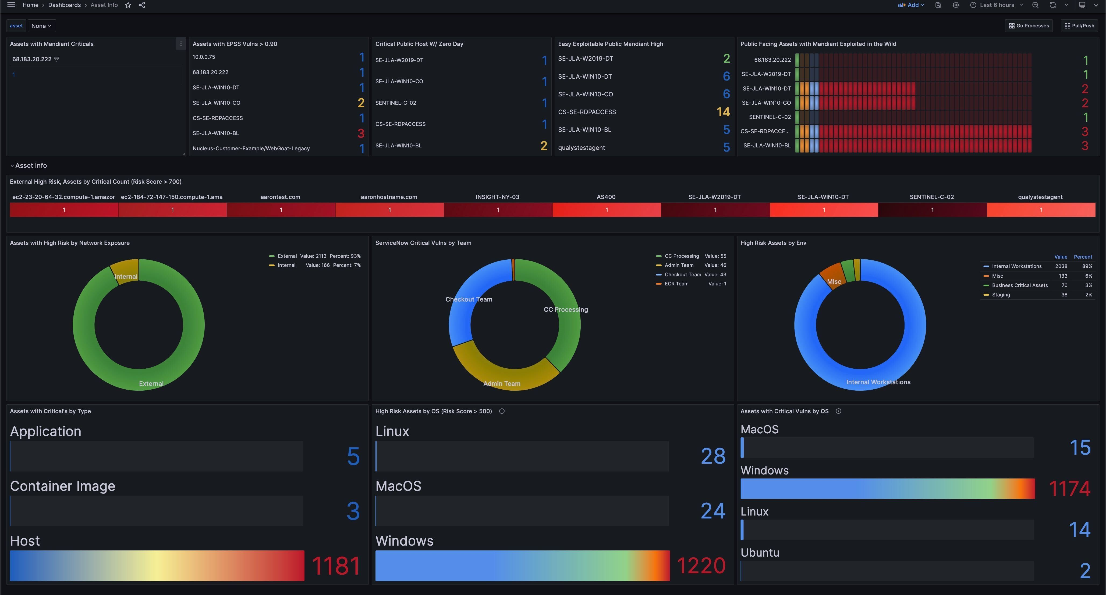
NUCLEUS PROPRIETARY

