Slide 1
Fognigma Overview & Program/Strategic Benefits

Slide 2
What Makes Fognigma Unique?
Strategy & Program Value to DISA
Fognigma provides secure digital environments in support of DISA’s mission focuses.
These rapidly deployable, scalable, automated, sandboxed environments provide:
Communication and Collaboration Capabilities (voice, data, video, messaging)
Anonymous Browsing (OSINT)
Intelligence Gathering and Analysis
Secure Data Transfer
Custom Software Hosting & Integration
Mission Partner Environments
Fognigma’s Zero Trust, least privilege environments are designed with:
Three-layers of encryption (using multiple libraries and key systems to prevent zero-day exploits)
A smart firewall that makes networks invisible to scans and other attacks
Per-user, per-resource access controls and segmentation
Anonymized user connections to prevent associations between users, resources, and the system itself.
Automation capabilities for the deployment and management of networks/resources, encryption keys, permission updates, and more
Rapid, seamless integration of inter-agency collaborators for intelligence sharing and response to developing situations and crises.
2

Slide 3
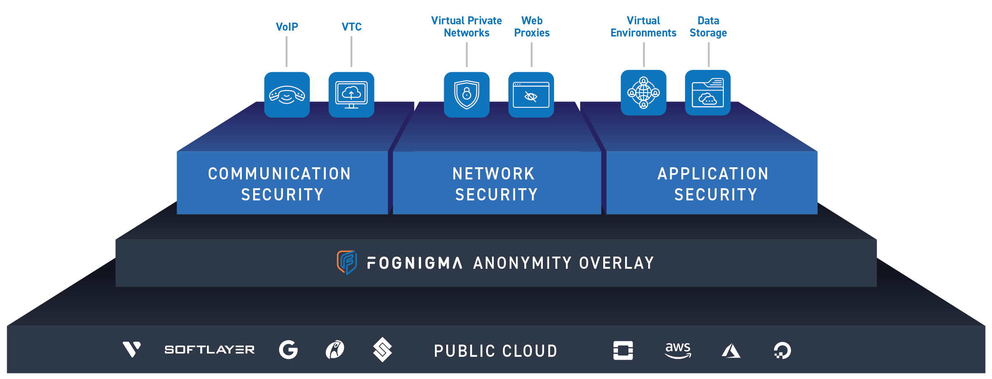
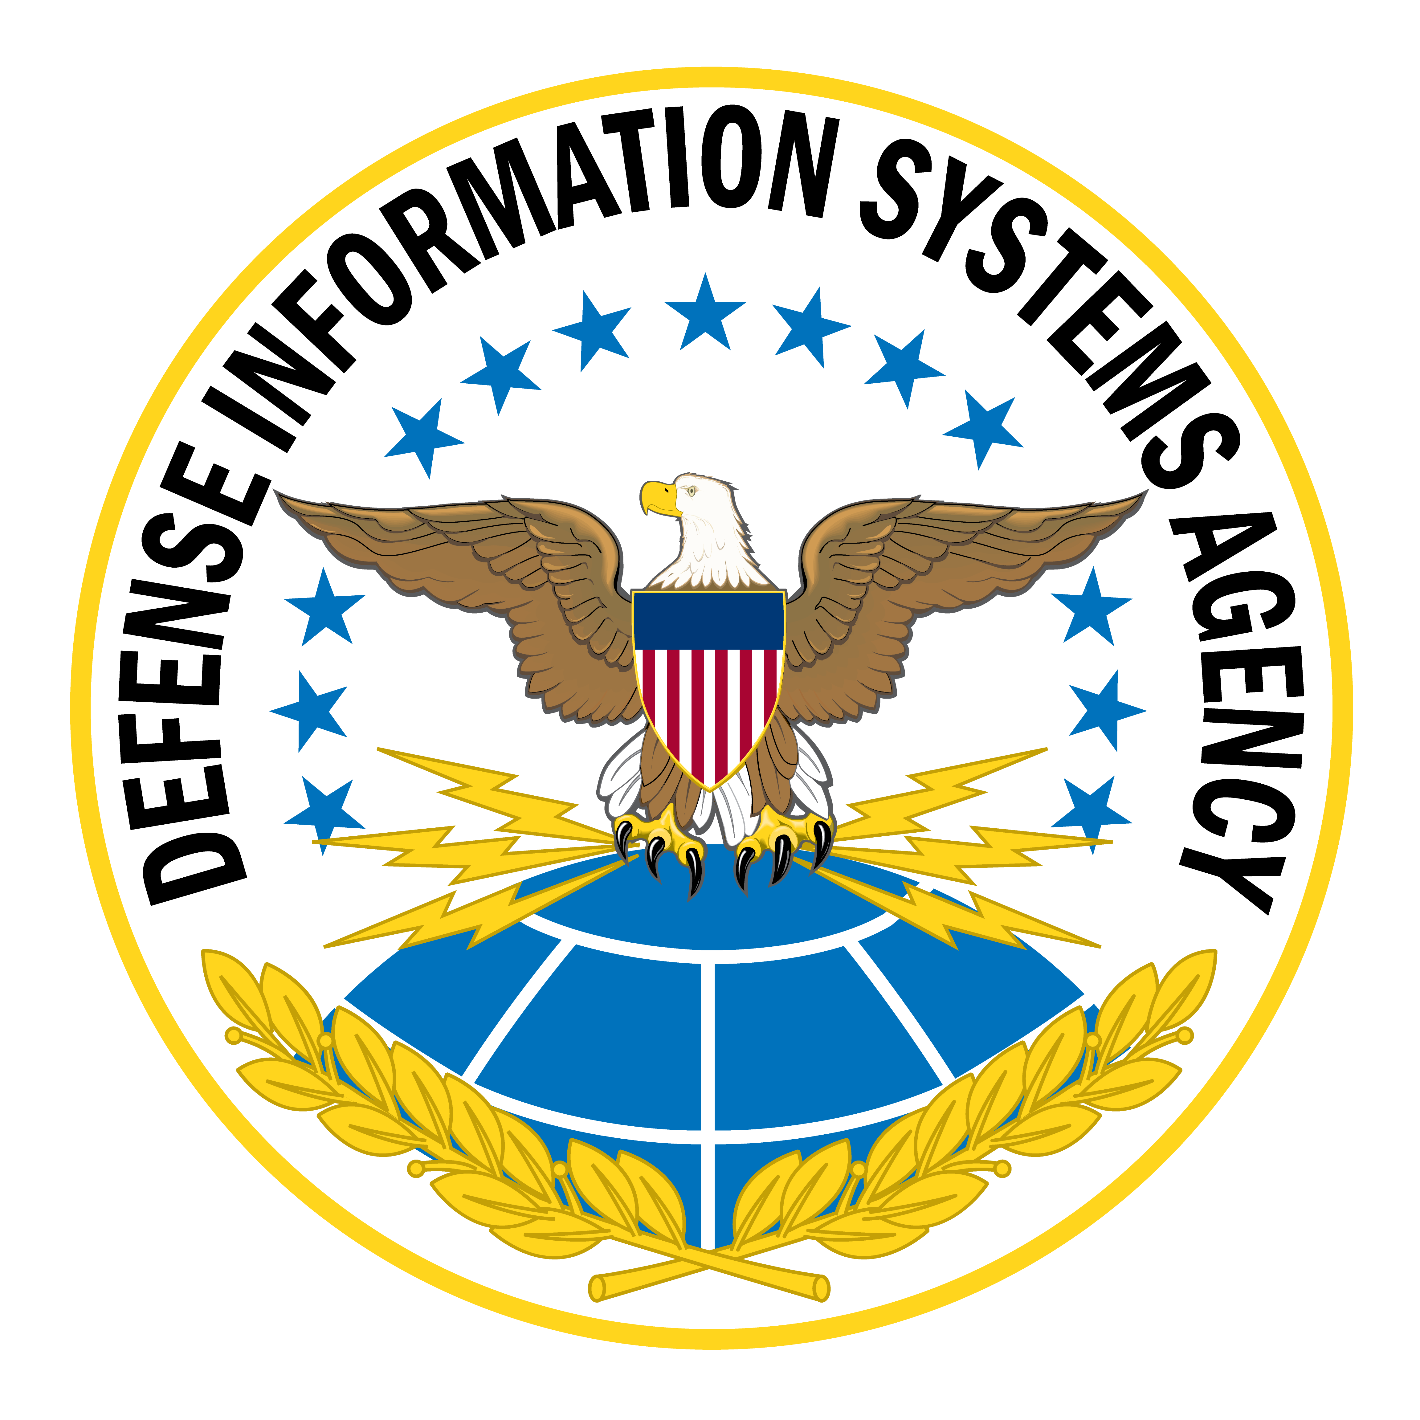
Fognigma Rapid Capability Deployment
4
What DISA can add or build
3
Out-of-the-box capabilities (what you can license)
Your Capabilities
2
Security, networking, & compute
?
1
Infrastructure
3

Slide 4
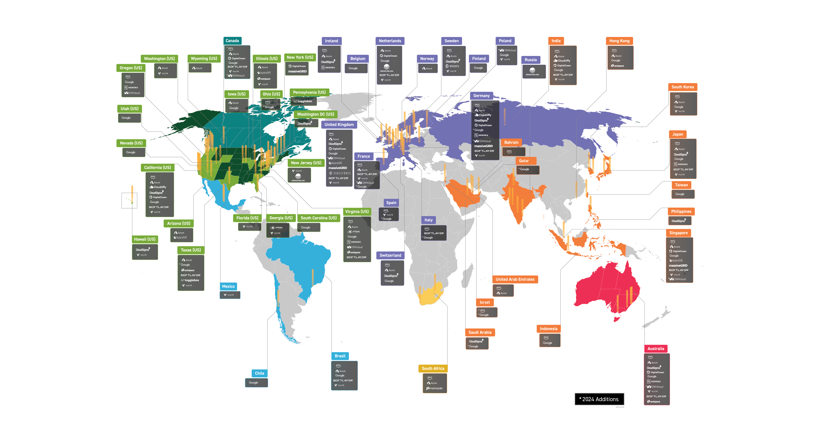
Fognigma Public Cloud Integrations
6 Continents
30 Countries
85 Cities
150+ Data Centers
4

Slide 5
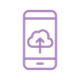
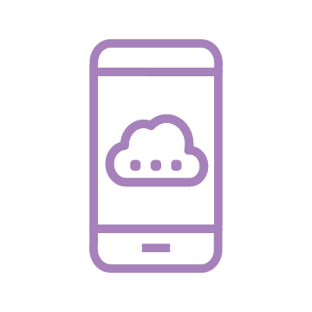
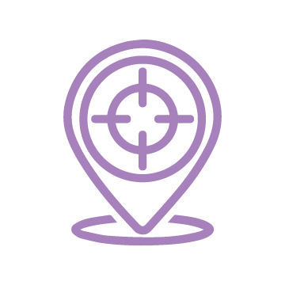
Product Overview – Application Solutions
Virtual Desktops (VDIs) & Androids
Anonymous, disposable, sandboxed workspaces deployed with mission-specific applications and capabilities for communication, collaboration, open-source research, data analytics & forensics, data persistence between instances, and persona management.
Virtual Androids
Virtual Androids function similarly to VDIs but provide a mobile Android operating system, feature drag-and-drop app installation, and can be preloaded with Fognigma’s network client, SIP clients, and more
Mattermost-Conclave
A team messaging application that integrates Fognigma’s per-user and per-device Conclave encryption to automate the generation, management, and exchange of encryption keys and enable rapid, secure messaging and file sharing
Erebus
A file sharing server that incorporates Conclave to automate encryption of all file uploads and decryption of downloads to enable rapid, secure file sharing
Element.io
A team collaboration server that includes per-device, end-to-end encryption to protect messages and files, integrated videoconferencing, and security features that reduce man-in-the-middle attacks
Standard Notes
A digital, end-to-end encrypted file vault that stores each user’s data in a single place and uniquely encrypts each piece of content so each user can only access their own data
Traccar
A real-time GPS tracking server that allows users to view live location data without delay, track movement behavior, create geofences, export data & reports, and more
Wazuh
A customizable, automated security monitoring and intrusion detection system that performs scans, detects vulnerabilities, provides countermeasure, data visualization, and more
5

Slide 6
Product Overview – Communication Solutions
Holler
A telephony server that leverages SIP numbers from up to 5 providers as intermediaries for call/SMS chaining to enable access to global numbers, hide users’ true numbers and identities, and provide persona management, conference calls, ring groups, and more
Speakeasy
A videoconferencing solution that leverages Fognigma’s automation and Portal Proxy technology to create disposable, regenerating private videoconferences with unique, anonymizing access paths for every participant
6

Slide 7
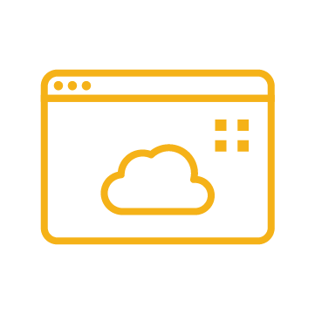
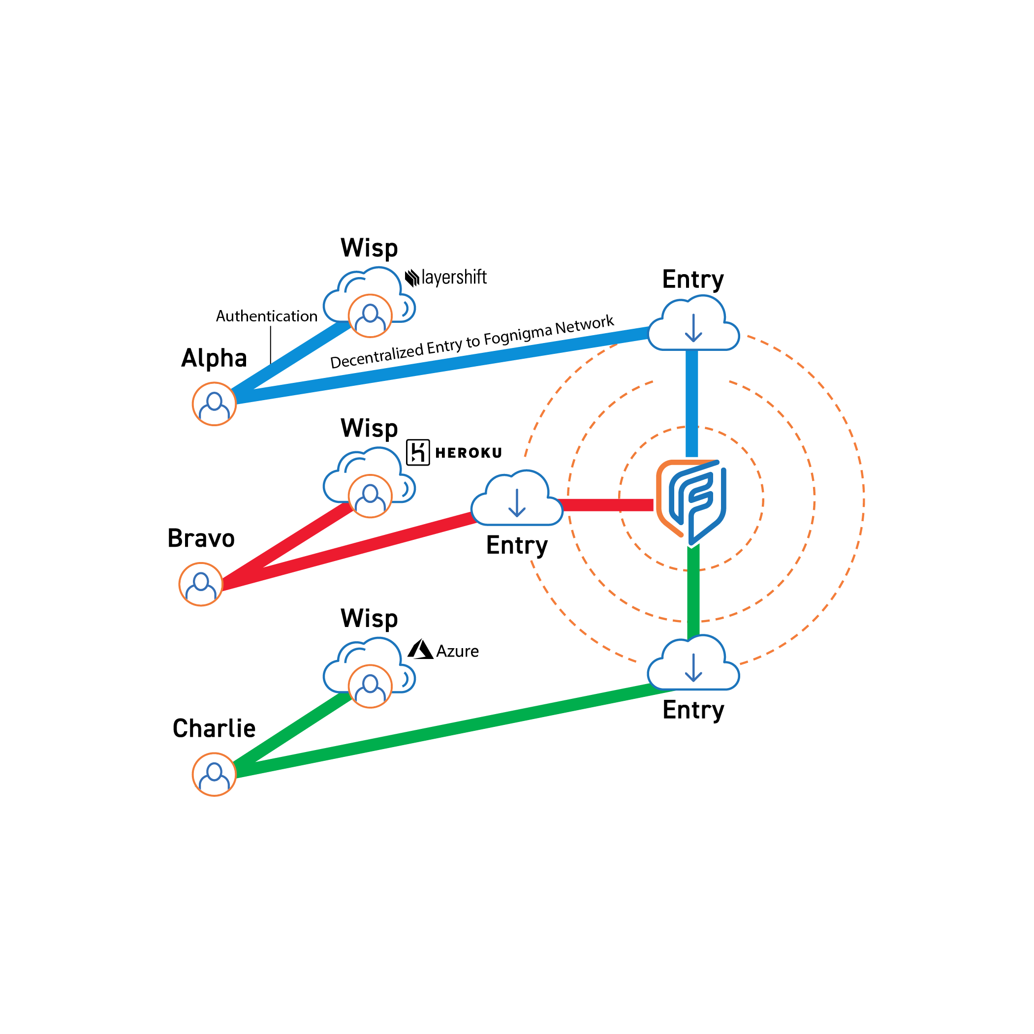
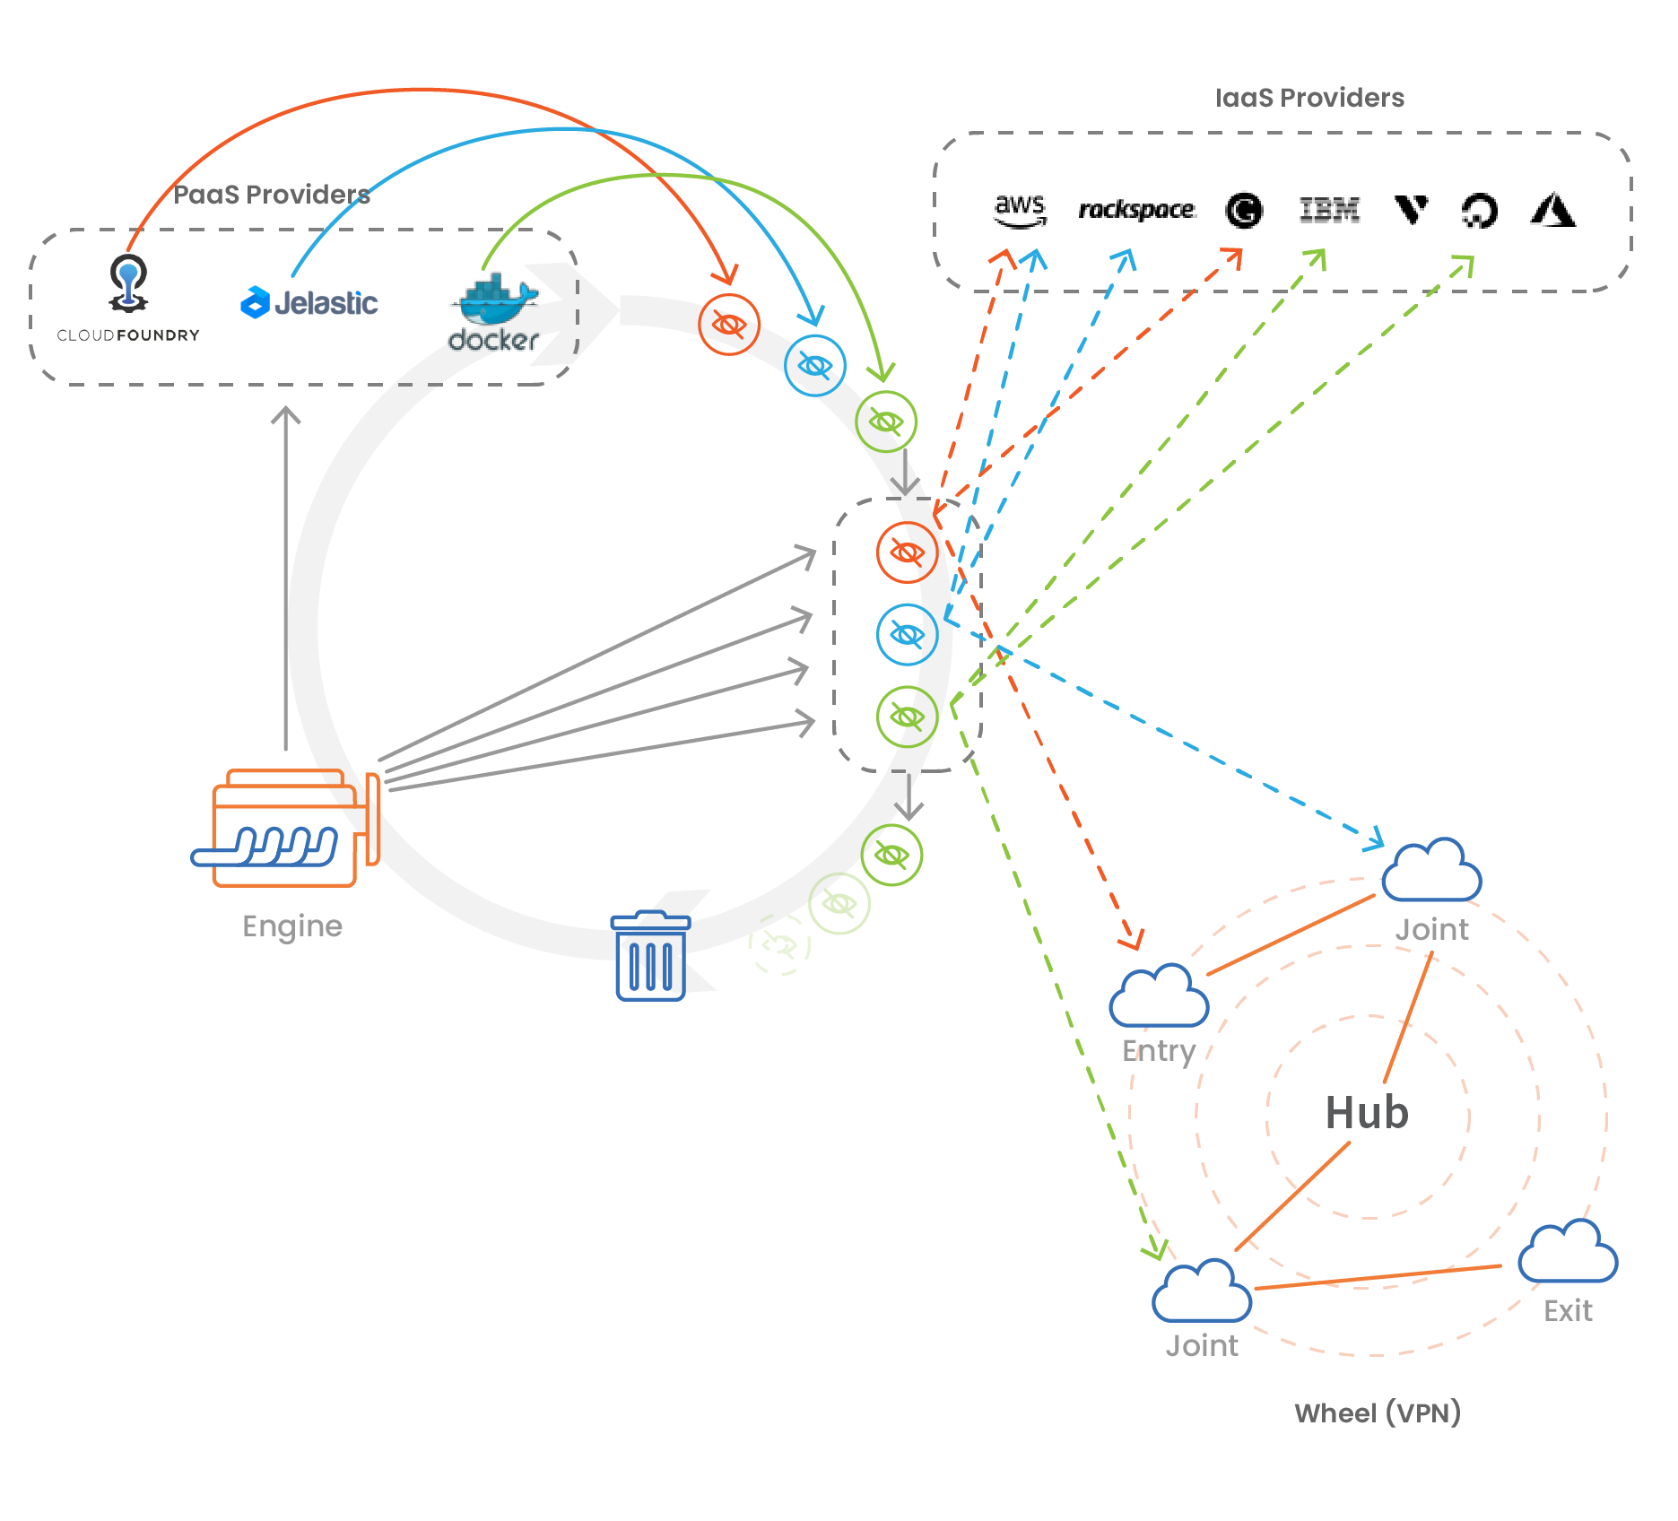
Product Overview – Security Solutions
Spawner Storm
A security solution that uses a pool of disposable, low-cost, cloud-based proxy intermediaries to anonymize the Fognigma engine’s interactions with commercial cloud providers and virtual machines by disguising interactions within commercial traffic
Wisp
A low-cost, cloud-based instance that bundles a user’s accesses, permissions, and tokens to allow them to authenticate with the Fognigma server without connecting to it directly or needing to know its location
ZeroProfile
A smart firewall that automatically blocks all unintended connections and creates a reduced operational profile, allowing the Fognigma engine and deployed virtual machines to maintain the appearance of being inactive and inaccessible
Spawner Storm Diagram
Wisp Diagram
7

Slide 8
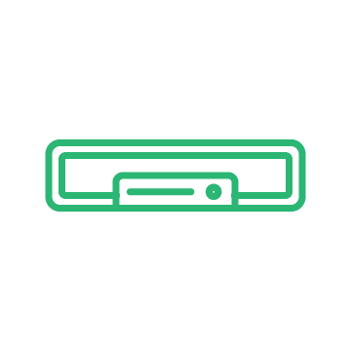
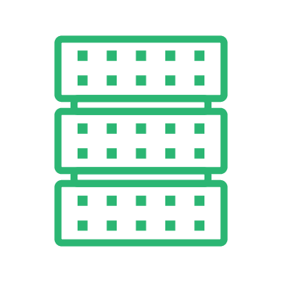
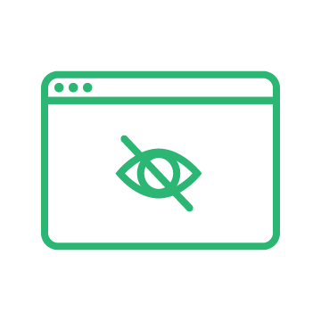
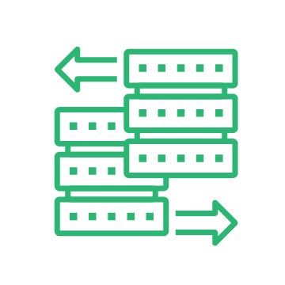
Product Overview – Network Solutions
Fognigma Networks & Mission Partner Environments
Rapidly deployable, private, cloud-based networks that provide anonymity, managed attribution, traceless connections, discreet communication, and hosting capabilities for single users or multi-coalition, multi-location, high-population deployments & missions
Wicket
A pocket-sized hardware device that protects users, IoT devices, or any IP-enabled device by connecting them to a Fognigma Network without requiring the installation of additional software
Netcutter
A portable device that provides remote access to LAN devices/resources and anonymous data forwarding
Gateway
A hardware device for headquarters environments that protects large numbers of users by connecting them to a Fognigma Network without requiring the installation of additional software
Portal Proxy
A disposable, low-cost, cloud-based instance that acts as an intermediary between users and web-based destinations to anonymize connections by disguising them as interactions with commercial web traffic (includes TOTP support)
Reverse Proxy
A proxy server that facilitates controlled access to Fognigma resources without revealing their locations or networks
8

Slide 9
Fognigma Certifications
Certifications
FIPS 140-3 Validated
ISO 9001:2015 Accredited
35+ patents across the Fognigma product line
FedRAMP
Fognigma is pursuing FedRAMP certifications for our services and capabilities to ensure Fognigma exceeds all security standards for current and future customers
9

Slide 10
mmarsteller@fognigma.com
anelson@fognigma.com

