Slide 1
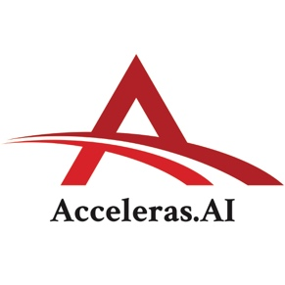
Acceleras.AI: AI Literacy Training for the Public Workforce
Capability Briefing
© Acceleras.AI LLC. All Rights Reserved

Slide 2
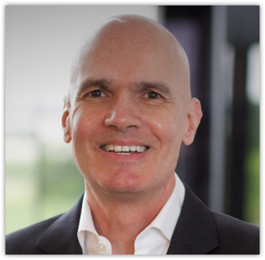
Acceleras.AI LLC Company
Company: Acceleras.AI LLC
UEI: VQX9DJ8BRNK8
CAGE: 9RZ43
WEBSITE: https://acceleras.ai/ SOCIO-ECONOMIC STATUS: Small business
Matt Davis, Co-Founder
Matt brings over 25 years of IT management consulting and delivery experience to Acceleras.AI.
Matt served as Principal Program Manager in Microsoft’s National Security Group where he oversaw $20 million in Federal consulting and Premier contracts, as well as CIO for two Federal contractors that provided services to the DoD, DHS, and Veteran Affairs.
Matt has also held various positions at Nextel, American Management Systems, PwC, and Arthur Andersen.
Contact:
PHONE: 703-930-5027
EMAIL: mdavis@acceleras.ai
Scott Phillips, Co-Founder
Scott worked 23 years with Accenture, Delivery Innovation/Offering Development for Cloud Native and AI/ML.
He managed a Skunkworks innovation lab for DevOps, Cloud, AI/ML prototypes with 50+ solutions over 7 years, $10M total.
He created executive training and enablement programs for new technologies including DevOps, Cloud Native, AI/ML.
He started his career as a Peace Corps volunteer and Peace Corps HQ DC staffer.
Contact:
PHONE: 415-948-7158
EMAIL: sphillips@acceleras.ai

Slide 3
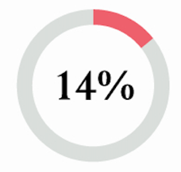
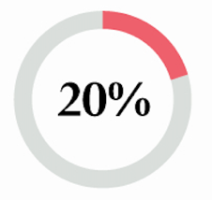
Goal: Create an inspired, confident public workforce able to work with AI.
Challenge:
49% have not received any training on AI.
50% are afraid of being “left behind” without learning about AI.
US Workforce* (2024)
Only 14% of government agencies call themselves “Very ready” for AI.
Only 20% “very” likely to adopt AI in coming year.
Federal Agencies* (2023)
*Sources: Washington State University, SAIC
Notes:
Sources:
“AI & Business Readiness 2024 Report”, Washington State University.
SAIC, How the Federal Government will win the cloud, January, 2023: https://www.saic.com/sites/default/files/2023-02/SAIC-Cloud-WP___2023.pdf

Slide 4
OMB Memo (March 28, 2024)
Advancing Governance, Innovation, and Risk Management for Agency Use of Artificial Intelligence
4.0 Advancing Responsible AI Innovation
a.VII: a current assessment of the agency’s AI and AI-enabling workforce capacity and projected AI and AI-enabling workforce needs, as well as a plan to recruit, hire, train, retain, and empower AI practitioners and achieve AI literacy for non-practitioners involved in AI to meet those needs;
Why AI Literacy for non-practitioners?
Without: Organizational equivalent to driving with the emergency brake on (for adoption) OR driving without a brake at all (for implementation).

Slide 5
Five Skills for AI Readiness/Literacy
AI ecosystem and solutions knowledge - How AI/ML models are built, how to apply the right AI/ML solutions to different business problems;
Computational AI skills using metrics, thresholds, and measures – How AI/ML models are measured, resulting in teams that can ask questions and understand outcomes;
Model bias awareness and diagnosis - Experience uncovering bias in model outputs, learn how to apply Responsible AI principles and support regulatory compliance requirements;
Evaluating AI uses cases for business outcomes - How to evaluate AI use cases to solve business challenges; and
Experience with real AI tools - Hands-on experience with Amazon SageMaker and the Azure Machine Learning Studio.
Basics of AI for working with AI / Data Science teams, tools, and programs.

Slide 6
Acceleras.AI offers a proven and tested format for AI workforce training.
Course formats are based on following components:
Foundational AI Content
Real AI Case Studies
AI-experienced Instructors
Hands-on AI Labs
Customizable Content
No coding and no prerequisites required to participate.

Slide 7
AI-Experienced Instructors
AI Training experience:
AI Solution experience:
Led capability programs that trained 4,000+ executives at Accenture on five continents.
Scaled Agile Framework (SAFe).
DevOps Made Real (DevOps).
Cloud Native Made Real.
120+ classes directly trained.
Trained-the-trainers in Australia, Japan, Germany, Italy, France, UK, US, and Canada.
2,000 people trained on AI/ML labs and AI content.
Led internal Skunkworks prototyping factories for DevOps, Cloud Native, and AI/ML solutions (7 years).
20+ AI/ML solutions created over 5 years. 50+ solutions across all technologies.
Managed $3M in annual innovation funding, 10 direct reports, dotted line responsibility for 100+ developers offshore.
Coordinated governance for business sponsors across all workstreams.
Single point of contact for all escalations between engineering teams and business sponsors.

Slide 8
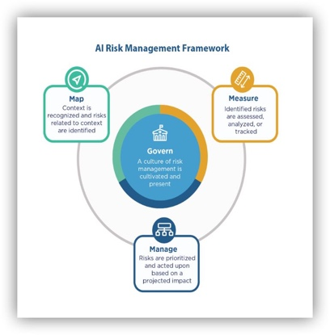
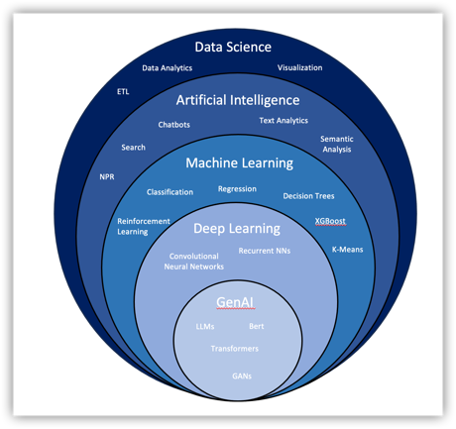
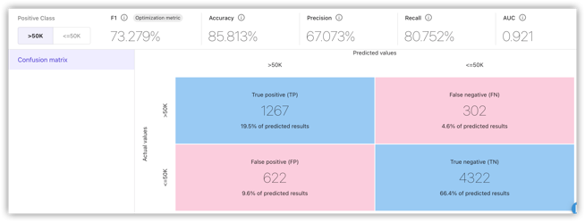
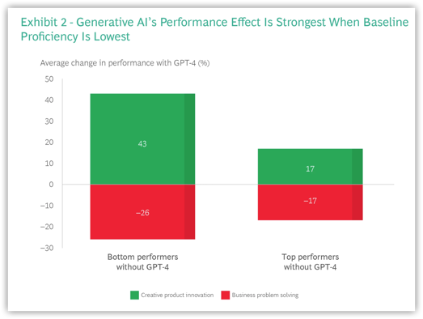
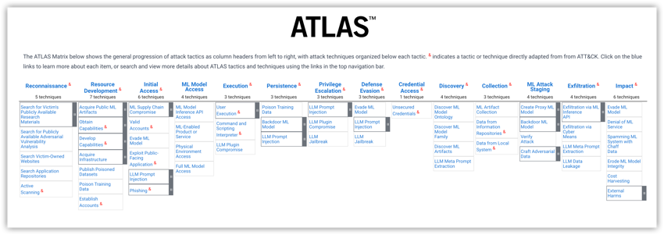
Foundational AI Content
Content on AI technology that is not too technical (no coding) and accessible to a variety of audiences.
AI trends, market, progress, and challenges.
Definitions, measures / metrics, and platforms.
Responsible AI frameworks, bias, explainability.
MLOps and how models are managed in production.
Generative AI trends, architectures, and challenges.
AI security threats and defenses.
Managing AI/ML: governance, evaluation, budgeting, communication, etc.

Slide 9
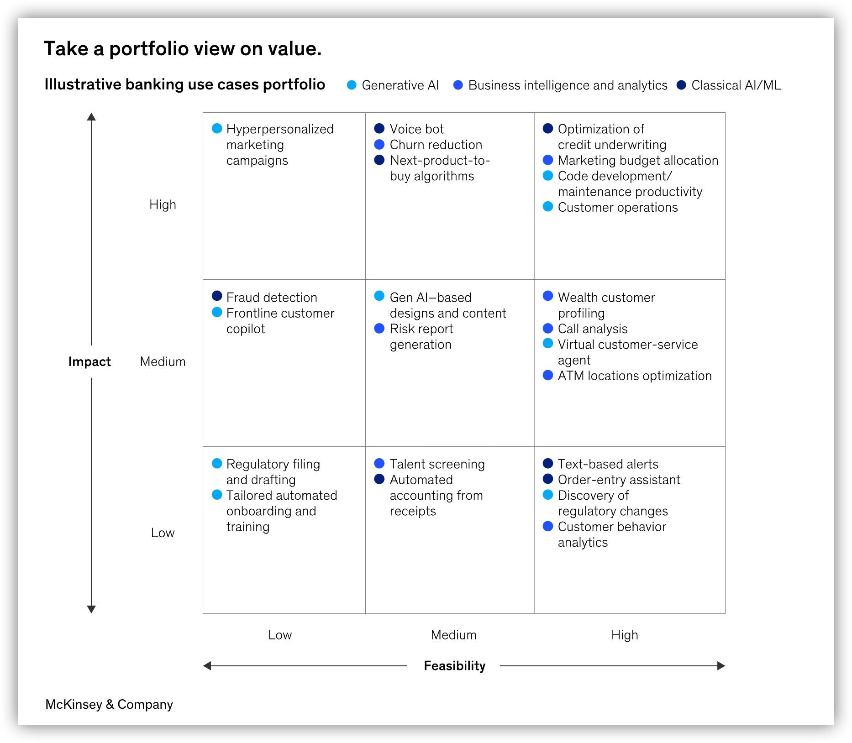
Portfolio Perspective: Not just GenAI
AI/ML is not just Gen AI:
Solutions should focus on value to the business.
They will be a mix of :
Traditional analytics/BI,
‘Traditional’ AI and Machine Learning solutions, and
Newer Gen AI applications.
This illustrative view is a good prompt to think about the range of technical approaches available to solving business problems.

Slide 10
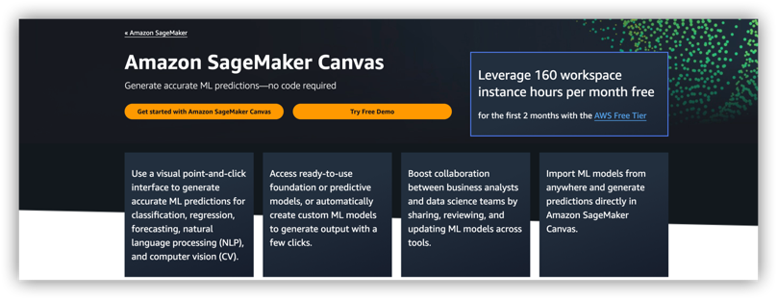
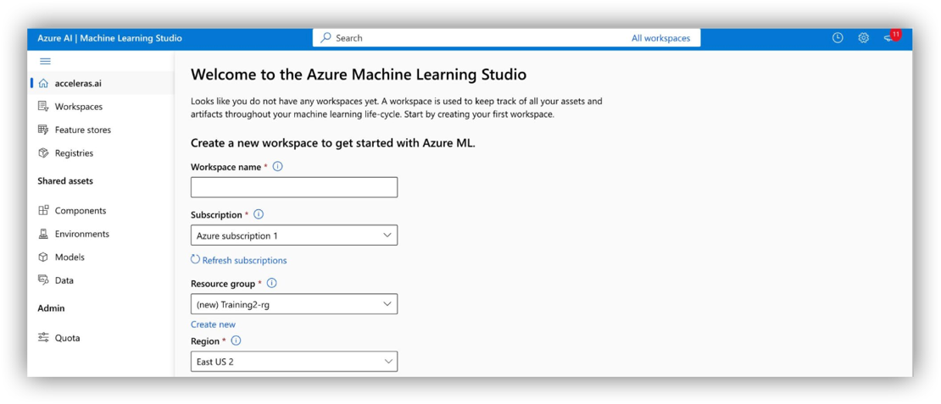
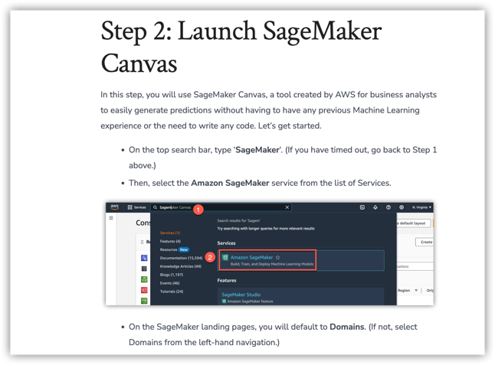
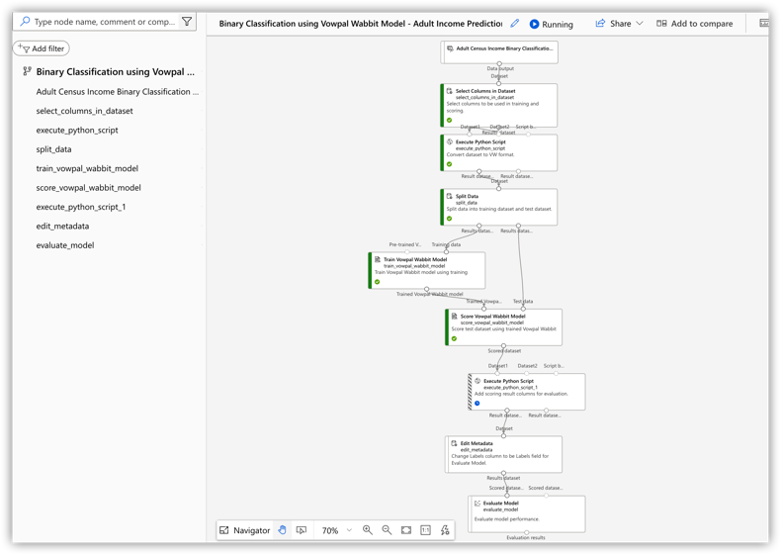
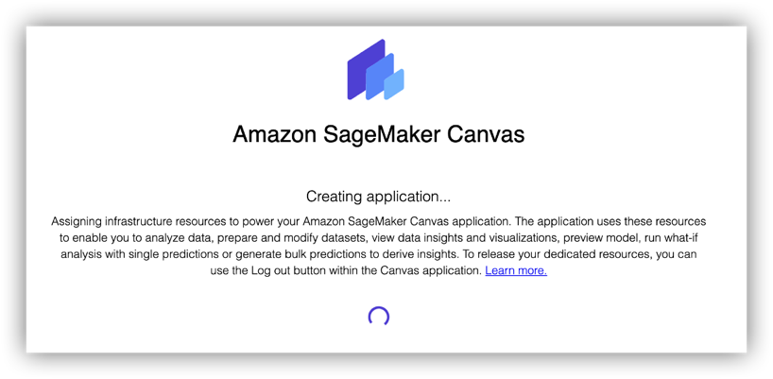
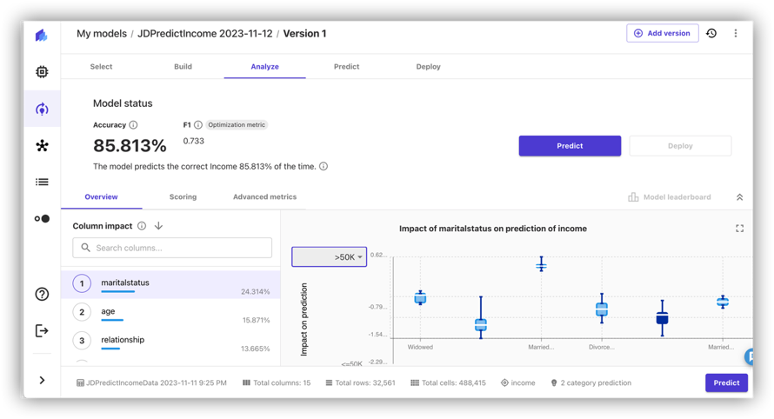
Hands-on AI Labs (no coding)
AWS SageMaker Canvas
Azure Machine Learning Studio

Slide 11
Real AI Case Studies
Training incorporates case studies of real-world AI/ML solutions that were built (or attempted) to highlight lessons learned on what works and where issues can occur.
Video Process Discovery (go)
Video analytics solution using multiple steps and algorithms to convert video workflow recordings into machine readable data for process analysis.
Patent filed, exists as a production asset today.
Organizational challenges:
Leadership not aligned on priority and funding.
Capability gaps in team, engineering, product support.
Telecom Paperless Billing Prediction (no-go)
Proof-of-Concept created to assess potential to predict user migration from paper to paperless billing to achieve cost savings.
Model development found weak correlations, high cost to develop and maintain. Decision was a no-go.
Technical challenges:
POC data may not reflect actual data and accessibility.
Models may not create strong enough predictions.
AI Sales Platform Text Analytics (go)
Asset created to ingest and analyze company market reports (annual reports, analyst reports) using NLP to identify linkage between key phrases/terms and consulting offerings.
Model proved effective and solution was incorporated into an existing platform.
Market challenges:
Build it and they will come doesn’t always work.
User or client uptake may fall short.

Slide 12
Customizable Content
Content and format can be customized with customer/agency specific AI content for programs, case studies, and guidelines.
1-Day Format, Common Content
1-Day Format, Agency Content
2 Half-Days, Flexible Content
AI Trends
Definitions
Platforms
AI Trends
Definitions
Platforms
AI Trends
Definitions
Platforms
Case Study
Lab 1
Responsible AI
Customer Case Study
Lab 1
Responsible AI
Case Study
Lab 1
Responsible AI
Lab 2
MLOps
GenAI
Lab 2
MLOps
GenAI
Lab 2
AI Security
Manage AI
Lab 3
AI Security
Customer Programs
Workshop
MLOps
GenAI
Governance
Budgeting AI
Conclusion
Governance
Budgeting AI
Conclusion
AI Security
Customer Programs
Workshop
Governance
Budgeting AI
Conclusion
In-person at Customer Site OR Virtual on Vendor’s Platform.

Slide 13
Example Courses: Many formats are possible
Managing AI/ML for Executive and Professionals (1-Day)
For executives and professionals seeking to lead or work more effectively with AI/ML initiatives, programs, and teams. You will:
Review AI/ML concepts, processes, measures, and issues.
Identify bias in an ML model, review Responsible AI frameworks.
Explore MLOps; managing models from prototype to production.
Review common AI security threats and defenses.
Investigate Gen AI use cases, architectures, and challenges.
Discuss governance, evaluation, and budgeting for AI/ML solutions.
Gain hands-on using two clouds (AWS, Microsoft Azure).
Supervised Learning Workshop (Half-day)
Created to provide a workshop format to explore and explain Supervised Learning, a Machine Learning model created with historical, labelled data used to make real-world predictions. Most organizations will use Supervised Learning as part of their AI/ML portfolio. We offer an engaging 3-4 hours workshop for your team to explore Supervised Learning in practice.
Review AI/ML definitions, metrics, and concepts to understand how Supervised Learning fits into the portfolio of AI/ML solutions.
Get hands-on with a cloud-based lab to explore creating a machine learning model in real-life and generating predictions.
Explore the basics of Responsible AI by diagnosing bias in model outputs.
Responsible AI Workshop (Half-day)
A workshop format of 4-5 hours to explore Responsible AI’s core frameworks and concepts for evaluating an AI solution. Useful for all professionals accountable for AI solution risk, compliance, and public or customer impacts..
Overview of Responsible AI frameworks, concepts, and methods.
Real-time exploration of Supervised Learning and Explainability in practice.
Identify gender bias in a machine learning model’s outputs using key metrics.
Explore model probabilities and thresholds and how they can lead to errors.
Review case studies and contemporary issues in Responsible AI.
Use AI platforms on two clouds for simple hands-on learning.
Reinforcement Learning Workshop (Half-day)
Created to provide a workshop format of 3-4 hours to explore Reinforcement Learning and how it works through discussion, simulation, and case studies. Useful for team building exercises to increase AI knowledge while having fun.
Overview of AI/ML concepts, processes, measures, and issues.
Explore how Reinforcement Learning models created.
Run a simulation in real-time to explore RL in action.
Review case studies and contemporary issues with RL.
Finish with a return to simulation exercise.

Slide 14
Questions?

Slide 15
Acceleras.AI LLC Company Data
COMPANY DATA
Company: Acceleras.AI LLC
UEI: VQX9DJ8BRNK8
CAGE: 9RZ43
WEBSITE: https://acceleras.ai/
FORMAT: Delivery at customer site or virtual
DETAILS: https://acceleras.ai/training/
ADDRESS: 8195 SW Ernst Rd, Portland, OR 97225
SOCIO-ECONOMIC STATUS: Small business
NAICS: 611420, 611430, 541611, 541618, 541511, 541512, 541519, 541690, 541990
PAYMENT: Accepts Credit Cards
POINTS OF CONTACT
Scott Phillips PHONE: 415-948-7158
EMAIL: sphillips@acceleras.ai
ADDRESS:
8195 SW Ernst Rd,
Portland, OR 97225
Matt Davis PHONE: 703-930-5027 EMAIL: mdavis@acceleras.ai
ADDRESS:
14813 Kelley Farm Dr,
Darnestown, MD 20874

