Slide 1


VeriTX –
DISA Presentation
July 30th, 2024
Presents: Fortis File Transfer

Slide 2

Agenda
Our Team
Company Overview: VeriTX
Capability Overview: FORTIS
DoD Strategy (How Does FORTIS Align)
Live Demonstration of FORTIS
Key Questions
Q & A
https://www.fortisfiletransfer.com

Slide 3
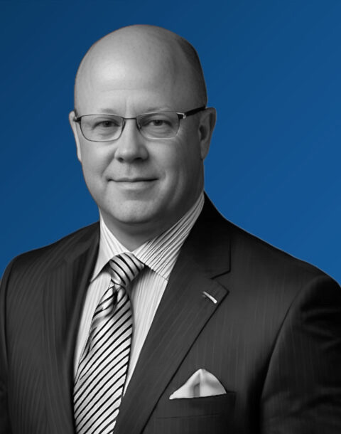
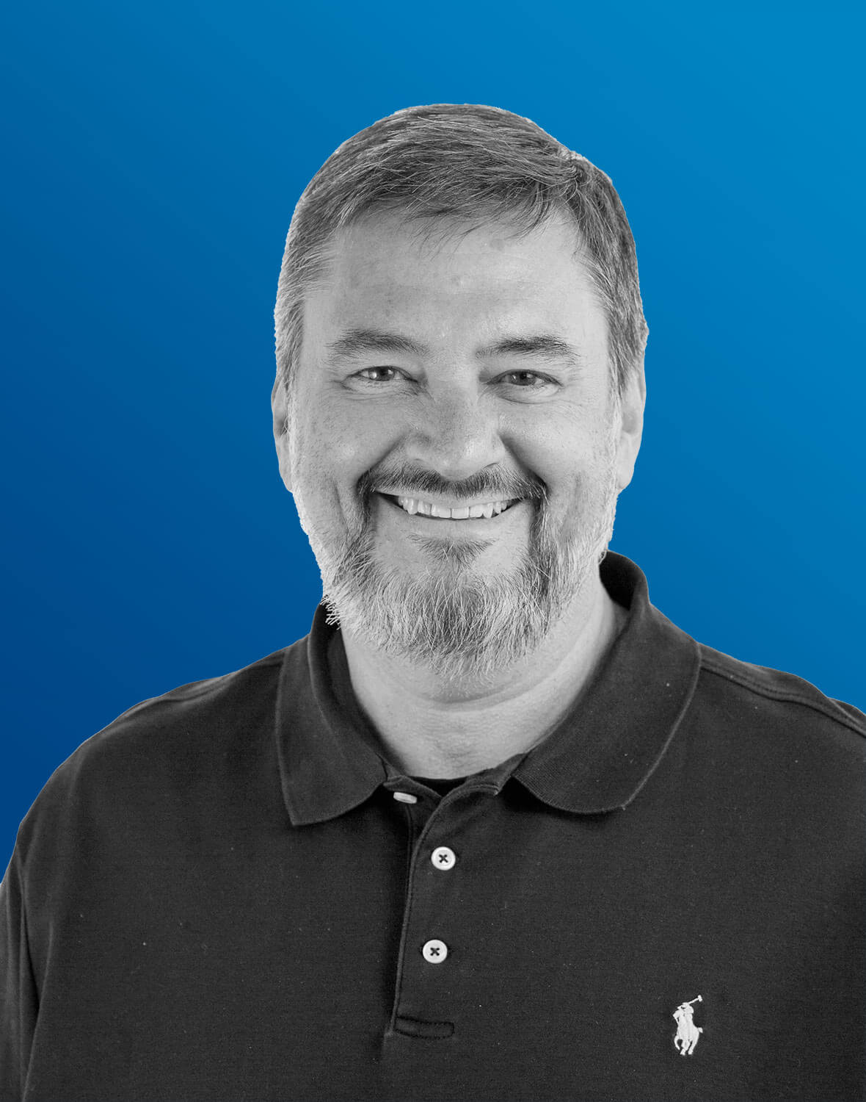

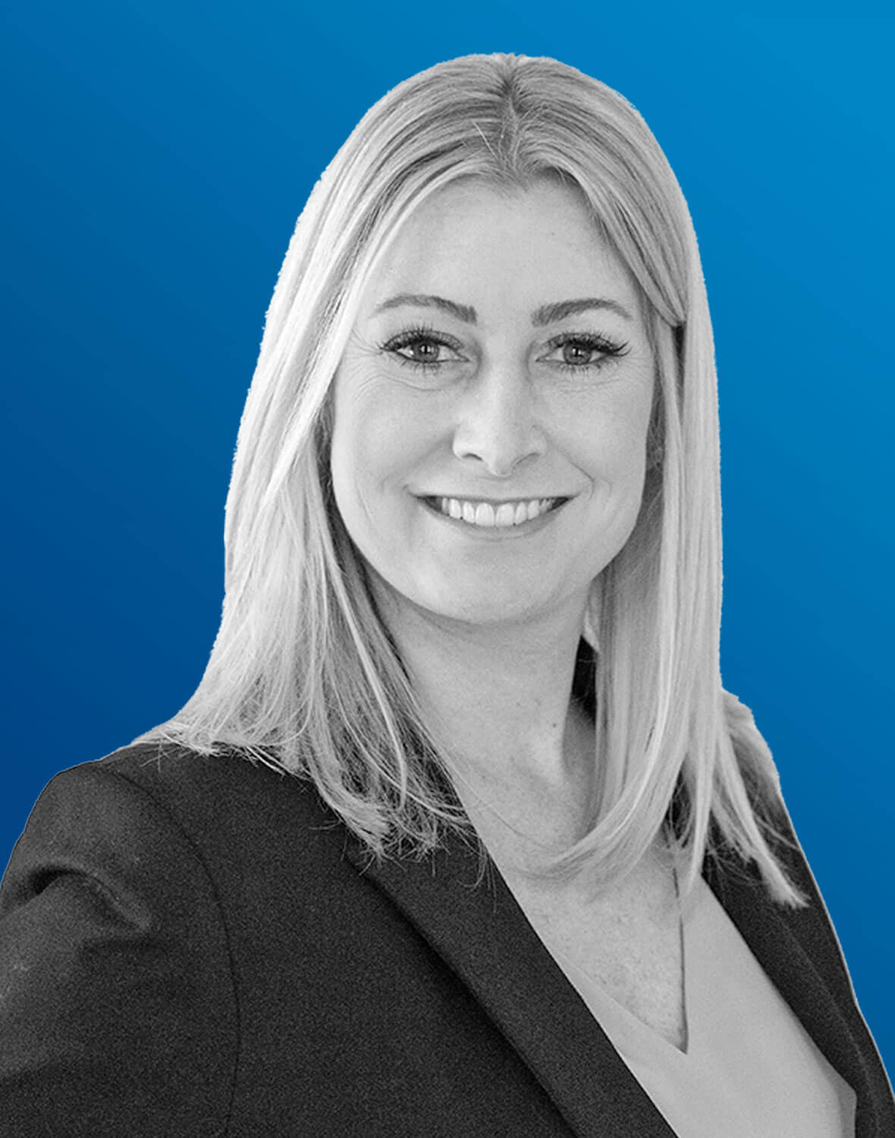
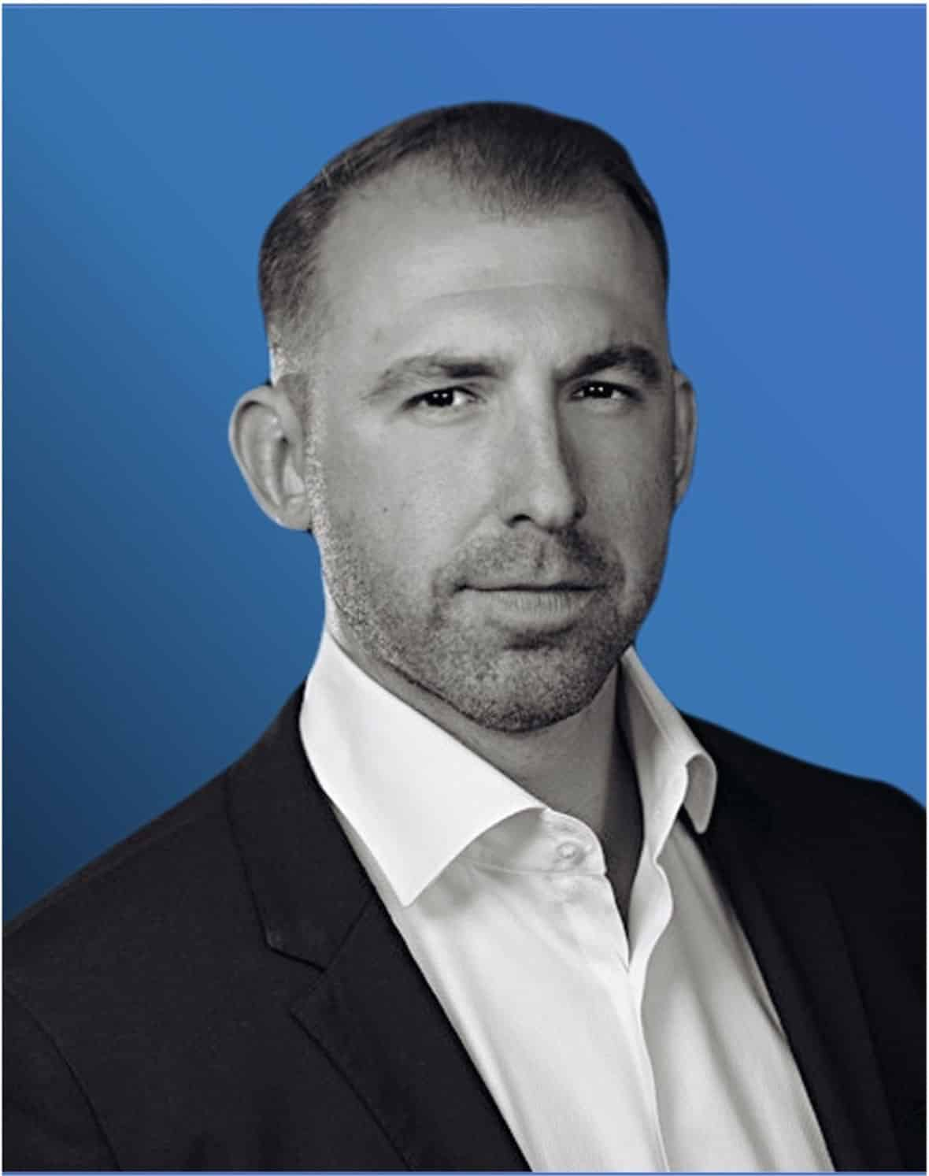

Our Team
James Regenor, PhD, Col (Ret)
Founder | President & CEO
U.S. Air Force Veteran
Legrand Richard Groves
Co-Founder
U.S. Air Force Veteran
Kristin “Kris” Horan
Director, Business Development
USAFR Lt. Col.
Jon Pierowicz
General Counsel
U.S. Marine Corps Veteran
Keaton Regenor
Director of New Business Initiatives
BUSINESS CONFIDENTIAL

Slide 4
Company Overview
Who is VeriTX
Founded the company to facilitate digital supply chains
  Secured Air Force Sustainment Center SBIR Phase III funding
Identified extensive applicability across all large-scale data
Developed Fortis: a robust platform for secure data transfer
  Recognized the necessity for comprehensive data assurance, including:
  Data security
  Tamper-evident measures
  Provenance verification
https://www.fortisfiletransfer.com

Slide 5
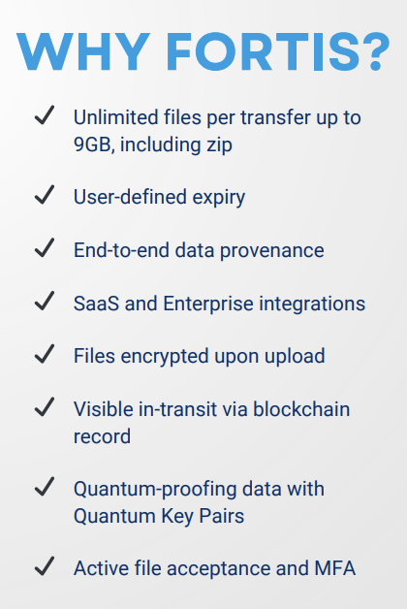
Fortis Capability Overview
FORTIS is a cutting-edge file transfer solution designed to enhance data security and integrity across the ensured data lifecycle.
As organizations increasingly move sensitive and Controlled Unclassified Information (CUI) to the cloud, the need for robust security measures is more important than ever.
Consuming bad data is NO longer an option.
BUSINESS CONFIDENTIAL
https://www.fortisfiletransfer.com

Slide 6

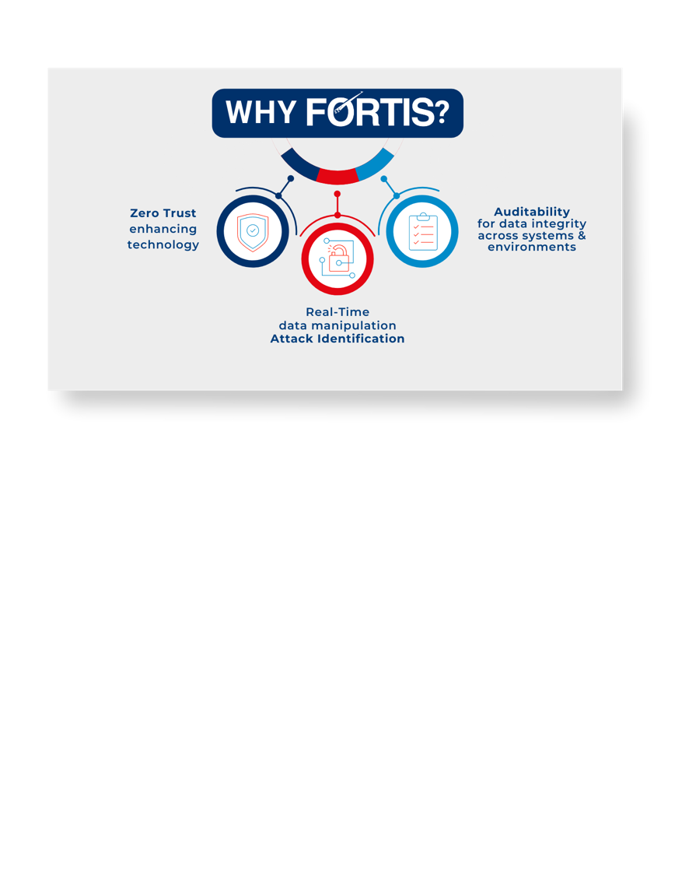


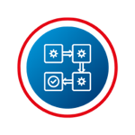
Fortis Capability Overview
Fortis looks at the individual files…data at rest as well as in motion to validate no changes have been made.
Fortis continually monitors for data manipulation (intentional or non-intentional).
Fortis provides zero-day data manipulation attack early warning through data monitoring.
Fortis prevents corrupted data/files from being consumed in downstream processes through complete data monitoring throughout the data transfer process.
BUSINESS CONFIDENTIAL
https://www.fortisfiletransfer.com

Slide 7
DoD Strategy: How Does FORTIS Align
FORTIS aligns with DoD Strategies & Policies:
NIST-8
NIST-10
DoD CIO Strategy (Fulcrum)
DoD CIO Defense Industrial Base Strategy
BUSINESS CONFIDENTIAL
https://www.fortisfiletransfer.com

Slide 8
Live Demonstration
Link to Fortis SaaS:
https://fortistransfer.com/

Slide 9
Data Assurance Questions
Key Questions
How do you know your data isn’t corrupted or manipulated?
How do you know your data isn’t being weaponized against you?
Can you trust your data in a cyber-contested environment?
How can FORTIS improve best practices within your organization?
Pillars
BUSINESS CONFIDENTIAL

Slide 10

Q & A
BUSINESS CONFIDENTIAL

Slide 11
Data Assurance
What is Data Assurance - The practice of verifying that data is unmanipulated and remains in its originally intended state
  Done at the asset level
  Data protection
  Data quantum proofing
  Data provenance
Web3 & Industry 4.0 Requires
  Operations in a Zero Trust Environment
  Data Assurance
  Quantum resilience
BUSINESS CONFIDENTIAL

Slide 12
Fortis Complies
DoD Instruction 5000.82…Section 3.9 (2)
(d) Implement industry best practices for secure authentication, access management, encryption, monitoring, and protection of data at rest, in transit, and in use, as appropriate.
(e) Store data in a manner that is platform and environment-agnostic, uncoupled from all infrastructure dependencies, and maximally portable, as appropriate.
DoD Data, Analytics, and Artificial Intelligence Adoption Strategy
VAULTIS:
Visible – Consumers can locate the needed data.
Accessible – Consumers can retrieve the data.
Understandable – Consumers can find descriptions of data to recognize the content, context, and applicability.
Linked – Consumers can exploit complementary data elements through innate relationships.
Trustworthy – Consumers can be confident in all aspects of data for decision-making. Interoperable – Consumers and producers have a common representation and comprehension of data.
Secure – Consumers know that data is protected from unauthorized use and manipulation.
Pillars
BUSINESS CONFIDENTIAL

