Slide 1
Streamlining DevSecOps Practices for Defense Enterprise IT Systems
Notes:
1
1

Slide 2
Outline
Introduction
Core Principles
Analysis of DevSecOps Cases
DevSecOps Problem Space
Cutting edge efforts
Summary

Slide 3
Introduction
Footbridge Federal presents insights on implementing DevSecOps for DISA enterprise IT systems, leveraging successful military experiences.
Comprehensive DevSecOps Engineering: We explore DevSecOps initiatives across all development phases, including project inception, best practice integration, and ongoing improvement.
Collaborative Tailored Solutions: Our focus on iterative improvement allows us to tailor solutions to clients' unique requirements, ensuring smooth transitions and maximizing efficiency.
Footbridge Federal’s Distinct Capabilities: As a small business with exceptional engineers, we shape new and existing DevSecOps environments, facilitating quicker iterations and reliable deployments, reducing troubleshooting time, and addressing today's complex threats.
Commitment to Continuous Innovation: We deliver cutting-edge technology solutions that drive mission success for defense and intelligence clients.

Slide 4
Outline
Introduction
Core Principles
Analysis of DevSecOps Cases
DevSecOps Problem Space
Cutting edge efforts
Summary

Slide 5
Core Principles
DevSecOps Core Principles
Iteration speed is paramount
The developer is the primary customer
Flexibility beats uniformity

Slide 6
Core Principles
DevSecOps Best Practices
Resources should be stateless whenever possible
Processes should be idempotent whenever possible
The developer and the CI tool should build code the same way
Builds should utilize intelligent caching mechanisms
Follow DRY principles
Balance abstraction with transparency and readability
CI/CD stages should be containerized and/or orchestrated
Develop in a simulated production environment
Splitting mono-repos is easier than combining poly-repos
CI systems should have inherent defaults with explicit overrides

Slide 7
Outline
Introduction
Core Principles
Analysis of DevSecOps Cases
DevSecOps Problem Space
Cutting edge efforts
Summary

Slide 8
Analysis of DevSecOps Cases: Stages of Development
New projects
Opportunity to implement best practices immediately
Containerized CI/CD
Agile development
Security tools tailored to ATO needs
Less is more:
new, small teams are hindered by an elaborate CI/CD & build system
Mature programs
Iterative approach to implementing best practices
Meet developers where they are. Radical changes are disruptive
Implement parallel pipelines.
Decouple and update individual components
Economy of scale
Standardize build process/tools, repo structure, base image sources
CI/CD container orchestration (i.e. Kubernetes)
Case:
New initiative, watching airspace with AI/ML. Only 5 developers
Case:
Large program, 5+ years and dozens of projects using Maven, Jenkins, VM-nodes, abnormal branch conventions -->
Multi-language builds, containerized Gitlab-CI, standard branches, cached builds and artifact promotion

Slide 9
Analysis of DevSecOps Cases: Development and Deployment Environments
On-Premisis
Full responsibility of hardware, virtualization, OS, packages
Packer, VMware, Ansible to reliably re-provision resources
Create identical dev, staging, prod environments. Eliminate discrepancies upon promotion
Enable CD to various deployment stages
Air-Gap / Classified
Replicate production environment as much as possible
Create deployment script product: bash, python, ansible
Automate creation of .tgz and physical media
Cloud
Utilize Terraform or other IaC to manage resources
Allows resources to be treated like cattle, not puppies
Attach developer IDE’s to cloud resources for live developing
Case:
ML-Ops R&D effort. Perfect replication of dev/staging/prod environments. True CD via Jenkins jobs
Case:
Operational secure communications software – Deployment time drastically reduced via pseudo-CD to create tgz’s for physical media
Case:
Airspace monitoring GUI. Duplicate environments created via Terraform, able to share production DB/S3/etc.

Slide 10
Analysis of DevSecOps Cases: IT & Hardware vs. CI/CD & Software
Case:
Case:
Creation and deployment of STIG’d VMs to SIPRNet
Re-architecting a docker-compose based anomaly detection system to use kubernetes (re-write services)
DevSecOps Engineers
IT / Tech Support
Software Developers
Front End Development
Hardware
OS Installs
Back End Development
Advanced Algorithms
Server Setup
Linux Admin
Virtualization
CI/CD Pipelines
Package Installs
Ansible Scripting
Containerization
Cloud Automation
Code Build Tools

Slide 11
Outline
Introduction
Core Principles
Analysis of DevSecOps Cases
DevSecOps Problem Space
Cutting edge efforts
Summary

Slide 12
DevSecOps Problem Space
In-Cloud
CI/CD & Software
New Project
Mature Program
IT & Hardware
Air-Gap

Slide 13
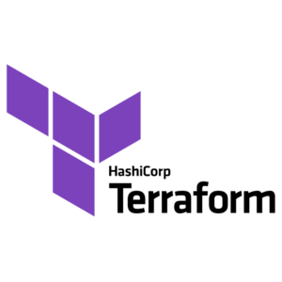
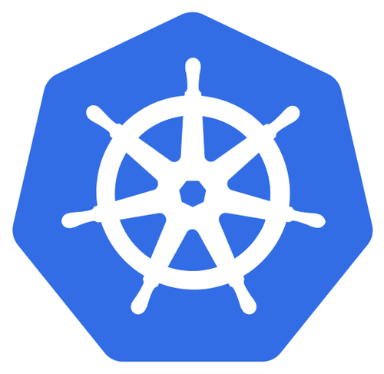
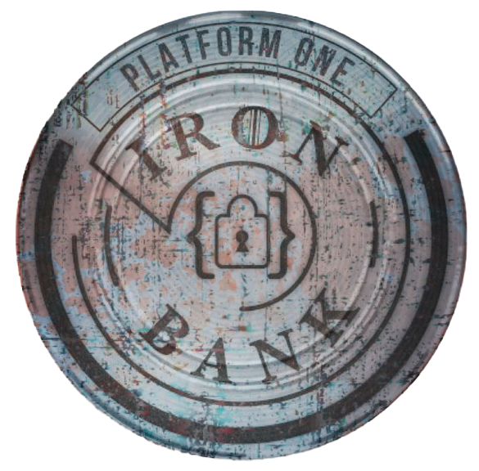
DevSecOps Problem Space
In-Cloud, IT focused, new project:
Start with IaC tools for reliable cloud resource allocation
In-Cloud
CI/CD & Software
On-prem, large-scale CI/CD:
Standardize build-process, artifacts and code storage, scanning, and deployment processes. Implement containerized/orchestrated pipeline
New Project
Mature Program
On-prem, IT Optimization:
Encourage ephemeral resources and virtualization. Utilize repeatable, idempotent provisioning processes
Mature, air-gap, transition to K8s:
Use kubernetes in parallel with existing solution. Simulate air-gap cluster for staging. Utilize hardened k8s resources
IT & Hardware
Air-Gap

Slide 14
Outline
Introduction
Core Principles
Analysis of DevSecOps Cases
DevSecOps Problem Space
Cutting edge efforts
Summary

Slide 15
Cutting edge efforts
Offline LLM Solution
ChatGPT-like functionality
100% Offline
Deployable in classified environments
RAG compatible
Open Source components
Fully Containerized
Kubernetes CI/CD Pipeline
Runs on PlatformOne’s BigBang
Gitlab CI/CD pipelines
Jfrog artifactory
Security scans
Containerized stages with Gitlab runners
.yaml build definitions
Customizable, extensible, CI/CD with inherited defaults
Components packaged as helm charts

Slide 16
Outline
Introduction
Core Principles
Analysis of DevSecOps Cases
DevSecOps Problem Space
Cutting edge efforts
Summary

Slide 17
Summary
DevSecOps Core Principles
Iteration speed is paramount
The developer is the primary customer
Flexibility beats uniformity
Cutting Edge Efforts
Offline LLM
Kubernetes CI/CD Pipeline
In-Cloud
CI/CD & Software
New Project
Mature Program
IT & Hardware
Air-Gap

