Slide 1
The Trusted Government Provider
for Reliable Communications Technology
NAICS CODES
517121 • 518210 • 517112
518111 • 334210 • 517122
518210 • 517111

Slide 2
Mobile Testing Expertise
…and many more

Slide 3
Global, Secure, Carrier-Agnostic Communication
Communications • Command and Control • Intelligence, Surveillance, and Reconnaissance (ISR)
Command, Control, Communications, Computers (C4) • Joint Interoperability • Logistics • Rapid Deployment
Connectivity Redundancy • Stakeholder Engagement • Operational Security (OPSEC) • First Response • Disaster Recovery
Telecommunications Support • Law Enforcement • Security • Industrial Operations Support • Oil - Gas - Energy

Slide 4
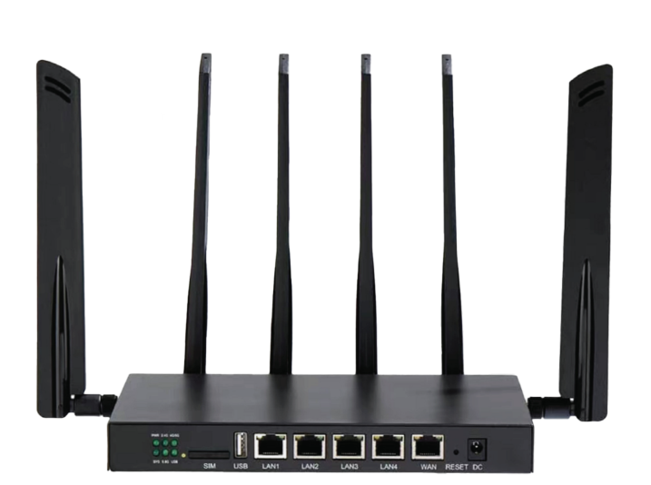
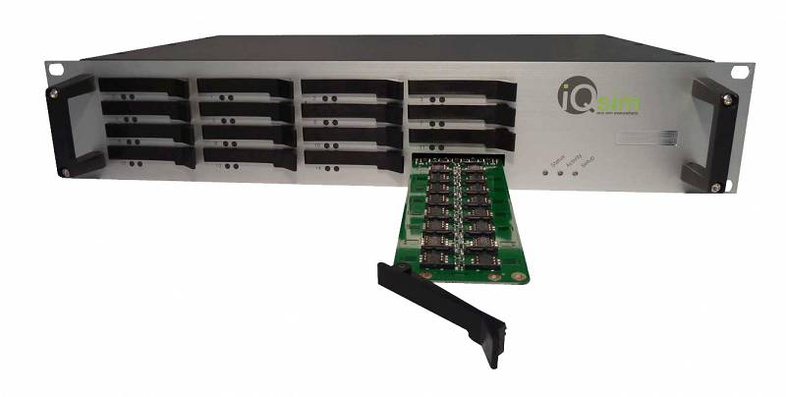
Mission-Ready Connectivity
NetLink Router
Revolutionary dynamic allocation
of 5G internet
SIM Racks
Swap local SIM cards that power
VSIM devices
Assured Connectivity | Global Anywhere Access | Cost Savings | Anonymity | Robust Virtual Support

Slide 5
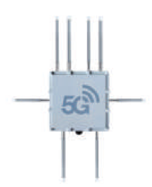
Saving Lives. In Any Environment.
Hardware | Software | Service
NetLink Fortress All-Weather Outdoor Router NetLink Go Portable MiFi Device | NetLink Command Remote Cloud Management Iron Suite Virtual SIM Control Bulk SMS Low-Cost Stakeholder Engagement | Data Failover Plan Multi-Carrier Backup Internet Primary Internet Plan Multi-Carrier Internet

Slide 6
Case Study 1:
Enhanced Connectivity in Life-Threatening Operations
Challenge
An undisclosed government agency tasked with conducting critical operations in enemy territory faced significant challenges in maintaining reliable communication networks.
The agency's operatives often operated in remote and hostile environments where communication was not only difficult but also life-threatening.

Slide 7
Case Study 1:
Enhanced Connectivity in Life-Threatening Operations
Solution
We provided the agency with advanced SIM racks and carrier-agnostic routers, enabling seamless and secure communication in the most challenging conditions.
SIM racks allowed operatives to easily swap virtual SIM cards, ensuring continuous connectivity even in the most remote locations.
Carrier-agnostic routers provided reliable internet access, allowing operatives to communicate with command centers and coordinate operations effectively.

Slide 8
Case Study 1:
Enhanced Connectivity in Life-Threatening Operations
Impact
Saved Lives
The reliable communication provided by our solutions helped operatives avoid life-threatening situations and make informed decisions in hostile environments.
Mission Success
The enhanced connectivity contributed to the success of critical operations, enabling the agency to achieve its objectives in enemy territory.
Operational Efficiency
Seamless communication improved efficiency, allowing operatives to focus on their mission without worrying about communication issues.

Slide 9
Case Study 2:
Private Voice Communication Network for Defense
Challenge
A defense agency required a private voice communication network to ensure secure and reliable communication across its operations.
The network needed to cover 49 sites, including remote and sensitive locations, while maintaining high levels of security and privacy.

Slide 10
Case Study 2:
Private Voice Communication Network for Defense
Solution
We deployed a private voice communication network, incorporating gateways at 49 sites to facilitate seamless communication.
The network utilized advanced encryption protocols to ensure the security and privacy of communications, meeting the stringent requirements of the defense agency.

Slide 11
Case Study 2:
Private Voice Communication Network for Defense
Impact
Enhanced Security
The private voice communication network ensured the security and privacy of communications, protecting sensitive information from unauthorized access.
Improved Coordination
The network facilitated seamless communication between different sites, improving coordination and collaboration among defense personnel.
Operational Efficiency
Our network lowered costs and improved the organization’s communication infrastructure with reliable communication.

Slide 12
Case Study 3:
Voice and SMS Solutions for International Forces
Challenge
Forces deployed in Africa required reliable voice and SMS communications to facilitate private communication among personnel.
The solutions needed to have remote SIM capability to ensure connectivity in remote and challenging environments.

Slide 13
Case Study 3:
Voice and SMS Solutions for International Forces
Solution
We provided voice and SMS solutions with remote SIM capability, enabling personnel to communicate securely and privately.
The solutions included advanced encryption protocols to ensure the security of communications, even in hostile environments.

Slide 14
Case Study 3:
Voice and SMS Solutions for International Forces
Impact
Secure Communication
Our solutions ensured the security and privacy of communications, enabling forces to communicate securely in hostile environments.
Enhanced Coordination
The voice and SMS solutions improved coordination and situational awareness among personnel, enhancing their effectiveness in the field.
Connectivity in Remote Areas
The remote SIM capability of the solutions ensured connectivity in remote and challenging environments, allowing forces to stay connected regardless of their location.

Slide 15
Capabilities
Capability | Benefits
Multi-Carrier Internet (Hardware + Software) | Increased coverage for uninterrupted operations
Internet Backup | Ensures continuity of operations in case of primary internet failure
Data Roaming | Enhanced logistics support in remote areas
Call Termination | Cost-effective calls for global communications
Bulk SMS | Efficient communication with large groups
M2M/IoT Networks | Automation and data collection between machines and devices
Card Swap | Convenient and secure SIM card replacement options
Virtual SIM network | Stay anonymous and manage end device connectivity remotely

Slide 16
Differentiators
1/5 - Assured Connectivity
Intelligent connection to the best available cellular carrier, not limited to a specific carrier
Automatic switch to another network when one goes down
Local connectivity offers priority on networks for better connectivity and faster speeds around the world
Optional redundant satellite connectivity
Static IP preserves your recognized IP address across carriers for consistent connectivity without reconfiguration (e.g. security cameras)
Multi-SIM aggregation, combining multiple carriers to generate faster speeds in low-speed areas

Slide 17
Differentiators
2/5 - Global Anywhere Access
Auto roaming gives you the best network in 200+ countries
No need to purchase new SIM cards in new countries, with the option to provide your own SIMs
Wifi router gives you local connection anywhere so you don’t need to look for a nearby internet source
Manage users, IP addresses, VPNs and activate/suspend service remotely
Assets can remotely communicate over data, voice, and text, simulating presence in another country
Perfect for deployments such as remote sensing, first response and logistics

Slide 18
Differentiators
3/5 - Cost Savings
Reduce downtime to almost zero, saving Forbes’ estimate of $5,600 per minute during an outage
Pay for 1 service plan instead of 3+ for multiple networks within the country
Access multiple countries and multiple networks within each country using 1 SIM card
Remote VPN control saves you from having to send technicians onsite at $150-$500+ per visit, allowing valuable engineering assets to remotely configure edge devices without requiring travel
Leverage less-expensive personnel to operate the easy-to-use systems
Pay pennies instead of dollars for each gigabyte of data
Bulk SMS discounted rates

Slide 19
Differentiators
4/5 - Anonymity
Dynamic SIM card swapping
Non-attributable SIM cards
Routine VSIM swap
VPN secure connections
Mobile data proxies allow you to remotely access data via any node in your deployment
Capability to dynamically swap the digital fingerprint of routers, including the IMEI, subject to jurisdictional compliance

Slide 20
Differentiators
5/5 - Robust Virtual Support
Simple plug-and-play deployment
24/7 tech support with engineers on staff
End-to-end network support - no more being bounced between router vendors and service carriers
Complete onboarding and training with optional onsite training available

Slide 21
Implementation

Slide 22
Implementation
Part 1 - Deployment
Conduct a thorough assessment of your current communication infrastructure and identify areas of improvement.
Deploy Veren’s 5G carrier-agnostic routers to automatically switch to another cellular network when one goes down.
Implement local connectivity options to provide priority on networks for better connectivity and faster speeds.

Slide 23
Implementation
Part 2 - Integration
Integrate the virtual SIM network into the communication infrastructure to simplify the management of local SIM cards.
Train government personnel on the use of the new communication technologies and security features.
Monitor and evaluate the performance of the new communication infrastructure to ensure security and operational efficiency.

Slide 24
Thank You
Veren Industries, LLC 4711 12th Avenue Brooklyn, NY 11219 www.verenindustries.com | David Shak Sales Representative (646) 434-9852 david.shak@verenindustries.com

