Slide 1
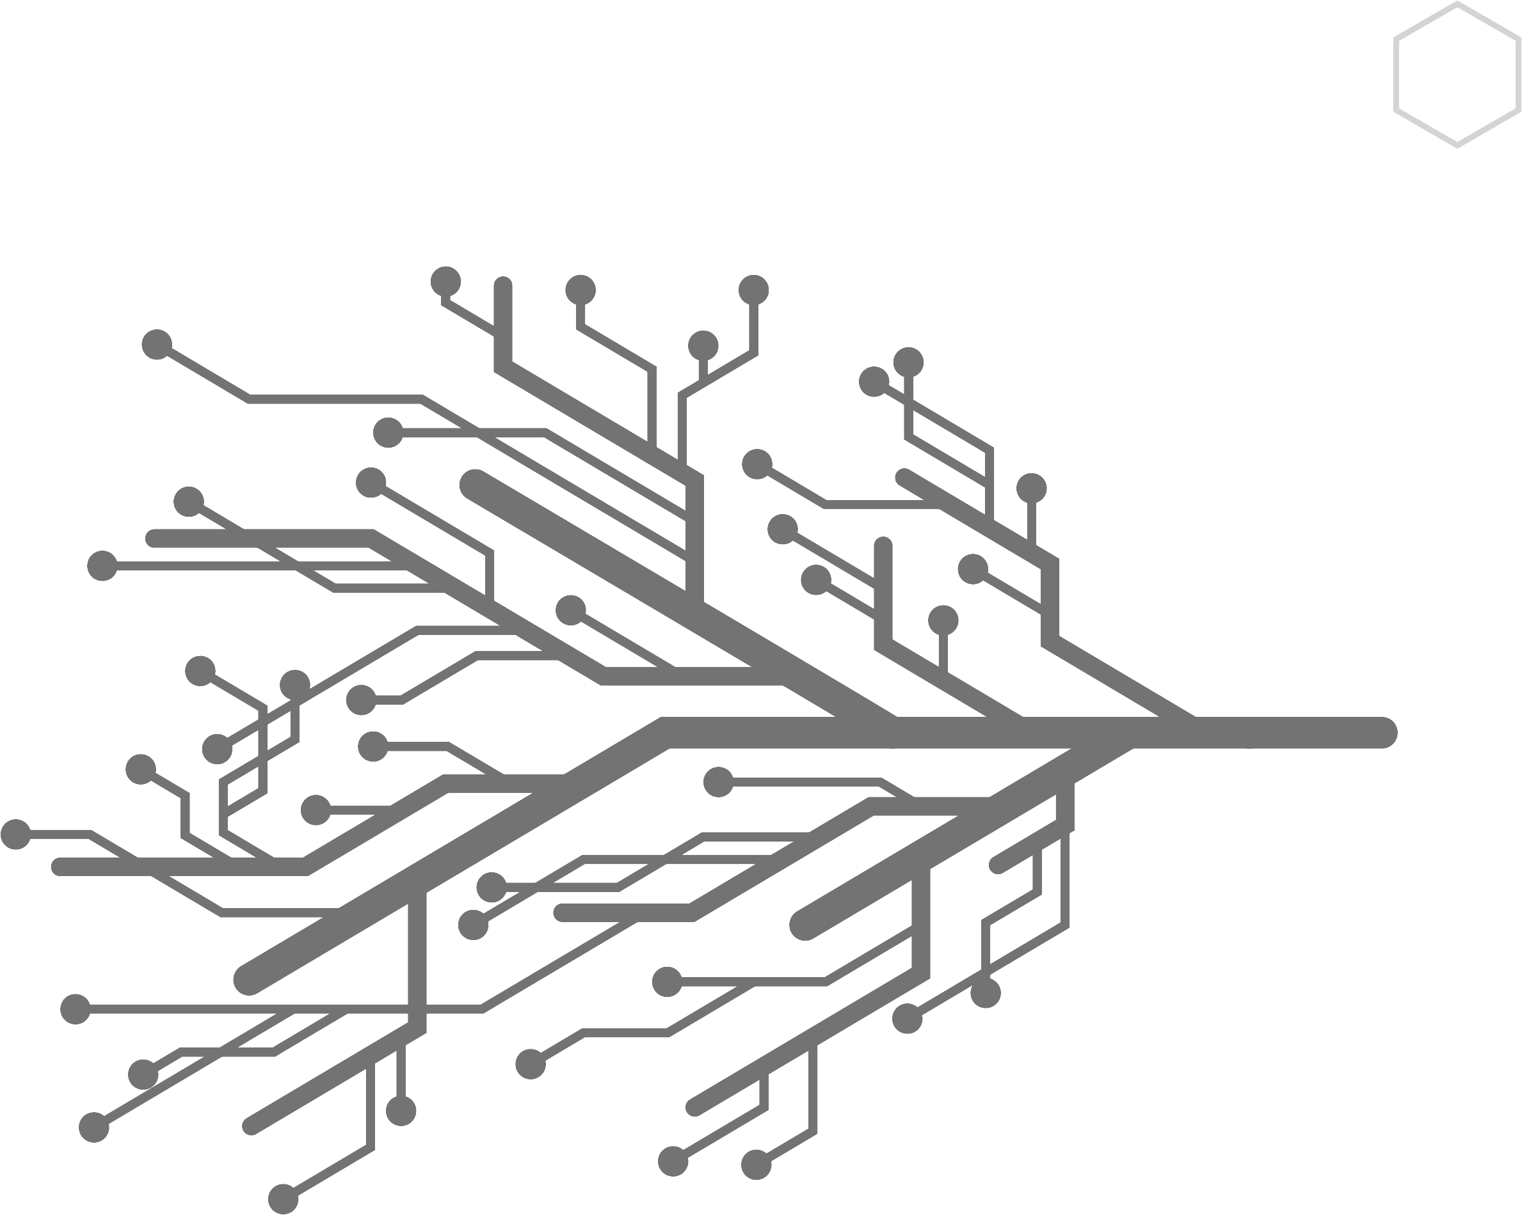

Slide 2
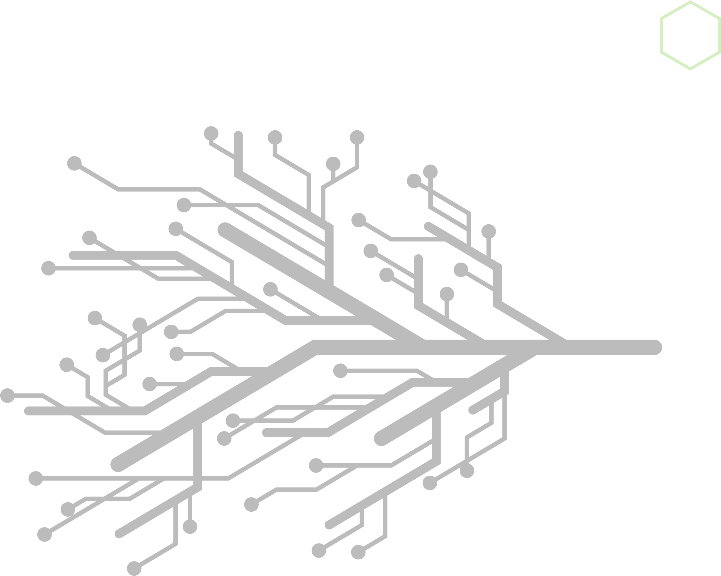
MantisNet Corporate Overview
Company
Technology
Founded in 2010
Headquarters – Vienna, VA
Self Funded
Cloud-native software company-Telco focused
Kevin Fecher – President/Co-founder
25+ years government sales and marketing
Elliott Starin – CTO/Co-Founder
25+ years SIGINT Engineer (NSA/CIA)
Mike Fecher – Director Customer Success
Verizon Account Manager
5+ years sales to IC (NGA) NetApp
Tawon CVF (Containerized Visibility Fabric)
eBPF based agents for cloud visibility
Cloud-native
5G focused
Enterprise security and performance applications
Complete packet capture
API observability, message focused
Low resource utilization
© 2024 Mantis Networks

Slide 3
Cloud Native Visibility Challenges
The challenges of cloud native visibility in a distributed computing environment are many: everything is hidden and ephemeral
Traditional methods of establishing visibility are no longer enough:
x
Physical TAPs and Packet Brokers: no central tapping point, lack of physical access
x
SPAN and Mirror Ports: lack of availability, resource intensive
x
vTAPS and container TAPS: resource intensive, encryption blindspots, large footprint
x
Vendor provided vTAPS: resource intensive, expense, visibility into own offering only, no infrastructure visibility, no vendor independent audit chain
© 2024 Mantis Networks

Slide 4
Cloud Native Telco Visibility Challenges
Protocols and protocol stacks are legacy and unique:
SBI, non-SBI (PFCP, NAS, NGAP, eCPRI, CUPS…control/user plane seperation)
Domain knowledge is multi-domain and historical:
Legacy generations of physical infrastructure
Need for monitoring across multiple domains: infrastructure, application (network function), security, operating system, orchestration
Distributed computing on steroids:
Geographic coverage and user experience demands require vast, scalable, high connectivity networks
© 2024 Mantis Networks

Slide 5
DRUID
CISCO
NOKIA
NRF
AF
MAVENIR
NSSF
PCF
AMF
SMF
UDM
SCP
AUSF
OCEUS
HPE
ORACLE
NEC
UPF
Altiostar
ERICSSON
SMSF
SAMSUNG
UDR
Cloud-native Telco environments are disaggregated and composable by definition
How do we design a vendor-agnostic visibility fabric which is disaggregated and composable?
© 2024 Mantis Networks

Slide 6
eBPF (Extended Berkeley Packet Filter)
pod
pod
pod
NODE >
containers
containers
containers
KERNEL
eBPF programs
eBPF is a native Linux capability that allows programs to run at the kernel level
These programs are not kernel modules- they run in a quarantined/hardened virtual sandbox within the kernel
eBPF programs have full visibility into all data moving within the node, across all pods and containers
eBPF programs are performant- they are designed for efficiency and are executed by the kernel’s eBPF virtual machine, which is optimized for speed
© 2024 Mantis Networks

Slide 7
5G Observability Use Cases
eBPF enables the following types of use cases:
service assurance
security assurance
infrastructure assurance
resource utilization
energy profiling
RCA (Root Cause Analysis)/trouble shooting
control plane and user plane monitoring
© 2024 Mantis Networks

Slide 8
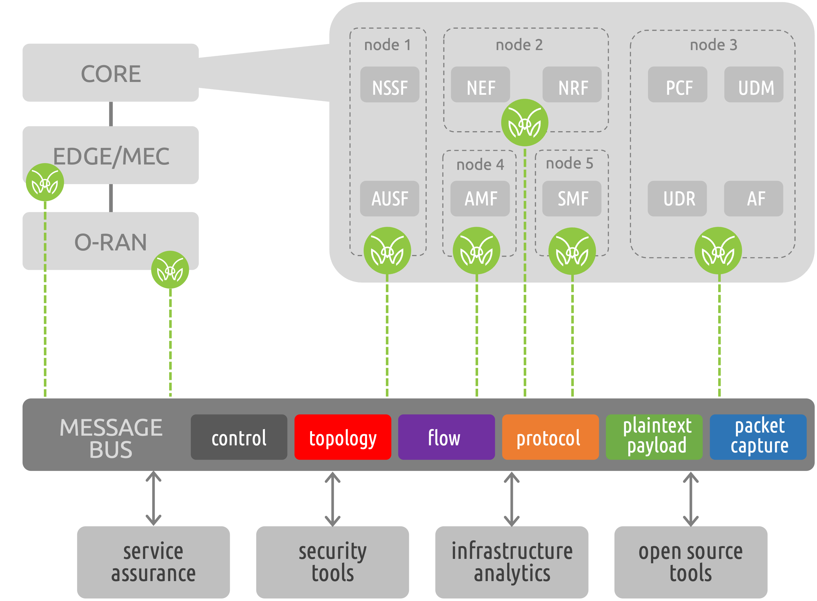
Tawon Containerized Visibility Fabric (CVF)
The CVF consists of lightweight, containerized agents that can be deployed anywhere from the core to the edge (via Kubernetes)
CVF Agents can capture and generate a variety of datasets from network traffic and internal container communications:
raw packets
dynamic topology
plaintext records of encrypted data (including TLS 1.3)
protocol specific metadata (eCPRI, SBI, DNS, HTTP, etc.)
advanced flow (CNFlow)
Analytics/third party applications can instruct any CVF agent to generate only the specific data needed for analysis
All CVF data is streamed continuously in real-time into a message bus for immediate consumption (synchronous or asynchronous)
© 2024 Mantis Networks

Slide 9
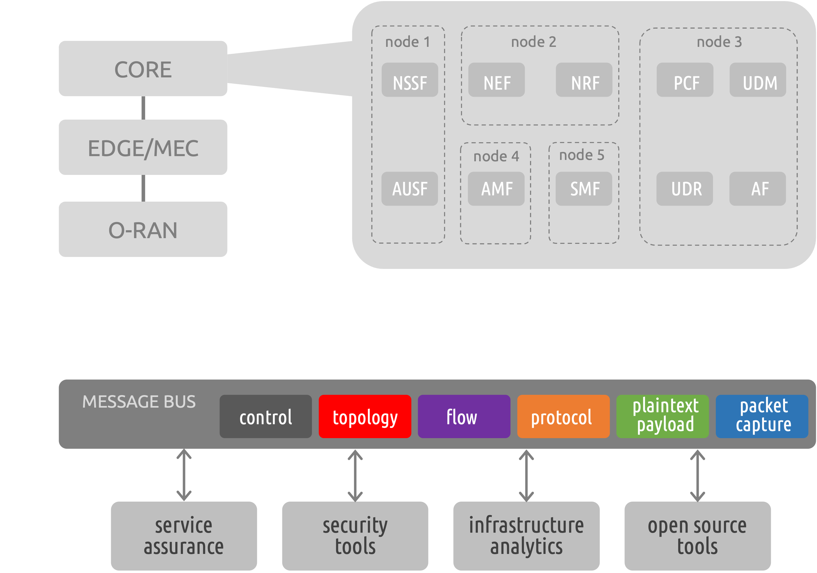
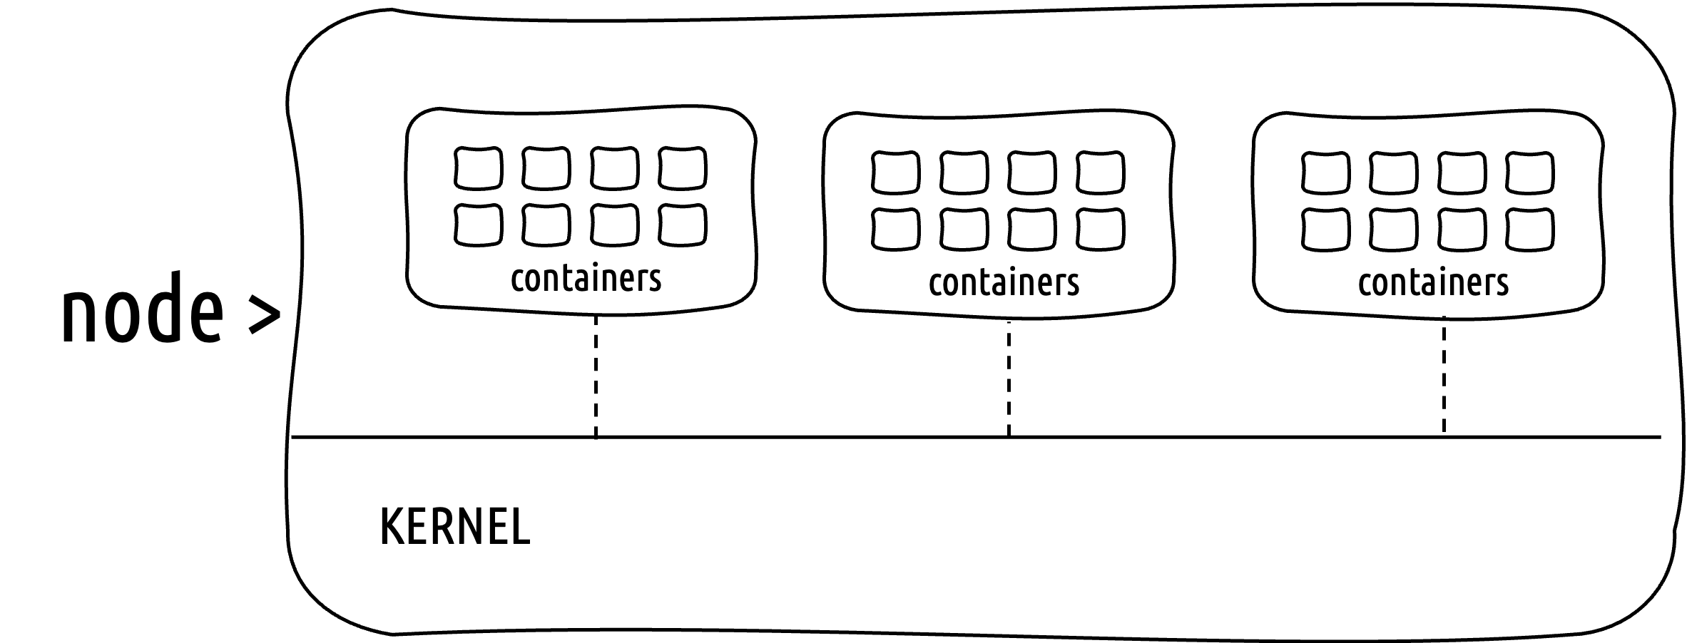
agents >
agent >
cluster
agent
controller/ operator
topology
flow
protocol
plaintext payload
controller/operator
packet capture
© 2024 Mantis Networks

Slide 10
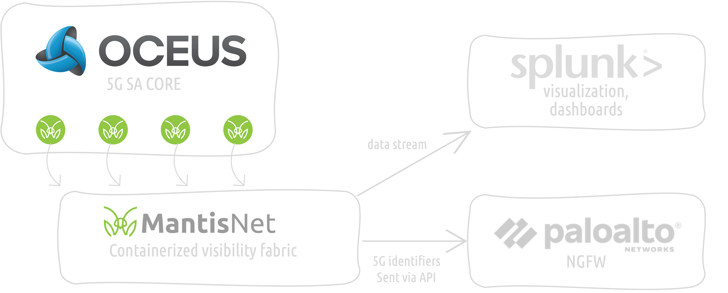
Hybrid 5G Integration for Security Assurance
Use cases being addressed:
-unauthorized device
-replay attack
-fuzzing attack
-flooding attack
-rogue gNB
-slice attack
© 2024 Mantis Networks

Slide 11
TL;DR
© 2024 Mantis Networks

Slide 12
Observability Domains
Application Performance Monitoring (APM)
Database and Storage Monitoring
Security and Compliance Monitoring
User Experience (UX) Monitoring
Environment and Configuration Monitoring
Container and Orchestration Monitoring
Service Discovery and Artifactory Monitoring
Load Balancer/Proxy Monitoring
Network Policy and Firewall Monitoring
Kernel Scheduler and Memory Monitoring
© 2024 Mantis Networks

Slide 13
Germane Use Cases
Transport Assurance (Access, Aggregation, Edge, Core)
5G-SA Core, MEC, RAN: SBI, NGAP, PFCP, Service API’s, eCPRI, F1-AP
5G CyberSecurity + (SIEM Integration) …
NG- Intelligent Service Assurance
Digital Experience Monitoring
Correlation of User-Plane to 5G Identifiers
RF Spectral Awareness
Network Slice QoS/SLA Auditing
AI/ML - Closed-Loop, Self Healing & Optimizing Network Automation
Infrastructure Assurance
© 2024 Mantis Networks

Slide 14
thank you
www.mantisnet.com
Mike Fecher | 571.283.1967 | mike@mantisnet.com
© 2024 Mantis Networks

