Slide 1
Zero Trust for the
Real World
DON’T JUST DETECT ATTACKS — STOP THEM.
Presentor: Joseph Riddle (JoJo)
Senior Federal Solution Engineer
jriddle@xagegov.com
Sales Engagement: Kimberly Bandler
Regional Director- Defense Accounts
kbandler@xagegov.com
Notes:
Thanks for taking the time to meet with me and learn more about how Xage can help you modernize your cybersecurity program for Operations across OT, IT, and Cloud.

Slide 2
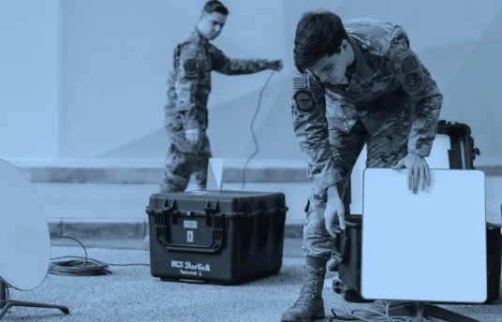
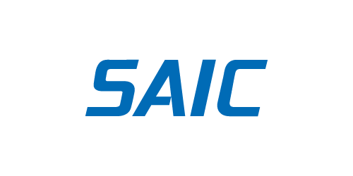
Practical Zero Trust Approaches for Operations
Xage delivers multi-layer identity and access management, secure remote access, and zero trust data exchange across IT, OT, and the cloud; to include support to operations in DDIL environments.
Mission Critical Infrastructure
(OT, ICS/SCADA)
Mission Sensors
DDIL Environments
Garrison Networks
Shared Mission Networks
Customers & Partners
Press Release
Awards & Recognition
CPS Protection Platforms and ZTNA Market Guides 2023
IoT Breakthrough Award 2023
10 Hottest IoT Startups of 2023
SINET16 Innovator Award Winner 2022
https://spacenews.com/cybersecurity-firm-xage-gets-17-million-contract-to-protect-space-force-networks/
Notes:
Key Talking Points:
Xage has innovated to bring Zero Trust solutions & services to Operational Enterprises across several sectors like energy, defense, utilities, manufacturing, and transportation.
Xage delivers identity-based access management, remote access, and data security through a highly resilient, highly available cybersecurity mesh.
Our capabilities bring preventive capabilities to critical infrastructure protection which has been lacking so far.
Our sample customers include Kinder Morgan, Gerdau, US Space Force, and PETRONAS; our partners include SAIC, 1898 (Burns & McDonnell), and Armis.
We have been recognized by Gartner as a key vendor in Cyber Physical Systems Protection Platforms, OT Security, Zero Trust Network Access (ZTNA) Market Guides; we have recently received several industry awards – e.g., SINET16 Innovator award which is voted by CISOs across several industries.

Slide 3
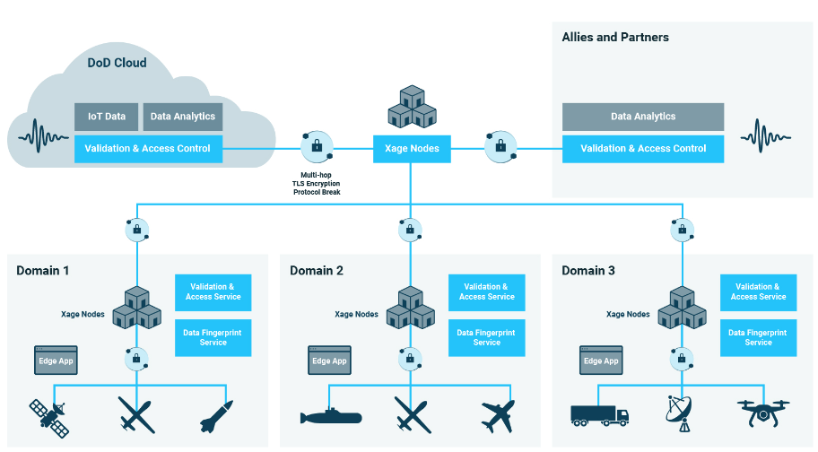
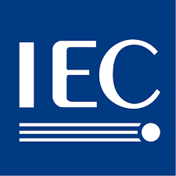
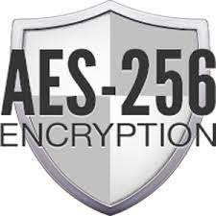
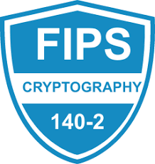
ZT for the Distributed Edge – Decentralized Mesh Platform
Identity-based Access Management, ZT Remote Access and ZT Data Security & Exchange
Software defined distributed mesh architecture
On-prem/BYOL ZT solution for IT, OT, and Cloud (multi-cloud)
Lightweight VM or container; resides on RedHat (STIG Compliant)
No Agents, no VPN client, no changes to devices; deployed on current architecture (no “rip & replace”)
Single TAA compliant hardware compliance; only for key use cases:
Machine to machine segmentation & control
Access control to IT/OT devices (when needed)
Fails open for use in mission critical operations
Centralized management, decentralized execution; can enforce/ extend policy in disconnected DDIL-type (Denied, Disrupted, Intermittent, and Limited) environments
Simplistic ZT fabric; eliminate VPN, minimize firewall configs, policy management does not require deep networking experience
20+ patents; blockchain-like ledger & Sharmir’s Secret Sharing
Highly available, highly resilient cyber security mesh
Built-In Capabilities
Certifications
IEC 62443-4-1
Jan 2023
Certified
Sep 2023

Slide 4
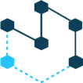
Cybersecurity with Zero Trust; Modernize without Compromise:
A modern identify-centric approach must enable:
Identity-based Access Control
User
Least Privilege: Just Enough Access, Just in Time
App
Identity
Machine
User-to-Machine and Machine-to-Machine Policy Enforcement
Data
Central Management, Distributed Enforcement
Deliver Cyber Hardening without:
Holes in Firewall
Network
Changes
Traditional VPN & Jump Hosts
Shared Credentials
Rip and Replace
Agents
Reduces complexity, accelerates cyber-hardening, protects existing legacy systems with no rip and replace; spans IT, OT, and cloud (multi-/hybrid cloud) to include operations in DDIL environments.
Notes:
Key Talking Points:
To tackle some of the challenges we discussed earlier, one of the first steps is to modernize your access management as part of your Zero Trust journey.
Identity is at the center of a zero trust strategy. Xage enables you to bring together identities of user, machine, app, and data in your environment to create and implement dynamic policies as opposed to being stuck with static & firewalls rules with a perimeter-based approach.
Zero trust principles are the key to enabling granular control of all access and every interaction throughout a modern organization with numerous sites.
A key part of this strategy is to reduce your attack surface and enact least privilege without slowing collaboration.
We enable you to embrace AN IDENTITY-CENTRIC approach to modernize industrial cybersecurity WITHOUT DISRUPTING OPERATIONS

Slide 5
Eliminate Disjointed Solutions for Operations
Xage Fabric Capabilities
Zero Trust Remote Access
Identity Based Access Management
Zero Trust Data Exchange
Deliver:
Identity-based access control per device & app
Multi-user session collaboration
Complete audit of all remote-access activity to include recording
Enforce least-privilege principles
Enable simple, just in time/just enough secure access
User-to-machine, user-to-application, and machine-to-machine control
Multifactor and multilayer authentication
Role-based access control per device & app
Privileged access management
Credential rotation
Identity-based segmentation
Secure cross-domain/cross-enclave data transfer with malware scanning
Granular validation and access control
Hash, sign, and encrypt data at source for any application, device, or protocol
Define policy centrally, enforce locally at sites
Assure data authenticity, integrity, and privacy across distributed sites/user sets
Eliminate:
OT SRA
VPN + Jump Hosts
ZTNA
VDI
Microsegmentation
PAM
Complex Firewall Rules
Switch ACLs
Data Diodes
Unidirectional Gateways
Network Data Encryptors
Notes:
Key Discussion Points:
Xage is able to replace the functionality of products like VPNs & Jump Hosts, IT-centric ZTNA, PAM, and Data Diodes and provide better cybersecurity approach for Operations.
If desired we could orchestrate across existing security solutions for your OT environment and replace some of these tools over a period of time. This will help to reduce complexity and improve your overall ROI.
A fragmented, disjointed security toolset costs your team time, energy, and money, and leaves gaps in security that attackers can exploit. By reducing the number of tools you have to buy and manage, you reduce operational friction while increasing security.

Slide 6
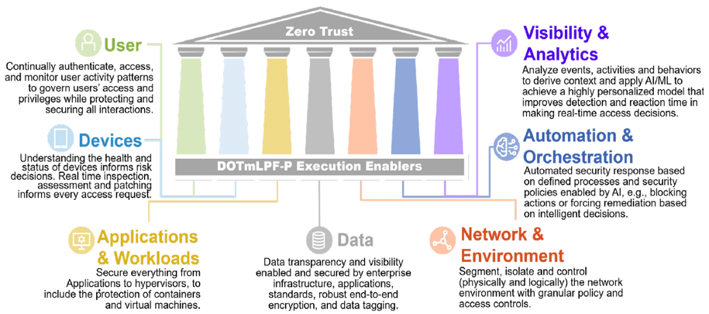
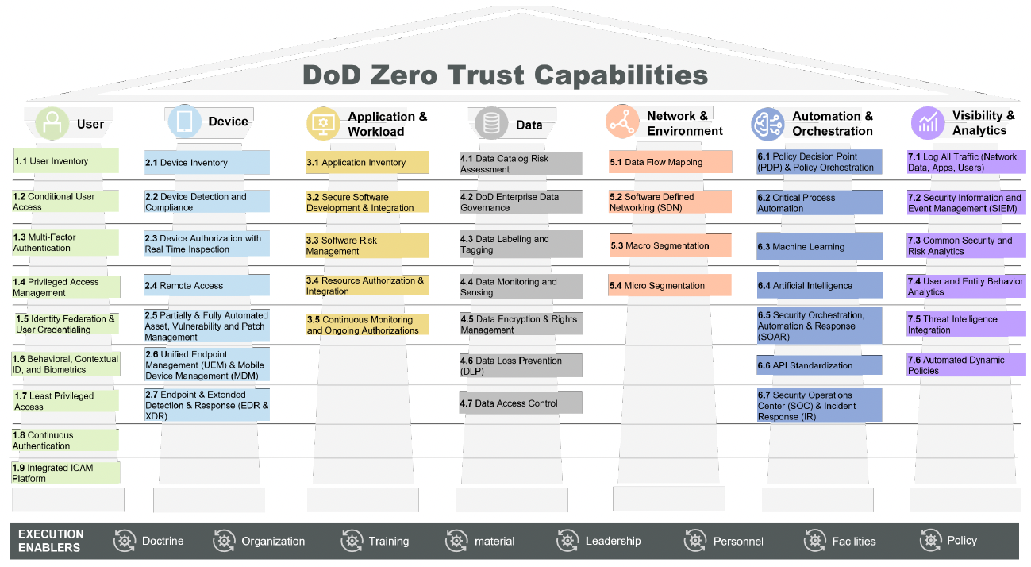
DoD CIO ZT Strategy – Oct 2022
DoD CIO ZT Strategy – Oct 2022
https://dodcio.defense.gov/Portals/0/Documents/Library/DoD-ZTStrategy.pdf
Xage Fabric Features
Cyber-hardening with distributed policy enforcement
Zero Trust Secure Remote Access
Zero Trust Data Protection & Sharing Ecosystem
Providing Zero Trust for both Enterprise IT and Cyber Physical Systems Today!
= Directly Supports
= Indirectly Supports/Integration

Slide 7
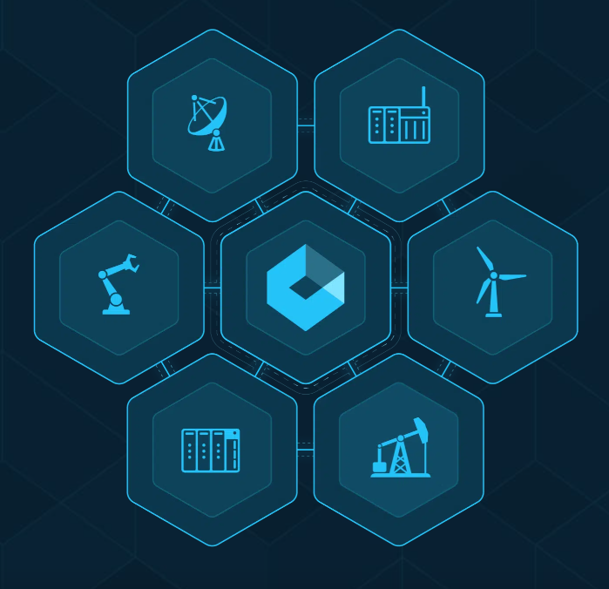
Summary and Wrap-Up
ZERO TRUST FOR THE REAL WORLD
The Xage Fabric delivers identity-based access management and data security.
Protect operations, critical infrastructure & converged IT-OT-Cloud with Xage:
Mission continuity - Reduce attack surface, protect mission critical systems, applications, and data
Cost & complexity reduction - Fewer tools, simplified workflow, OT vendor agnostic
Undisruptive - No changes to existing infrastructure
Secure the digital transformation of operations across IT-OT-Cloud
Increase productivity and enable multi-party cooperation
Meet and exceed government regulations

