Slide 1
CPIKMS Demo & Discussion
E-Cyber 7 Technologies, LLC
March 2024

Slide 2
CPIKMS Cryptographic Product Inventory Knowledge Management System
A first of its kind, real time security system that empowers you to track information about your crypto products, in order to proactively mitigate risk. CPIKMS enables secure communications between organizations, which are designed to support collaborative efforts towards making existing crypto products more resilient against compromise.
CPIKMS is an enterprise customizable SaaS developed by E Cyber7 that utilizes a mix of emerging technologies to automate and streamline existing processes while controlling and monitoring user access and activity. This innovative, interactive AI-enabled Governance, Risk, and Compliance (GRC) platform leverages analytics, workflow automation and AI to visualize, and analyze data, generate reports, and automate complex workflows involving multiple stakeholders and data sources through Content/Knowledge Management, Workflow Automation, Artificial Intelligence/Machine Learning, Data Analytics, and Collaboration features.

Slide 3
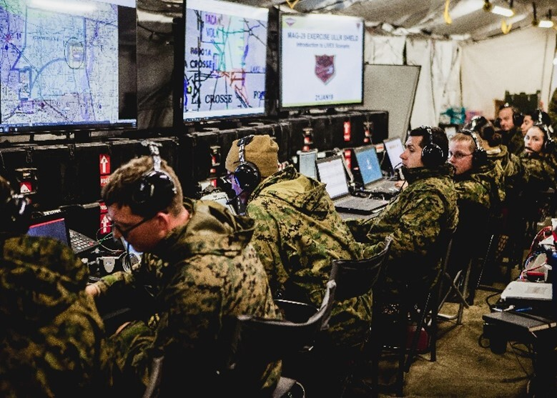
Why CPIKMS?
Cryptographic Modernization (CM) is a Secretary of Defense (SECDEF) initiative, governed by DoD Chief Information Office (DoD CIO), led by the National Security Agency (NSA), and implemented by the entire Federal Government—Combatant Commands, Services, and Agencies.
SECDEF currently promulgates the CJCSN-6510 CM guidance to all the COCOMs/Services/Agency’s systems to mandate CM timelines and technical requirements. The ability to correlate CM products to missions via the overarching weapon system not only facilitates warfighter prioritization by platform but also enables threat assessment by mission and platform as well. In order to effectively and efficiently navigate the challenges of CM which will impact an estimate of over 90% of US encryption capabilities, the government must view this initiative holistically and in full partnership with the MILDEPs and COCOMs to minimize impact to operational readiness throughout the CM campaign. Adding “CPIKMS” enables all warfighters and Federal employees with SIPRNET access to see the deployment of critical encryption products across the spectrum of platforms, systems, and networks. CPIKMS is crucial to quantifying CM2 requirements and directly supports the SECDEF Digital Modernization Strategy Goal-3: Evolve cybersecurity to a more resilient posture using Artificial Intelligence and Machine Learning technologies.

Slide 4
A U.S. aircraft has been shot down in a hostile territory. Which crypto products were on board of that vessel (aircraft, tank, ship, submarine, etc.)?

Slide 5
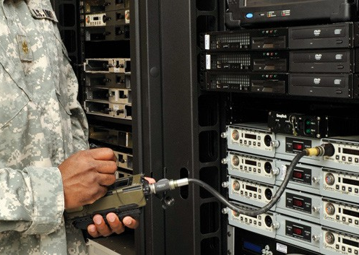
SECDEF has declared a cryptographic algorithm as obsolete so no more key shall be generated after a certain date. What is the impact across critical platforms, systems and networks supporting the various MILDEP missions? What are the resource needs to replace this encryption capability in fielded products to enable continuity of operations?

Slide 6
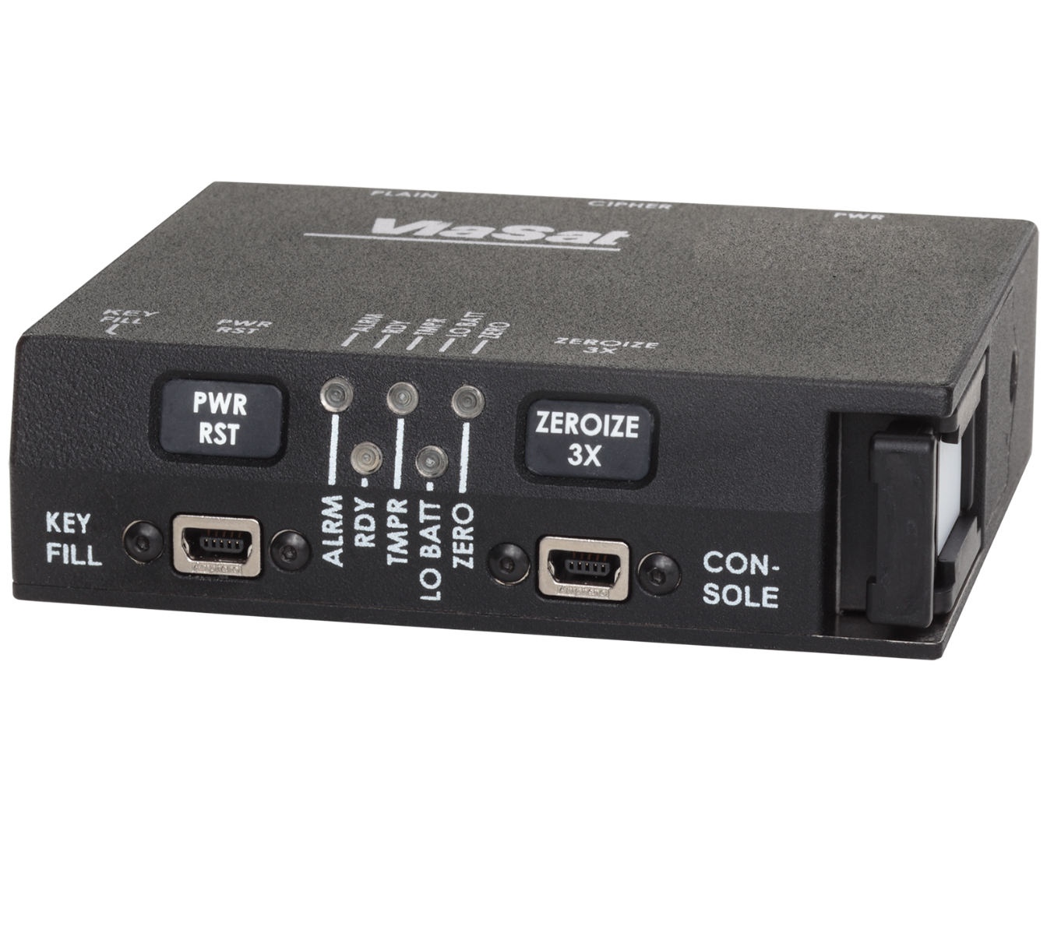
The Intelligence Community (IC) has reported that a certain encryption algorithm has been broken by a U.S. adversary. How many crypto products are affected? How many MILDEP platforms, systems, and networks contain this product? What alternative cryptographic algorithms or crypto products are available?

Slide 7
Our Platform CPIKMS
CPIKMS
CPIKMS is an open systems architecture AI enabled platform that allows users to collaborate, track, assess vulnerabilities and prioritize cryptographic modernization efforts. CPIKMS includes self-service access tools that enable users to collect the relevant data on their crypto product inventory, vulnerabilities, and security features, without compromising the sensitive data associated with the products and collaboratively engage with users across the government. CPIKMS AI/ML technology gives you actionable insights in seconds, not days or weeks.
As a cloud-based service that provides access to information and tools used in all phases of the secure product lifecycle management (SPLM) — Production/Deployment, Development/Engineering, Use/Exercise/Training, Analysis/Testing. CPIKMS is a completely web-based solution with a user-friendly interface that is available now.
Notes:
Open systems architecture is a system design approach which aims to produce systems that are inherently interoperable and connectable without recourse to retrofit and redesign.

Slide 8
CPIKMS Core Functionalities
Cryptographic Product Search
Powerful AI/ML powered search of cryptographic products and all of their related attributes in an easy to use platform
Discussions
Ability for system end users to collaborate and knowledge share securely within the tool using our discussion board functionality
Data Analytics
Automated and ad-hoc reporting capabilities that provide mission managers with the most up to date data at their fingertips in tailored dashboards
Knowledge Management
Ability to search through crypto product inventory, vendors, articles, policies and relevant data from the web via one single module within CPIKMS providing a summarized view of information related to a user’s query
Certification Tracking
Provides Program and Mission Managers the ability to quickly see the status of their certifications through our workflow module
Cryptographic Product Management
Automated tools which allow crypto product managers the ability to manage and maintain their inventory of crypto products
Algorithm Management
The Ability to create, update and maintain all crypto algorithms and their related attributes and association with crypto products
Notifications
Provides system administrators and Agency Leadership with the ability to provide system end users with useful information upon log-in related to crypto products or any policy changes which affect the current crypto product inventory

Slide 9
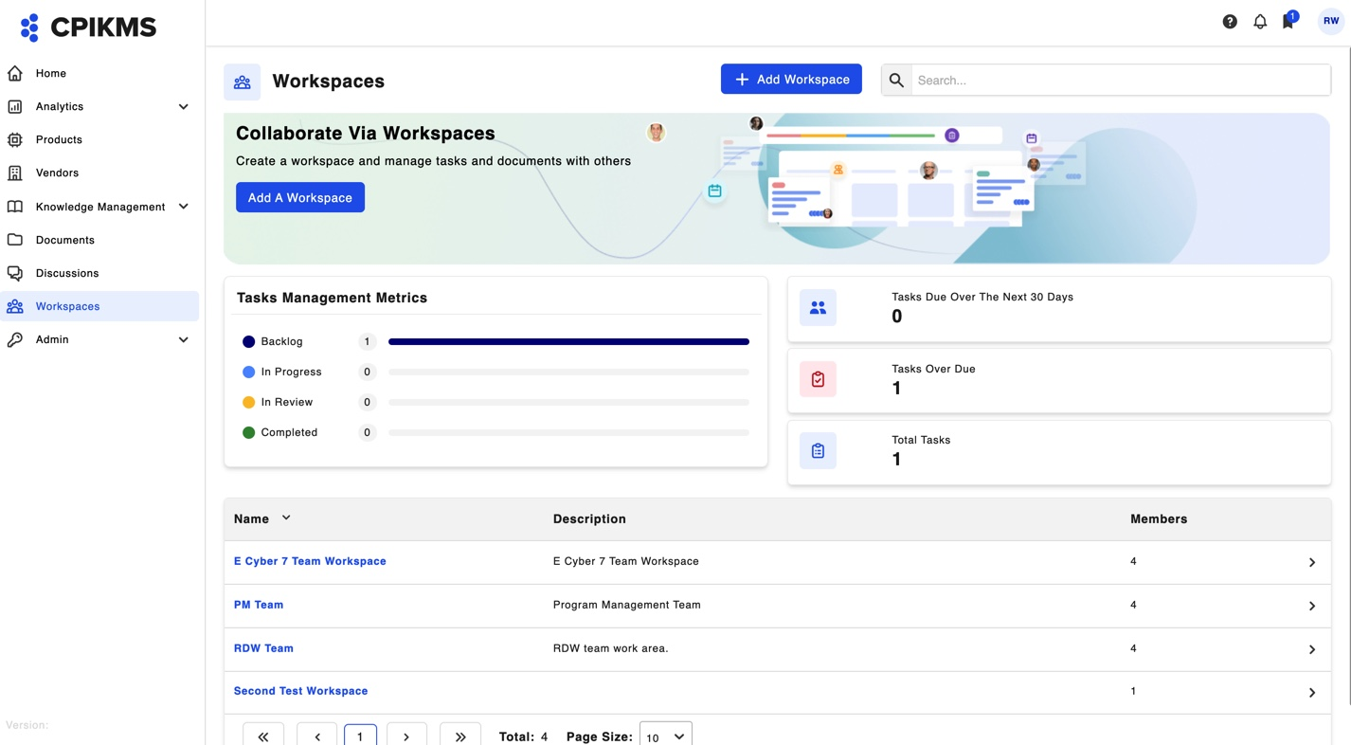
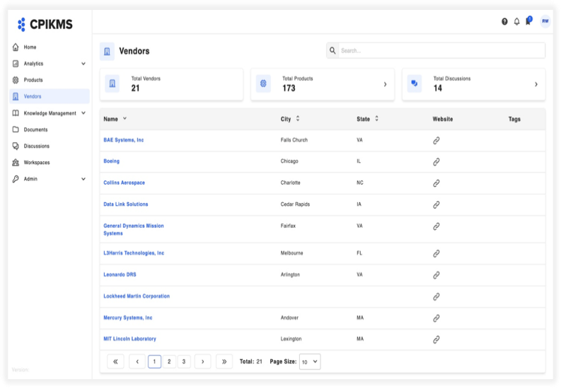
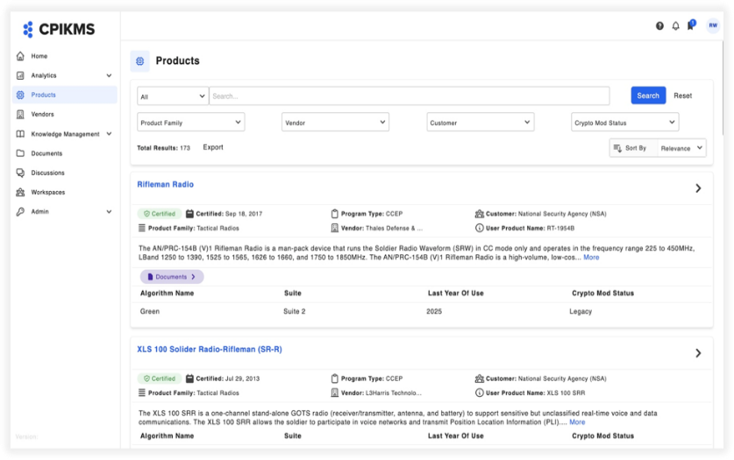
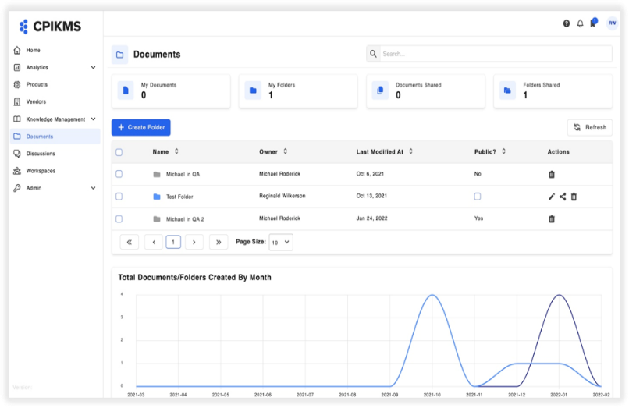
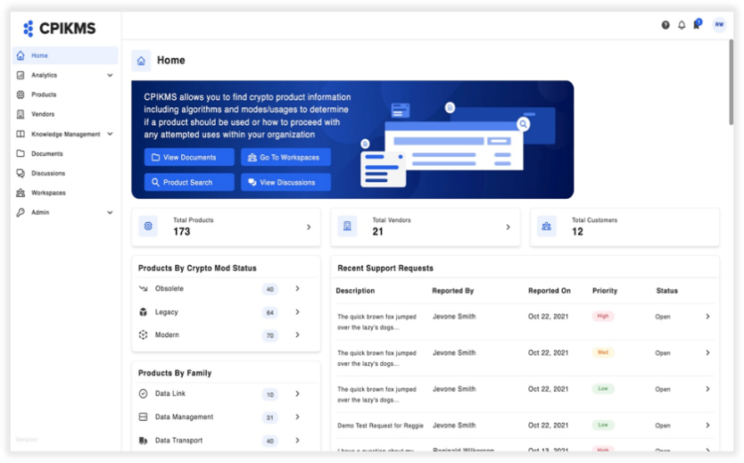
CPIKMS Solution Highlights
Program Management Portal
Cryptographic Inventory
Advanced Search
Standardized data structure of product information
Track products,
algorithms and documents
Advanced search features
Real-time consolidated
view of crypto products
Intelligent search
of real-time data
Analytics/reports at your fingertips
Notes:
** How does image need to be marked? Should there be a note that the image data is fictitious?
Is the copyright date 2020 and not 2022?

Slide 10
CPIKMS with CMMM Output
CPIKMS with Crypto Mission Management Module (CMMM) provides a Platform focused on system level tracking and decomposition for identified missions and platforms across the MILDEPs and COCOMs. This module will allow users to select mission sets (Link-16, Blue Force Tracking, Global Positioning, etc.) or platforms (F-22, F-35, E-3, Black Hawk, etc.) and combat systems (Patriot Missile Systems, Ballistic Missile Defense Systems, BICES, etc.) for decomposition. A selected system will automatically show a list of Encryption Products integral to the system. Follow-on selection of any listed encryption product will further decompose that product to critical cybersecurity functions and attributes supported by algorithms, specifications, and protocols.

Slide 11
Key Take-Aways
CPIKMS rapidly enables analysis to support holistic enterprise planning
CPIKMS Platform supports COCOMs/Services/Agency planners and decision makers with:
Data analysis for crypto replacement and quantum resilience strategy
Lifecycle modernization and sustainment
Tactical and strategic deployment platform integration planning
Understand impact and risk posture across products and integrated platforms
Quickly determine which individual products are at risk due to quantum computing
Rapidly identify locations and platforms impacted by changes to and products status

Slide 12
Why E Cyber7 We are a highly experience innovation company
. Deep Understanding of the Problem and Mission: CPIKMS provides the framework needed for cryptographic product asset tracking. Unlike routine asset tracking systems, CPIKMS product tracking breaks certified products into cybersecurity functions and characteristics which enable products tracking and risk management in real time.
Our Relationships: E Cyber7’s workforce contains members from the prior NSA Information Assurance Directorate (IAD) now Cyber Security Directorate (CSD) that were involved in the design, development, testing, and certifications of numerous cryptographic products and specifications. Our current and past affiliation with CSD’s requirement to decompose certified products into cryptographic functions and assist in analyzing threat and resiliency in real-time.
Proven ability to Innovate: E Cyber7’s current product capabilities combined with our company's unique cybersecurity experience enables E Cyber7 to leverage external innovations surrounding cloud security, data analytics and role-based access control to deliver a foundational knowledge management tool to meet current and future cryptographic asset tracking and situational awareness requirements.
Over XX Years Crypto Design, Planning, and Integration Experience: Our unique experience enables the Department of Defense leaders to levy broad cryptographic knowledge management objectives onto their perspective contracts without costly delays in ramping up to understand CSD’s processes and products. Our experience positions us to assist in training personnel in the use of CPIKMS and products as it pertains to existing NSA product certification and fielding processes.

Slide 13
E Cyber7’s Security Posture
Our facility has an approved security in-depth plan in place authorized by Defense Counterintelligence and Security Agency (DCSA). Our building is only accessible via pin number or programmed key fob outside of working hours. The facility suite requires a badge and pin for entry, is alarmed, video-surveilled, and has 24/7 locked doors. E Cyber7 also has an approved classified secure area with the capability to store documents up to the Secret level. E Cyber7 has a Top-Secret facility clearance with an approved concept of operations (CONOPS) sanitation procedure to have classified discussions in conference rooms up to the Top-Secret level. Our secure area is Underwriters Laboratory (UL) 2050 certified and alarmed with an approved 30-minute response time. All facility policies and procedures are documented in our EC7 corporate Standard Operating Procedures (SOP) and our facility Standard Practices and Procedures (SPP), which shows our compliance with the 32 CFR Part 117 NISPOM Rule allowing us to operate, handle and safeguard classified information properly.

Slide 14
Questions?

Slide 15
CONTACT
Name
(240) 512-3033
e.fentry@ecyber7.com
https://ecyber7.com

