Slide 1
Only First-Hand Operational Insight Can Ensure Mission Success

Slide 2
Introduction / Agenda
Introductions
Secure Enterprise Engineering
Value proposition
Distant Rook OV-1
DISTANT ROOK Overview Briefing
TRUBOROOK Demo Start
Pawn Shop
CNMF
TACFI
Questions
Unified Platform Program Management Office
Cyber National Mission Forces

Slide 3
Company Overview Key Highlights
Founded in 2005
Woman-Owned Small Business
18 years’ experience in engineering many of the IC’s and DoD’s most critical Cyber Defense and Warfare methodologies, architectures, and systems.
Reputation for timely capability delivery and direct support to mission.
Customers: Air Force Unified Platform PMO, FBI Hybrid Threat Center, NSA, USCYBERCOM J6/J7/J9
Strategic Partnerships: Dell, VMWare, SPLUNK, Recorded Futures, Eclypsium, HII, World Wide Technologies

Slide 4
Value Proposition
What do we do at Secure Enterprise Engineering?
We allow the user to focus on hunting
Simplified deployments (no need for FSR)
Deployments tailored to mission requirements and RMF
Deployments agnostic of hardware
Simplified Deployment Infrastructure
Ability to live update systems while on mission
(both off-line and online options)
RMF Artifact Generation
Training integrated into the system
Deployed in less than 3 Hours
Tiered Deployment for flexibility
Allow us to show you how…..

Slide 5
VALUE PROPOSITION
BEST-OF-BREED CYBER
Oftentimes, Cyber Operations teams prepare their kits with “golden” or static images. These static images are frequently out of date and may have unpatched critical vulnerabilities.
The DISTANT ROOK platform’s “App Store” is continuously maintained and expanded, with a notable focus on offering best-of-breed cybersecurity solutions, analysis, and forensic tools. SEE can rapidly add new applications to the enterprise authoritative repository in as little as 48 hours to meet the ever-changing landscape across the cyber domain

Slide 6
VALUE PROPOSITION
UNIFIED PLATFORM JCWA CONNECTION
Currently, the service components generally use their own authoritative repository or “golden images” for kit provisioning. Maintaining a service-specific authoritative repository or “golden image” is costly and time consuming.
The DISTANT ROOK platform’s “App Store” is JCWA-enabled and paid for by Unified Platform, meaning the individual service components do not have to pay for or manage their own repository. Service-specific requests can be added to the overarching platform, and are then available across the JCWA, reducing redundant efforts and ensuring best-of-breed cyber across the service components and greater DoD / IC.

Slide 7
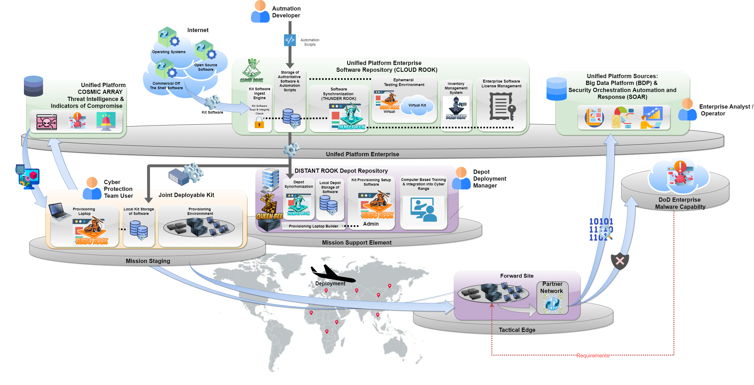
Unified Platform Driven Enterprise Provisioning for Joint Deployable Kits
Notes:
The need for an Enterprise Driven Provisioning solution is a key component to the overall success of the Unified Platform and the implementation of the Joint Cyber Warfighting Architecture (JCWA). This solution will allow for the installation, configuration, and integration of a complete capability on either hardware, virtual or cloud environment providing complete flexibility on the instantiation and deployment of any Unified Platform environment.
The Unified Platform Driven Automated Provisioning solution is being developed here at Secure Enterprise Engineering on a project called DISTANT ROOK. The initial intent of the DISTANT ROOK project is to automate the deployable Hunt Forward Kits used in partner countries across the globe by the Cyber National Mission Forces. As the provisioning capability matures, Cyber Protection Teams across the Military Services will have the ability to quickly and securely provision “kit” solutions to respond to Cyber Defense Missions by selecting the tools and configurations that best align to their objectives. This customization also allows for the integration of the latest JCWA tools, Containers, and techniques to provide a fully integrated solution for our Cyber Warriors.
The DISTANT ROOK project is broken down into 5 major Tasks that will each be represented as part of this demonstration. Each of these 5 tasks provides a major capability for the Unified Platform hosted Enterprise Provisioning Initiative. The five tasks are:
(TASK 1) An Enterprise Hosted Enterprise Software Repository and Synchronization Capability (called CLOUD ROOK) that establishes the Unified Platform as the authoritative source for deployed software.
(TASK 2) A mirrored local Repository hosted at a Mission Staging Environment and the ability to manage the contents of this local repository.
(TASK 3) A Local provisioning capability (hosted on a laptop) that can be used by Cyber Protection Kits that leverage an automated provisioning capability
(TASK 4) the ability to ingest mission data from Unified Platform available data sources and data services .
(TASK 5) the ability to send relevant data into the Unified Platform Cloud Environment made of systems like the Big Data Platform and the Data Caching and Triage Service (DCTS)
SLIDE
---------- FROM Proposal Document
2.31 (U)Unified Platform Enterprise Hosted Software Repository:
(U) Unified Platform Enterprise Hosted Software Repository provides the ability to host the Authoritative Software Repository used to provision Unified Platform capabilities such as the Joint Deployable Kit.
(U) The UP Enterprise Hosted Software Repository automatically populates and updates software from external sources on the Internet as well as Unified Platform developed automation scripts that are needed to provision Unified Platform enabled capabilities.
(U) The UP Enterprise Hosted Software Repository leverages a Software Web Application, called THUNDER ROOK to pull down and synchronize software to a Mission Staging area (referred to as the DISTANT ROOK Depot Repository) for Joint Deployable Kit Deployment.
(U) The UP Enterprise Hosted Software Repository can also synchronize software through THUNDER ROOK directly to the Joint Deployable Kit if a Mission Staging area (Depot) is not available.
2.3.2 (U) DISTANT ROOK Depot Repository
(U) The Mission Support Element (DISTANT ROOK Depot Repository) is located in a Service Depot. The Mission Support Element (Local Depot) provides a location for the Cyber Protection Teams/Mission Elements to prepare their hardware/software (Joint Deployable Kit) before going on mission. The Mission Support Element (DISTANT ROOK Depot Repository) provides a local repository of all software needed to provision a Joint Deployable Kit (JDK), connection to the Unified Platform Enterprise Software Repository, physical space to host he Team(s)/Mission Element(s), and basic tools used to deploy, monitor, and test provisioned capabilities.
(U) The initial deployment of the DISTANT ROOK Depot Repository is to the Cyber National Mission Forces (CNMF) PURPLE FORGE Depot in San Antonio, Texas. Other DISTANT ROOK Depot Repositories can be stood up and deployed to other sites and/or Service Depots as required.
2.3.3 (U) DISTANT ROOK Provisioning Laptop
(U) The DISTANT ROOK Automated Provisioning Laptop provides a demonstrable capability to efficiently and consistently provision/configure the operating systems and software tools required to build a Joint Deployable Kit (JDK) in a fully automated manner. The DISTANT ROOK Automated Provisioning Laptop leverages the TURBO ROOK software to provide users with a simple user interface to build out the operating systems, software tools, and settings on Joint Deployable Kits. This software eliminates the time-consuming, error-prone processes for installing and configuring cyber capabilities manually. After selecting your software of choice, TURBO ROOK’s back-end provisions the JDK from bare metal to a mission-ready system. This workflow can be quickly replicated across multiple platforms ensuring a standardized and authorized build of JDK capabilities. The efficiencies gained from automated provisioning via TURBO ROOK reduce JDK deployment from weeks to hours.
2.3.4 (U) DISTANT ROOK Integration with Unified Platform Threat Intelligence
(U) The Unified Platform Enterprise Provisioning capability leverages Unified Platform hosted Threat Intelligence and Indicators of Compromise so that Cyber Protection Teams (CPT) and the Cyber Operational Forces (COF) always have available threat intelligence to support their missions.
2.3.5 (U) DISTANT ROOK Integration with Data Analysis & Security Orchestration
(U) Using a Unified Platform managed provisioning capability, data management capabilities can be deployed uniformly across Joint Deployable Kits to assure standardized data tagging, encryption and ingest into Unified Platform hosted Data Analytic platforms such as the Big Data Platform (BDP). This data can be used to augment data available with Unified Platform data nodes.

Slide 8
DISTANT ROOK Hardware Meets Software
DISTANT ROOK is hardware agnostic
Hardware can be chosen to scale based on mission
Software Deployments can be tailored to meet mission needs
Distant Rook is a Suite of Software tools the align to the cloud, the depot level, and to the tactical edge.
Cloud Rook (Cloud)
Queen Bee (Depot Level)
Turbo Rook ( Tactical Edge)
Pawn Shop (Inventory Management)

Slide 9
DISTANT ROOK Use Cases
IT deployments requiring frequent, repeatable builds
Tactical missions (hunt forward, DMSS)
Test environments
Training environments
Server based static environments
IT deployments requiring unplanned changes while on mission
Air-gapped
Internet-connected
IT deployments managed by minimally trained end users
IT deployments on current hardware with scaling and flexibility to incorporate future capabilities
IT deployments requiring full hardware and software customization
Provisioning aligned to user skillsets
Provisioning fully open-source infrastructure
Provisioning small scale or large scale
IT deployments requiring controlled customization
Provisioning requiring baseline tool suites
Provisioning requiring RMF/ATO

Slide 10
DISTANT ROOK– Platform Subsystems

Slide 11
Three Tiers of Implementation
Cloud
Gots Repos
AWS Dev ENV
Automation ACAS
Artifact REPOSVM
AWSGOV PROD ENV
REPO
VM License
Hardware
Central View
Commercial/
DODIN
Cloud Tier Software
CLOUD ROOK
PAWN SHOP
Ephemeral Test
Distant Rook Software Suite Highlights
Bi-Direction information flow
Infinite Baselines
All Nodes configured
Automated License Management
Automated HW Management
Metrics Collected
Depot Can be Deployed anywhere with a connection to Comm. or DODIN
Can Update directly to AWS GovCloud
Synced Nightly
Vendors
Open Source
Secure Repos
Ephemeral Test Env
Depot/Forge
Depot Tier Software
QUEEN BEE
PAWN SHOP
Georgia QB
Texas QB
Hawaii QB
Belvoir QB
Tactical Edge
Tactical Edge Tier Software
TURBO ROOK
TRUSTY KNIGHT
7000
7000
Noe
Node
Node
Node
Node
Node
Node
Node
Node
Node
Node
7000

Slide 12
CLOUD ROOK Enterprise Cloud Environment
Enterprise Authoritative Repository
Hosts the Unified Platform Enterprise Authoritative Repository
Currently hosted in AWS Commercial Cloud Environment and available in AWS Gov Cloud Environment
Developed using Infrastructure as Code (IaC) so can be stood up in any AWS environment
Software Pipeline & Ephemeral Test Environment
Leverages Robust Software Pipeline
Accounts for External Contributors of Automation Scripts (Ansible)
Hosts Ephemeral Test Environment
Hosts a Containerized Web Application to allows users to choose the software applications they want to use

Slide 13
QUEEN BEE Depot Server & Provisioning Laptop Builder
Managed Local Repository
Local Cached Copy of Enterprise Authoritative Repository
Can run connected or disconnected from Enterprise
User Driven Update Frequency of Repository
Software Synchronization with Enterprise Authoritative Repository managed through User Interface
Manage Provisioning Laptop
Install and Configure TURBO ROOK Software and Local Repository on new Provisioning Laptop
Update existing Provisioning Laptop to most current available release
Updated local Repository on Provisioning Laptop with latest software versions and automation scripts

Slide 14
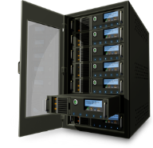
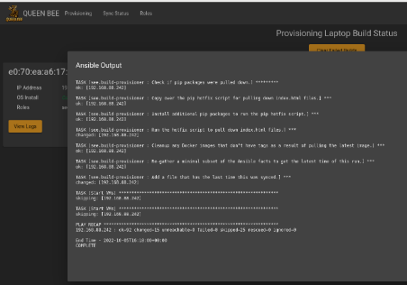
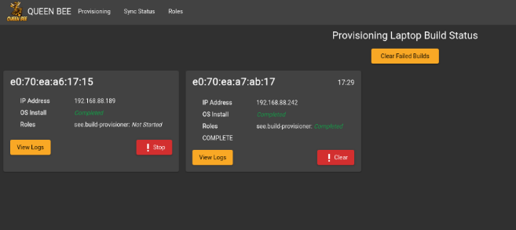
Build Provisioning Laptop
Building/Updating Provisioning Laptop from QUEEN BEE
Ability to designate any commodity laptop to be built as a provisioning laptop (caveat: must have enough storage to pull down a local version of Repository (~2TB maximum)
Leverages same provisioning technology to build a Provisioning Laptop that is used by TURBO ROOK
Ability to track current status of Provisioning Laptop build
Ability to view all Ansible output for Provisioning Laptop build
Typical Time to build a Provisioning Laptop with full repository is approximately: 3.5-4 hours (with 1GB NIC) OR 2.0 hours with a 2.5GB NIC (using USBC dongle)
Note: most of this time is coping the repository
At any time, the Provisioning Laptop can be connected to the QUEEN BEE for a forced update to get the latest QUEEN BEE Software and Updated Repository
Building a Provisioning Laptop Demonstration (3.5 mins)
Commodity
Laptop
Provisioning Laptop
Monitor QUEEN BEE Build Status
Focus:
Easily Create Provisioning Laptop
Easily Update Provisioning Laptop

Slide 15
TURBO ROOK Automated Provisioning Software
Provision Hardware for Mission
Reduces Time to Field from weeks to hours
TURBO ROOK is the cyber operator’s UI for selecting software tools for deployment onto their desired hardware infrastructure (e.g. kit).
Custom created Container-based Engine to leverage Ansible Automation Scripts to deploy and configure identified hardware for mission.
Created to provide a “TURBO TAX-like” approach to Infrastructure Provisioning.
Hardware agnostic and is used to lay down a virtually limitless combination of Operating Systems, Virtual Machines, and Software Applications.
Users can scale hardware and software applications to fit the mission need.

Slide 16
How do we build systems
3. Ansible then installs all tools and optional configs onto the system per the teams mission requirements.
Tools installation
2. PXE boot again boots the system and installs the selected platform and OS
Platform Install
1. PXE boots the system and installs a minimum OS and then completely wipes the system
System Wiping

Slide 17
SOFTWARE AVAILABILITY
BEST-OF-BREED CYBER
The DISTANT ROOK platform automated the deployment and configuration of 200+ commonly used cyber operation software tools. Notable tools are shown below.
This tool suite is ever-evolving and new additions can be rapidly integrated based on customer/mission need.
Operating Systems | Software Tools
VMware CentOS 7 CentOS 8 Stream Ubuntu 20.04 Windows Server 2019 Windows 10 Kali Linux pfSense | Security Onion 2.3 REMnux SIFT Splunk ELK (Elasticsearch, Logstash, Kibana) CarbonBlack EDR Velociraptor Volatility FlareVM Active MQ NIFI | VMware Workstation Player/Pro Wireshark Nmap Nessus Nexpose Forensic Toolkit Arkime The Hive Autopsy SOLR VScode

Slide 18
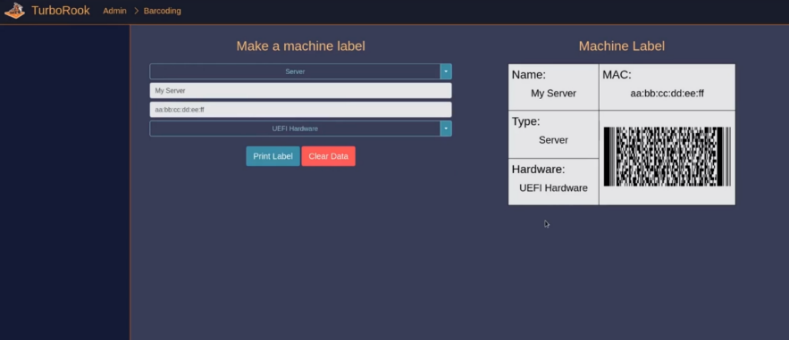
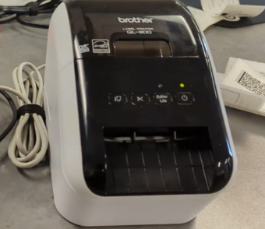
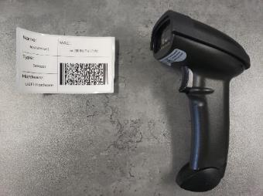
Barcode Based Provisioning
Barcode Creation Demonstration (0.5 mins)
Barcode stores information specific to the hardware being provisioned
Encodes MAC Address into Barcode to enable Automated Provisioning
Barcode can also contain information about how to configure hardware (include disk partitioning, etc.)
Barcodes can also be used to store inventory and license information (PAWN SHOP Proof of Concept)
Focus:
Add Barcode to relate hardware to software and to help drive software Automation process

Slide 19
PAWN SHOP Asset Management (Proof of Concept)
PAWN SHOP Demonstration (7 mins)
Track who is using hardware (tied to CAC Card)
Keep track of inventory at local and/or enterprise level (Check In/Check Out/Decommission)
Able to capture specific hardware fields (Serial Number, Part Number, Manufacturer, Hardware Specs, etc.)
Able to import from Existing Excel Spreadsheet
Leverage same barcode system used for provisioning solution (TURBO ROOK)
Track how & where hardware is used (Details)
Generate reports based on inventory
Roadmap:
Further integration into DISTANT ROOK Suite
(Long Term) Extend PAWN SHOP Hardware Inventory Management to work with Enterprise License Management Capability (marry hardware to licenses)

Slide 20
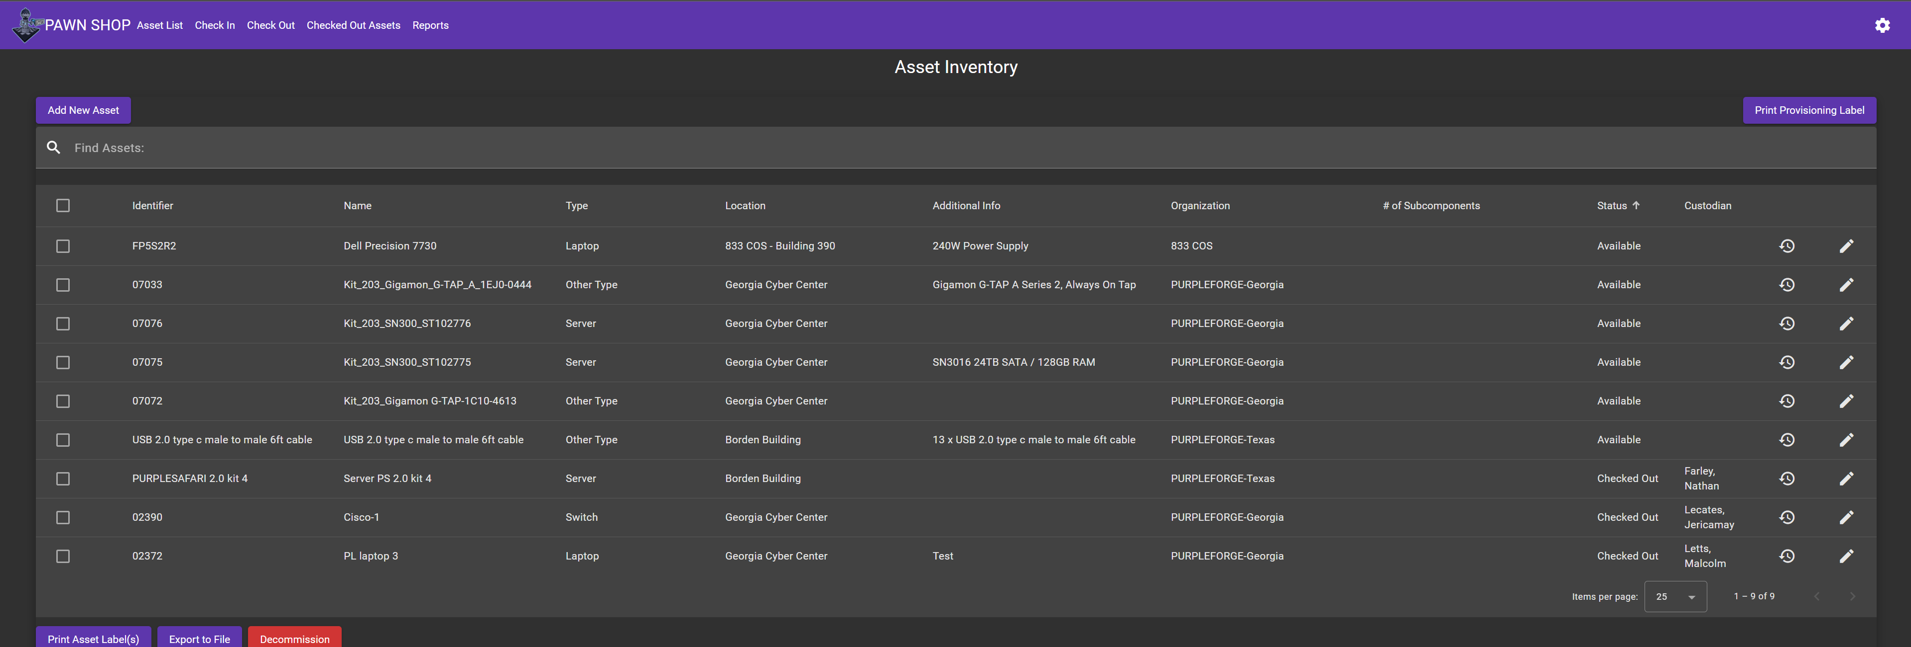
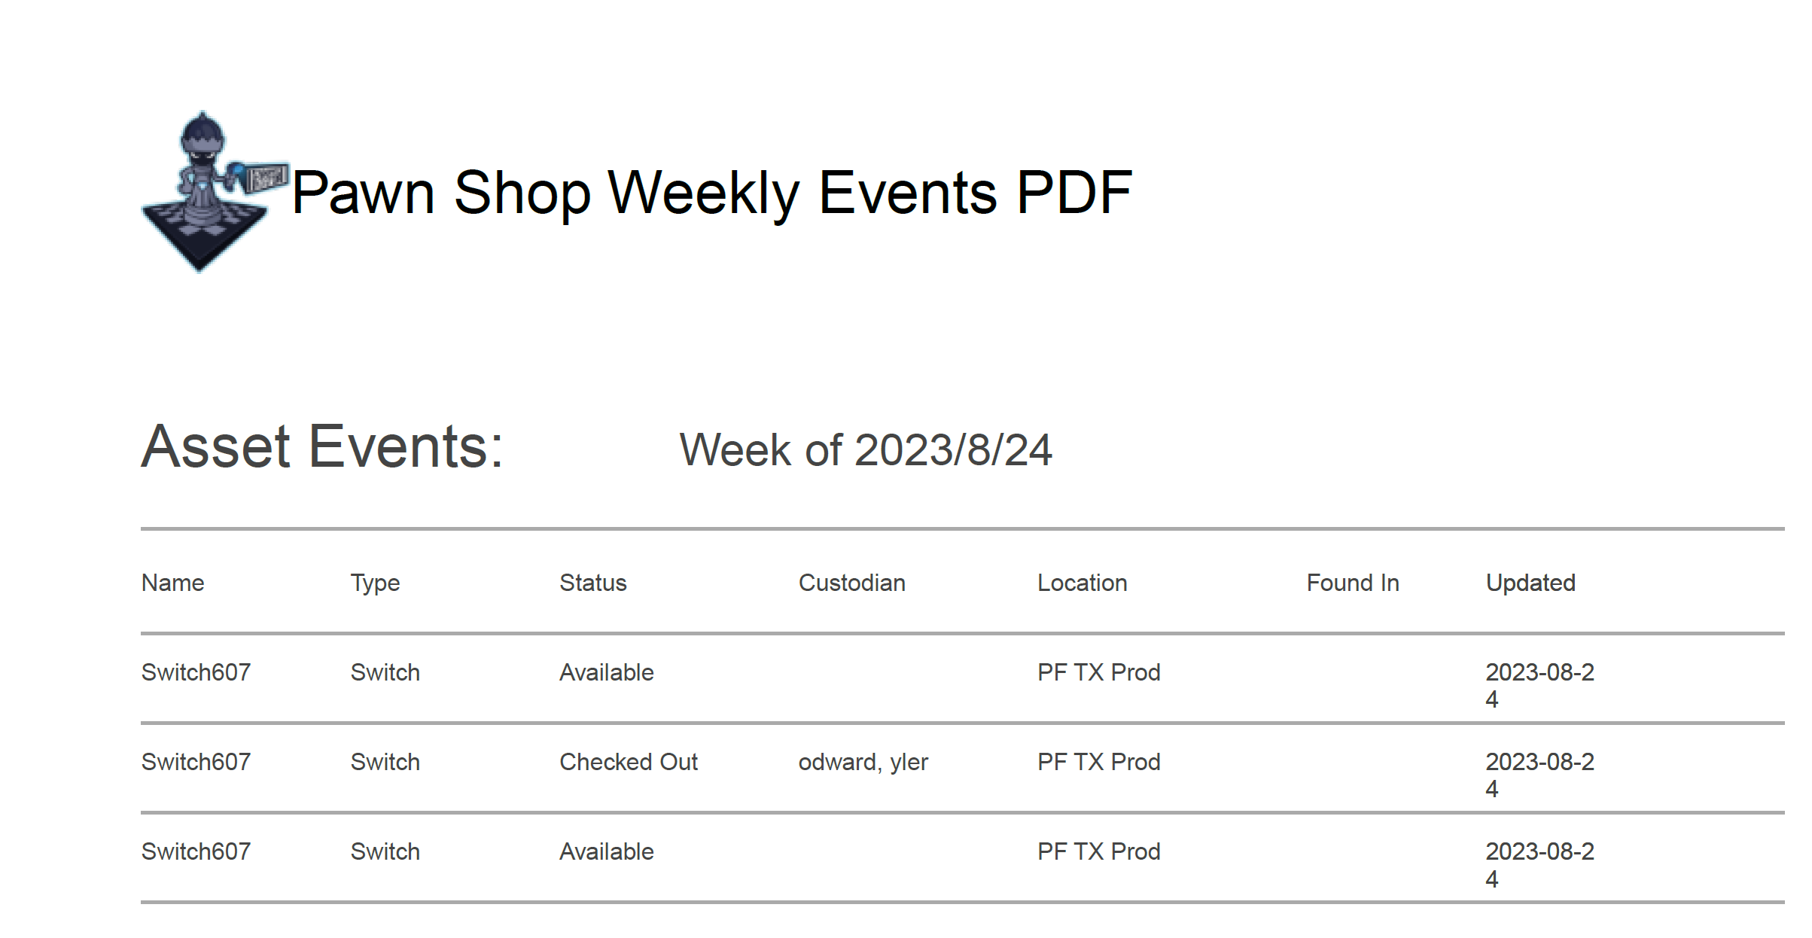
PAWNSHOP DEMO
Key Highlights
Asset Listing by location
Complete Asset Inventory
Asset Status and Analytics
PAWNSHOP Maintenance Reports
Hand Receipt Generation per service
CAC Card generated Users
Hardware historical Record
License Management (May 24)
Software Metrics (Future)
Hardware Metrics (Future)
How:

Slide 21
CNMF Support
CPT | Location / Service | POC | Email
01 | Maryland / Army | CW2 Aaron A. Robertson (Rob) CW3 Daniel Garcia | aaron.a.robertson.mil@army.mil daniel.garcia36.mil@army.mil
02 | Maryland / Navy | Mr. Robert Lane ITC Allan Stregner Mark Heier | rtlane@cybercom.mil amstegn@nsa.gov miheier@cybercom.mil
03 | Georgia / Army | Mr. Malcolm Letts III CW3 Clevon Gaspar | malcolm.a.letts.civ@army.mil clevon.a.gaspar.mil@army.mil
04 | Texas / Air Force | Capt Ron Puertollano Mr. John Degennaro | ron.puertollano.1@us.af.mil john.degennaro.1@us.af.mil
05 | Georgia / Army | CW3 Clevon Gaspar Mr. Leo Hanson | clevon.a.gaspar.mil@army.mil leo.j.hanson.civ@army.mil
21 | Maryland / Navy | David Kivi Ray Mensah | ddkivi@cybercom.mil ramensa@nsa.gov
23 | Maryland / Army | CW2 Jacob Worley CW2 John Ground | jacob.l.worley.mil@army.mil john.t.ground.mil@mail.mil
24 | Maryland / Navy | ENS Morgan Giraud Lt. David Lopez CWO3 Roland “Raleigh” Leitner | mlgirau@nsa.gov dclopez@cybercom.mil rcleitn@nsa.gov
25 | Maryland / Navy | CWO2 Kurt Myers | ​kjmyers@nsa.gov
26 | Hawaii / Navy | ITC Oscar Frear Chief Tyler Bleau LT John R. Barrett | oscar.w.frear.mil@us.navy.mil tyler.j.bleau2@navy.mil john.r.barrett12.mil@us.navy.mil
41 | Texas / Air Force | Capt Elpidio Villalpando MSgt John McNary | elpidio.villalpando@us.af.mil john.mcnary.2@us.af.mil
42 | Texas / Air Force | Capt Elpidio Villalpando MSgt John McNary | elpidio.villalpando@us.af.mil john.mcnary.2@us.af.mil
43 | Texas / Air Force | Capt Elpidio Villalpando MSgt John McNary | elpidio.villalpando@us.af.mil john.mcnary.2@us.af.mil
61 | Hawaii / Navy | LCDR Mark S. Javate ITC Daniel Lopez CPO Christopher Karski | mark.s.javate@navy.mil daniel.l.lopez32.mil@us.navy.mil christopher.karski@pacom.mil
62 | Texas / Air Force | Capt Dillon Pettit Joseph McDowell | dillon.pettit.1@us.af.mil joseph.mcdowell.3@us.af.mil
81 | Maryland / Marine Corps | CW3 Santiago GySgt Nathaneal Register | emsanti@nsa.gov nathaneal.register@gmail.com
82 | Texas / Air Force | Capt Adam Byne Mr. Hilario Carrizales | adam.byne.2@us.af.mil hilario.carrizales.1@us.af.mil
83 | Maryland / Marine Corps | GySgt Stanley Thomas CWO2 Luebbert, Jared A | swthom7@nsa.gov jaluebb@nsa.gov
Key Features and Highlights
Support TO:
Air Force National Teams (04, 41, 42, 43)
Marines National Teams (81, 83)
Navy National Teams (02, 21, 24, 25, 26, 61, 62 82)
Army National Teams (01,03,05,23)
Locations
Maryland (8 Teams)
Texas (6 Teams)
Hawaii (2 Teams)
Georgia (2 Teams)
How:

Slide 22
SECURE ENTERPRISE ENGINEERING PROPRIETARY
TACFI
What is a Tactical Funding (TACFI):
A TACFI is a funding increase of an existing Small Business Innovated Research (SBIR) phase II project and is funded by AFVentures. This TACFI is an extension of SEE’s DISTANT ROOK SBIR.
Scope:
Extending the DISTANT ROOK Phase III Solution capability from a focus on hunt forward kits to also address the software automation needs of On-DoDIN DCO kits is consistent with Joint Cyber Warfighting Architecture (JCWA) Implementation Strategy: IT Infrastructure objectives to include designating “… the UP PMO as the JCWA foundation developer and establishing a single JCWA functional component as the lead for both JCWA IT infrastructure and the JCWA core.”
Task:
Develop an automated deployment baseline based on DISTANT ROOK software that will deploy service specific On-DODIN Capabilities that meet DOD service requirements for On-DODIN operations.
High-level Task Requirements:
Integration of On-DoDIN Automation Scripts into DISTANT ROOK
Integration of End Users Container and Orchestration Capability (Kubernetes or LTAC)
Integration of DCO Programs of Records Capabilities into DISTANT ROOK
Creation of DCO On-DoDIN Software Baseline Templates
Creation of Hybrid Cloud Deployment
Fully Automated Deployment of Services On-DODIN Deployment

Slide 23
SBIR Enhancement: TACTFI
MILESTONES | EXPECTED DELIVERY | DELIVERABLE
Milestone 01: Kick Off & Roadmap | Award +1 month | Contract kick-off meeting Initial development roadmap
Milestone 02: Deployment Document | Award +2 months | Deployment Document Containing Stakeholder Software Requirements, System Software Layout, and Overall System Architecture
Milestone 03: Automation Scripts | Award +5 months | Development of necessary Automation Scripts Addition of necessary Software to Unified Platform Enterprise Repository
Milestone 04: Kubernetes Deployment | Award +8 months | Demonstration of Ability to Deploy Kubernetes Management Capability
Milestone 05: Container Integration | Award +12 months | Demonstration of ability to integration stakeholder capabilities/Containers into CI/CD Pipeline
Milestone 06: End-to-End Prototype Demonstration | Award + 14 months | Demonstrate End-to-End Capability to deploy a Kubernetes Management Solution with stakeholder capabilities onto and On-DoDIN Deployable Sensor
Milestone 07: Final Report & Protype Delivery | Award +15 months | Final Report Fully Delivered working prototype to Air Force Unified Platform Stakeholder
Full Documentation Available Upon Request

Slide 24
Back Up Slides

Slide 25
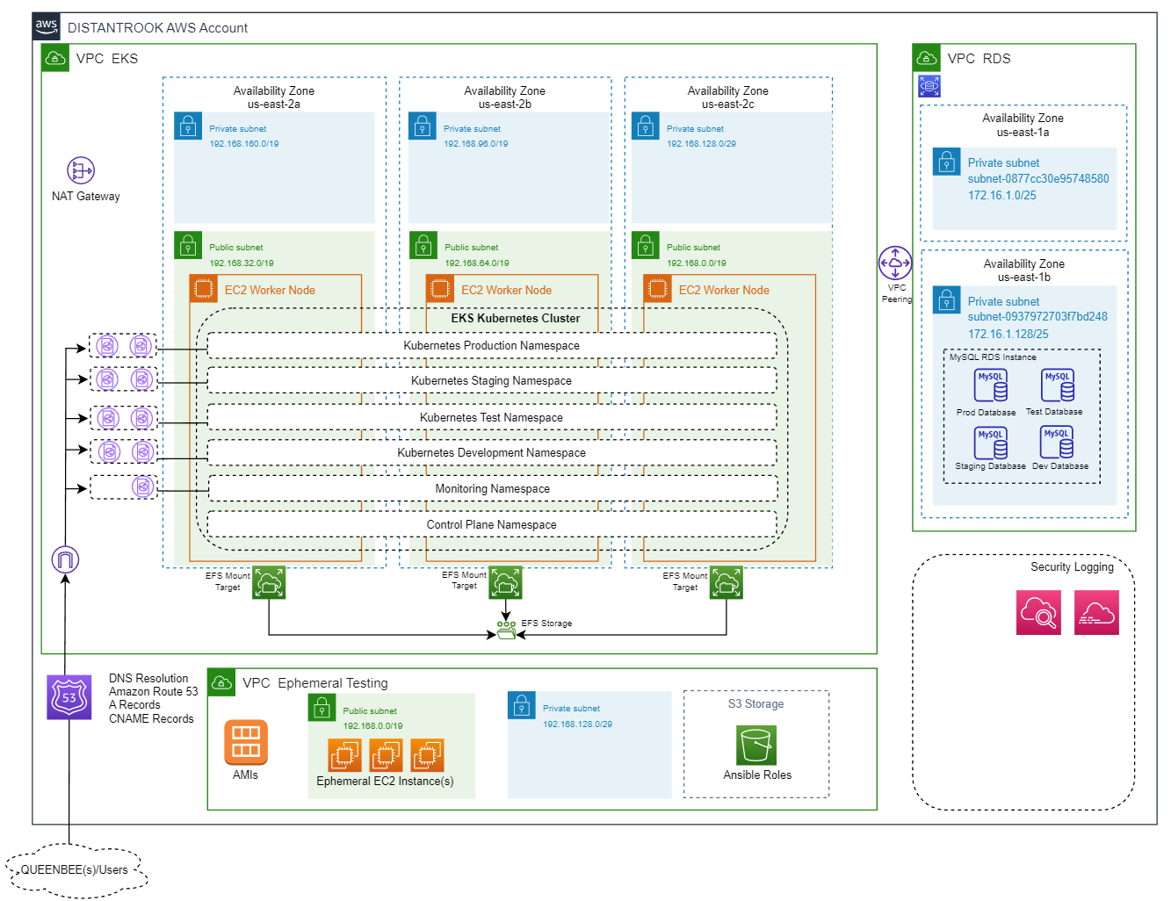
AWS Environment (Architecture)

Slide 26
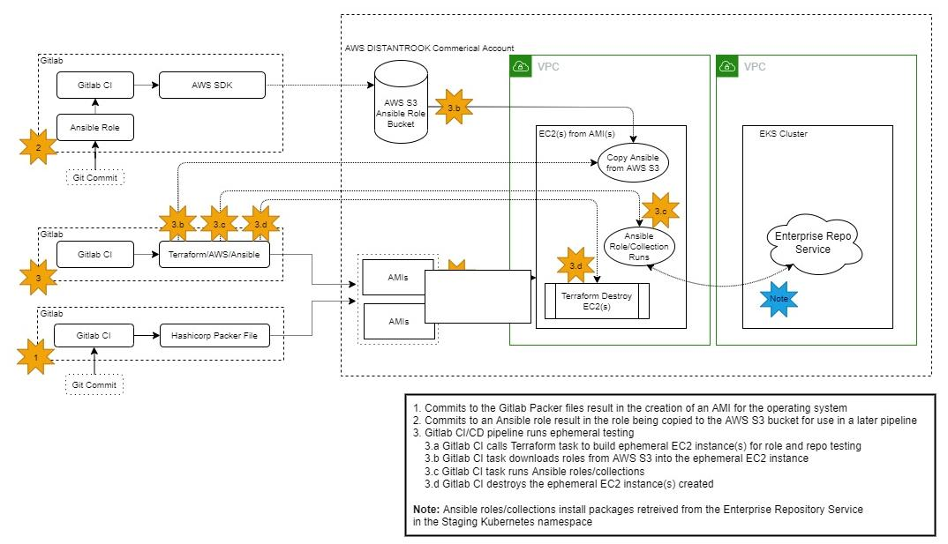
Ephemeral Test Environment Flow Diagram

Slide 27
DISANT ROOK & Risk Management Framework
Leverage existing investment in RMF
Can leverage existing RMF Capability already attained by Army
QUEEN BEE can deploy multiple different “RMF baselines” without having to go through RMF process again
DISTANT ROOK Provides a path towards updates/non-static deployments
Automatic updates made available through Offline/Online means
Reduces use of old/outdated software that could be potentially vulnerable
Ephemeral Test Environment helps to assure new software/automation updates are compatible
DISTANT ROOK RMF Path (new initiative)
Plan to leverage ACAS/Nessus to scan Kit Deployments (based on approved templates),QUEEN BEEs, and Enterprise Repository to maintain RMF
Moving into AWS GovCloud and Leverage AWS Security Best Practices
Establishing secure comms between enclaves (VPN Tunnels, encryption, etc.)
SEE Active Participant in RMF Process
Help create RMF Artifacts (DISTANT ROOK is well documented with architecture)
SEE has experience with RMF Process working with both NSA,USCC, & DISA
Started with an Off-DoDIN customer but adding security to align with Risk Management Framework.

Slide 28
VALUE PROPOSITION
COST/TIME SAVINGS
Historically, preparing a Cyber Operations kit for mission is a manually intensive and tedious process. Current estimations from validated sources estimate that manual configuration of one kit takes 7 operators a total of 2 weeks.
(7 operators)*(80 hours per operator per kit)*($67 per man hour) = $37,500 per manual kit deployment
The DISTANT ROOK platform automates this entire process in a repeatable and secure manner, bringing kit preparation down to a 3 hour “push-button” process.
(1 operator)*(3 hours per operator per kit)*($67 per man hour) = $201 per DISTANT ROOK kit deployment
DISTANT ROOK drastically saves the government money while at the same time allows operators to deploy for mission much faster

Slide 29
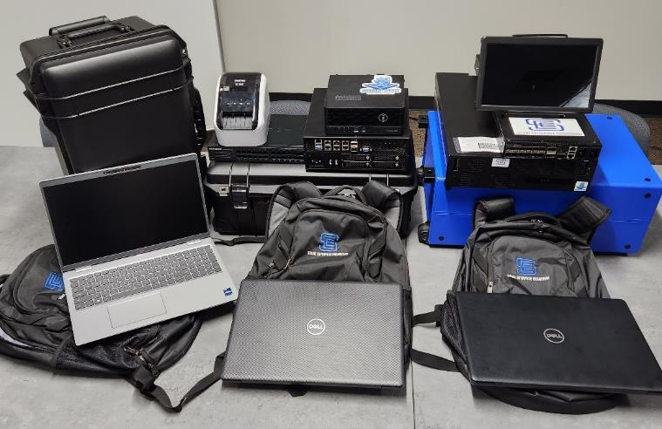
Joint Deployable Kit – Layout & Specifications
Case 2: Sensor Nodes
Small Sensor: Dell Precision 3260: 16x Core i9 (2x 8 Cores)Cores,
64 GB Memory, 8 TB NVME M.2 Storage, 1 x 1GB onboard, 4x 1B PCI Card
Large Sensor: Padova Supermicro Edge Server: 32 x Core Xeon
128 GB Memory, 2 TB Storage; 6x 1GB Onboard, 2x SFP 10GB, 1x Mgmt
Case 1: Networking & Storage:
24 port NetGear Switch (Unmanaged)
Label Printer
Network Cables
Power Cables
Case 3: Analytic Node: Virtualization Platform
Dell Power Edge R6515: 64x Core AMD EPYC 7702P
512 GB Memory, 30 TB NVME 2.0 ( 2 slots):
(12 More Bays Available for additional storage)
Backpack #1:
Provisioning Laptop:
Dell Precision 3571: 20x Core i5 12th Gen
16 GB RAM, 2 TB NVMe M.2
Label Scanner
External Display
Keyboard
Backpack #3:
Analyst Laptop 2: Linux Variant
Dell Inspiron 15 3000: i5 (4x Core)
8 GB Memory, 256 Storage SSD
External Display
Keyboard
Backpack #2:
Analyst Laptop 1:Windows Variant
Dell Inspiron 15 3000: i5 (4x Core)
8 GB Memory, 256 Storage SSD
External Display
Keyboard
You can always add new hardware, customize your kit for your deployment.

Slide 30
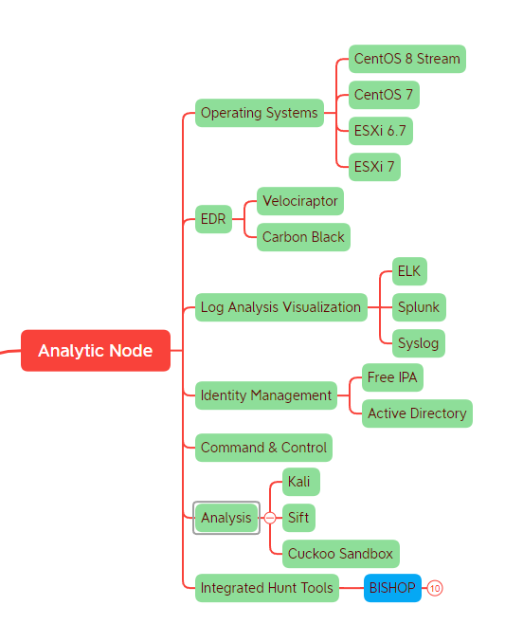
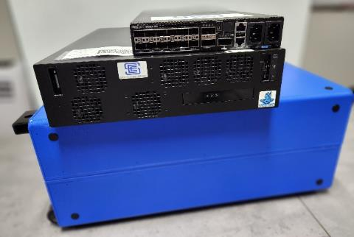
Joint Deployable Kit – Analytic Node
Will be able to leverage Virtual Machines or Containers; system is agnostic
Backlog Highlights:
In Development/Prototyped:
RHEL (Licensed Red Hat) *
VCenter (VMware) *
MISP
Project IKE
ESXi Networking Customization
FireEye HX
Planned:
Red Hat Open Shift
VSANs (VMware)
Case 3: Analytic Node: Virtualization Platform
Dell Power Edge R6515: 64x Core AMD EPYC 7702P
512 GB Memory, 30 TB NVME 2.0 ( 2 slots):
(12 More Bays Available for additional storage)

Slide 31
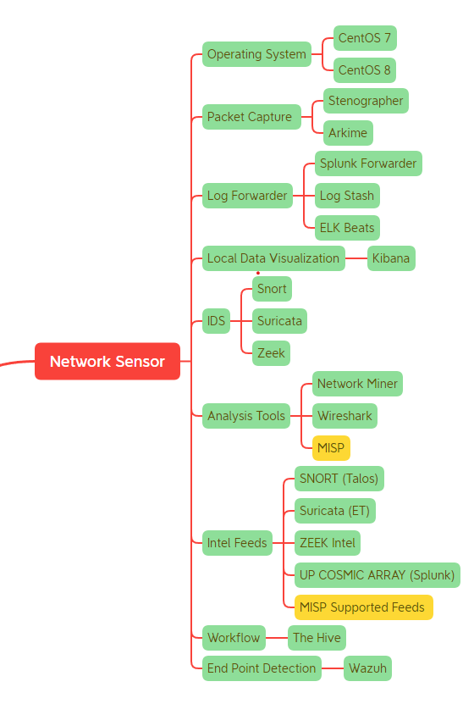
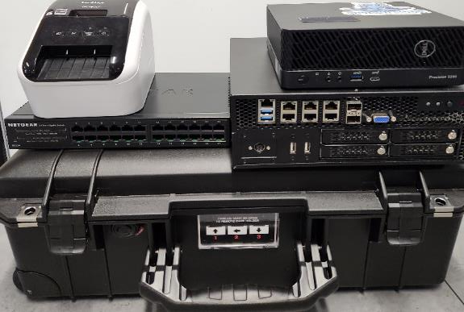
Joint Deployable Kit – Sensor Node(s)
Roadmap: Estimates for hardware throughput, use Security Onion to benchmark sensor (Best of Breed)
Backlog Highlights:
In Development/Prototyped:
Offline Security Onion Install
Distributed Security Onion
MISP
SEE Custom Sensor Role
UP COSMIC ARRAY Integration
Planned:
Core Lite
Testing Network through put on various sensor hardware platforms
Case 2: Sensor Nodes
Small Sensor: Dell Precision 3260: 16x Core i9 (2x 8 Cores)Cores,
64 GB Memory, 8 TB NVME M.2 Storage, 1 x 1GB onboard, 4x 1B PCI Card
Large Sensor: Padova Supermicro Edge Server: 32 x Core Xeon
128 GB Memory, 2 TB Storage; 6x 1GB Onboard, 2x SFP 10GB, 1x Mgmt.

Slide 32
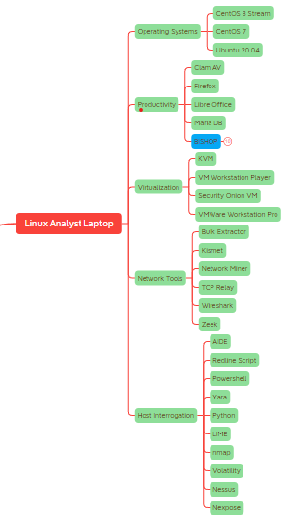
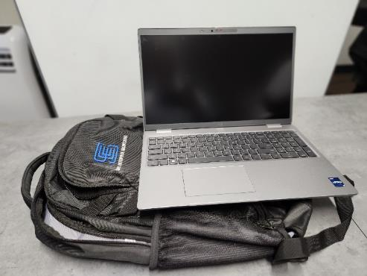
Joint Deployable Kit – Linux Analyst Laptop(s)
Backlog Highlights:
In Development/Prototyped:
Breaking larger roles into smaller atomic roles for better customization and testing
ZenMap
Volatility (multiple version support)
Cuckoo
Planned:
Gathering Requirements from N-CPTs within CNMF
Backpack #3:
Analyst Laptop 2: Linux Variant
Dell Inspiron 15 3000: i5 (4x Core)
8 GB Memory, 256 Storage SSD
External Display
Keyboard
Requirements driven directly from Cyber Protection Teams

Slide 33
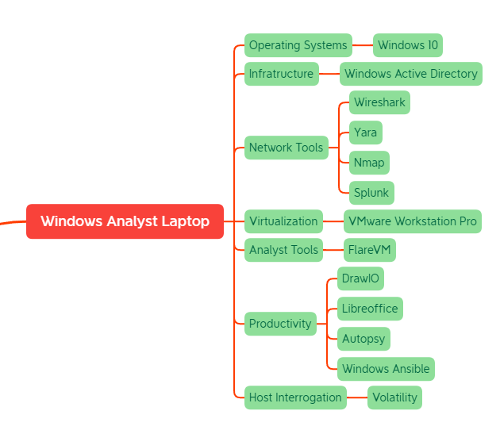
Joint Deployable Kit – Windows Analyst Laptop(s)
Backlog Highlights:
In Development/Prototyped:
Breaking larger roles into smaller atomic roles for better customization and testing
Planned:
Gathering Requirements from N-CPTs within CNMF
Backpack #2:
Analyst Laptop 1:Windows Variant
Dell Inspiron 15 3000: i5 (4x Core)
8 GB Memory, 256 Storage SSD
External Display
Keyboard
Requirements driven directly from Cyber Protection Teams

Slide 34
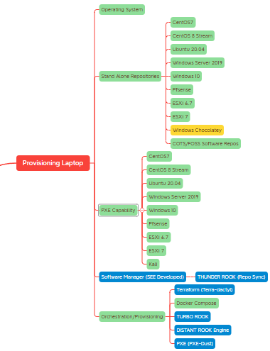
Joint Deployable Kit – Provisioning Laptop
Backlog Highlights:
In Development/Prototyped:
TURBO ROOK 2.0
Enhanced Backend Framework
Network Device (specific) automation (Palo Alto/Pfsense)
Planned:
OS Credential Customization
Managed Switch Deployments & Customization
Enhanced Barcoding Customization
Backpack #1:
Provisioning Laptop:
Dell Precision 3571: 20x Core i5 12th Gen
16 GB RAM, 2 TB NVMe M.2
Label Scanner
External Display
Keyboard

