Slide 1

Unrivaled Security
Technical Capabilities

Slide 2

Public Sector Use cases
Unrivaled security without complexity or compromise
VectorZero Active Data Vault
Ephemeral Vaults
Stand up high assurance, zero trust, NIST 800-53-5, enclaves within minutes from anywhere
Confidential Compute
Data protected while in process & memory without compromising speed or useability
Secure Multiparty Computation
Confidential collaboration over disparate datasets
TM
©July 19, 2023, VectorZero Technologies, LLC All Rights Reserved Confidential – Do not circulate or duplicate
2

Slide 3




Unrivaled security without complexity or compromise
Active Data Vault
High Assurance Enclaves for Sensitive Data
Protecting Against:
Offering:
Advanced Persistent Threat
Cloud Threat Actor
Insider Threat
Legacy Vulnerability
Privileged Software Attacks
Quantum Computing Decryption
Side-Channel Attacks
Chain of Trust Edge to Cloud
Data Governance / Confidential Secure Collaboration
Ease of Integration & Use
Encrypted Analysis
Managed Attribution
Post Quantum Encryption
Rapid Build / Tear Down
TM
Low to High Transfer
©July 19, 2023, VectorZero Technologies, LLC All Rights Reserved Confidential – Do not circulate or duplicate
3
Notes:
Keep boxes, remove highlightEase of Integration & Use
Encrypted Analysis

Slide 4

Unrivaled security without complexity or compromise
NIST 800-53-5
ADV Achieves All Technical Controls of NIST 800-53-5
96%
Compliance Score
100%
CIS Critical Security Controls V8
1,360 out of 1,360 checks passed
94%
CIS AWS Foundations Benchmark v 1.40
Compliance Score
NIST 800 181
TM
©July 19, 2023, VectorZero Technologies, LLC All Rights Reserved Confidential – Do not circulate or duplicate
4

Slide 5
Unrivaled security without complexity or compromise
Comprehensive Security Features
Non-Exhaustive List
24/7 Honeypots
Customizable Geofenced Access
Geographically Distributed Backups
Last Logged in Location & Time Banner
Deeper Differentiating Features
TM
©July 19, 2023, VectorZero Technologies, LLC All Rights Reserved Confidential – Do not circulate or duplicate
5

Slide 6
Unrivaled security without complexity or compromise
Automated Moving Target Defense (AMTD)
Preventing adversaries from gaining a foothold by changing your infrastructure
Planned Infrastructure Move
Planned Infrastructure Move
Planned Infrastructure Move
Triggered Infrastructure Move (automated)
Time (t)
Intrusion Alert
(Pattern matching AI/ML)
TM
©July 19, 2023, VectorZero Technologies, LLC All Rights Reserved Confidential – Do not circulate or duplicate
6

Slide 7
Unrivaled security without complexity or compromise
Each AMTD move orchestrates changes in:
The Moving Components
API gateway servers configurations
Backup NoSQL database endpoint
Certificate manager server configuration
Cisco firewall
Palo Alto firewall
Content delivery network configuration
CSP network firewalls
DNS configuration
DNSSec configuration
Isolated virtual networks
Network address translation gateways
NoSQL database repository
NoSQL database endpoint
Object storage endpoint
Object storage repositories
Routers
Subnets
Switches
Threat detection configuration
TLS certificates
VPN servers by region
Web application firewalls for content
Additional security policy check against NIST 800-53-4 configuration
App (IAM) accounts
App (IAM) group
App (IAM) policies
Asymmetric encryption key
Auditing accounts
Auditing log repository
Backup Auditing log repository
Backup NoSQL database repository configuration
Backup services configuration
Hardware Security Module configuration
(IAM) accounts
(IAM) policies
Identity Access Management (IAM) group
Operating system logging repository
Security group configuration
Security policy checks configuration
Sensitive data machine learning
Symmetric encryption keys
VPN certificates
Web application firewalls for authentication & authorization
Object storage repository security policy
TM
7
©July 19, 2023, VectorZero Technologies, LLC All Rights Reserved Confidential – Do not circulate or duplicate
7

Slide 8
Unrivaled security without complexity or compromise
Servers
Networking
Storage
Accounts
Firewalls
Encryption Keys
Ephemeral Vaults, Infrastructure As Code
An Automated Moving Target Defense
Provision Vault In Minutes
Run Workload Fully Encrypted
Save Data in Storage, Deprovision Vault
Provision New Vault with Saved Data & Users
Reducing attack surface to near zero, and destroying any implanted malicious code
Deploy Linux server-based applications including analytics, AI/ML & other tools
Patched, updated, & available anywhere on the public fabric
TM
©July 19, 2023, VectorZero Technologies, LLC All Rights Reserved Confidential – Do not circulate or duplicate
8

Slide 9

Unrivaled security without complexity or compromise
Supported Encryption
Because ADV is software-defined, we rapidly and easily interchange encryption algorithms.
FIPS 140-2 L3
BIKE
Kyber
S2n-tls
S2n-quic
Elliptic Curve
Fully Homomorphic
Other algorithms
Compatible with existing + future post-quantum algorithms
TM
©July 19, 2023, VectorZero Technologies, LLC All Rights Reserved Confidential – Do not circulate or duplicate
9

Slide 10




Unrivaled security without complexity or compromise
Less than 2% performance overhead
Confidential Computing
Typical Data Lifecycle
Encrypted Lifecycle
Encrypted in Transit
Encrypted in Transit
Encrypted at Rest
Decrypted to Plaintext for Processing
Encrypted in Transit
Encrypted in memory & Processing
Encrypted in Transit
Encrypted at Rest
TM
©July 19, 2023, VectorZero Technologies, LLC All Rights Reserved Confidential – Do not circulate or duplicate
10

Slide 11

Unrivaled security without complexity or compromise
Fully Homomorphic Encryption Performance Overhead
Microsoft Research published a study finding FHE to be orders of magnitude slower than traditional encryption [3]
European Network and Information Security Agency (ENISA) notes FHE may struggle to keep pace with post-quantum encryption [2]
Studies show Fully Homomorphic Encryption (FHE) is 10^6 to 10^7 (10 million) times slower than traditional encryption [1]
*VectorZero can additionally work with homomorphic encryption as required by the Sponsor
TM
©July 19, 2023, VectorZero Technologies, LLC All Rights Reserved Confidential – Do not circulate or duplicate
11

Slide 12
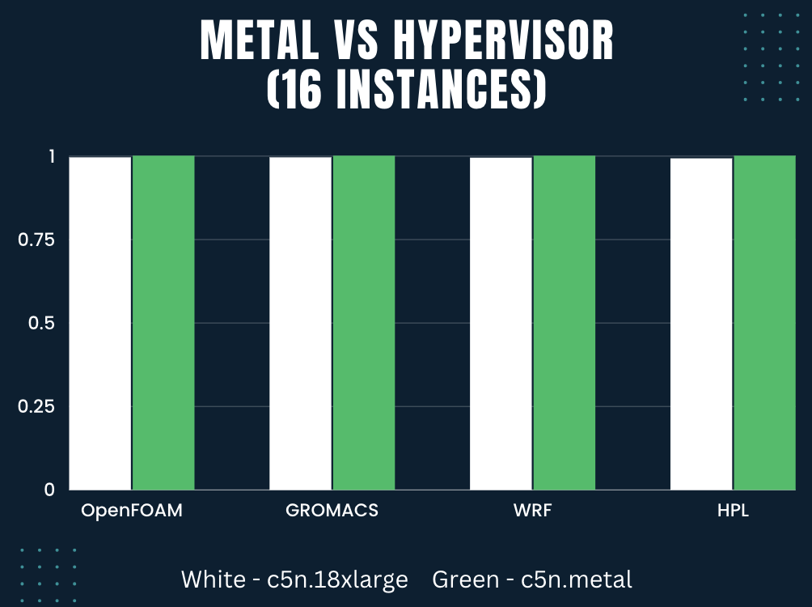
Unrivaled security without complexity or compromise
Confidential Computing Performance Overhead
AWS Comparison of Bare Metal vs Amazon Confidential Computing (1)
99.5%
99.5%
99.4%
99.2%
TM
©July 19, 2023, VectorZero Technologies, LLC All Rights Reserved Confidential – Do not circulate or duplicate
12

Slide 13



Unrivaled security without complexity or compromise
Attestation: Don’t Trust, Authenticate
Authentication for Supply Chain & Servers
If adjudication is successful then release compute, connection, data, or key.
ADV takes measurements of CPU, bootloader, firmware, OS, software, and data.
ADV uses AI/ML to adjudicate attestation measurements against corporate security policy.
©July 19, 2023, VectorZero Technologies, LLC All Rights Reserved Confidential – Do not circulate or duplicate
13

Slide 14


Unrivaled security without complexity or compromise
Technical Trust Vectors
Verify more, trust less with supply chain attestation
Typical Technical
Trust Vectors
Confidential Computing Technical Trust Vectors
CPU Manufacturer
Motherboard
Boot Loader
Firmware
Operating System
Software Vendors
Cloud Service Provider
CPU Manufacturer
TM
©July 19, 2023, VectorZero Technologies, LLC All Rights Reserved Confidential – Do not circulate or duplicate
14

Slide 15
Unrivaled security without complexity or compromise
Insider Threat & Community Behavior
Data is accessible to your protected workload, yet unreadable to:
Platform Administrators
Data Scientists
Data Engineers
Cloud Service Providers (Paige Thompson)
Hypervisors
3rd Party Partners
Threat Actors
TM
©July 19, 2023, VectorZero Technologies, LLC All Rights Reserved Confidential – Do not circulate or duplicate
15

Slide 16













16
Locking Data
Unlocking Collaboration
Unrivaled security without complexity or compromise
Secure Multi-Party Computation (SMPC) Example: AI/ML Training
Org 1
Enclave computation
AI/ML Training Outcomes
Org 2
Encrypted data in
Program runs securely
Aggregate
Data
3rd party AI
Org 3
Results are delivered to pre-agreed upon brown keyholder(s)
3rd party AI is also encrypted, no proprietary code is exposed
TM
©July 19, 2023, VectorZero Technologies, LLC All Rights Reserved Confidential – Do not circulate or duplicate
16

Slide 17







17
Locking Data
Unlocking Collaboration
Unrivaled security without complexity or compromise
SMPC Example: Finding Common Devices
Device #1
Device #6
Device #16
Device #24
Device #5
Device #7
Device #16
Device #24
Device #1
Device #7
Device #12
Device #24
Enclave computation
Encrypted data in
#1
#7
#16
#24
Program runs securely
#1
#16
#24
#7
TM
©July 19, 2023, VectorZero Technologies, LLC All Rights Reserved Confidential – Do not circulate or duplicate
17

Slide 18




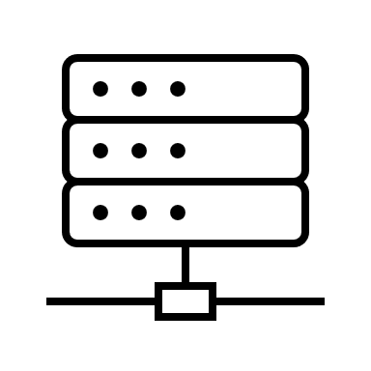


Unrivaled security without complexity or compromise
Only Networked to Front Room (No Internet)
Front Rooms
A Virtual Desktop For Accessing Your Secure Backroom
Internet
Video Feed (files never resident on user device)
Front Room
Back Room
Enclave
Signal
User
Data
VPN
Server
Processing
Excel
Secure Client Computing Environment
Secure Server Computing Environment
Internet
©July 19, 2023, VectorZero Technologies, LLC All Rights Reserved Confidential – Do not circulate or duplicate
18

Slide 19

Unrivaled security without complexity or compromise
Active Data Vault
Toolchain OEM Solution, Low Overhead
NIST 800-53-5 Security Controls
NIST 800-207 Zero Trust
FIPS 140-2 Level 3
ICD 503
Available through multiple procurement vehicles:
ICWERX
SHI
SEWP
ITES
NASPO
NCPA
OMNIA
Compliant with
Next Steps…?
TM
©July 19, 2023, VectorZero Technologies, LLC All Rights Reserved Confidential – Do not circulate or duplicate
19

Slide 20
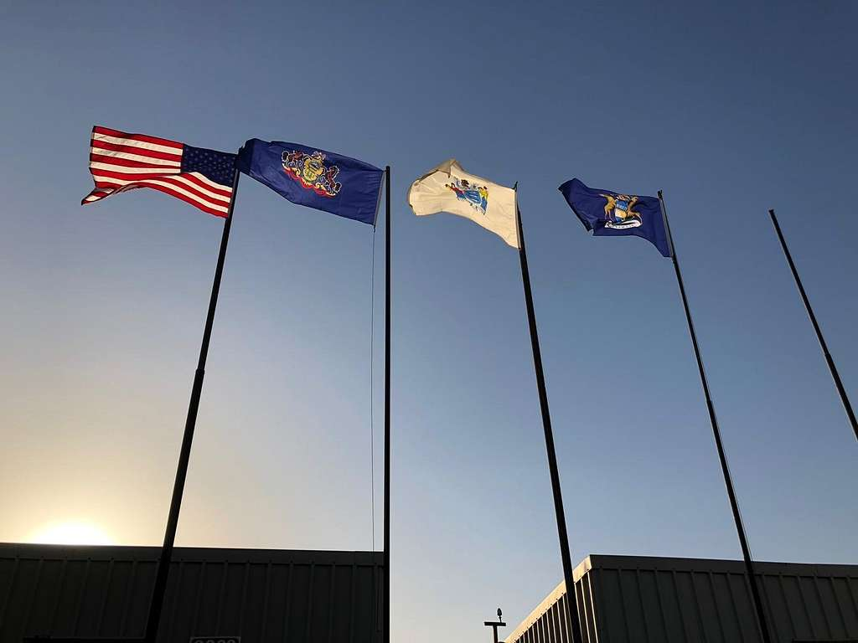
Unrivaled security without complexity or compromise
US Intelligence Community Pedigree
Technical staff are cleared, former IC Officers
100% US-Owned & Operated
All code developed in Reston, Virginia
TM
©July 19, 2023, VectorZero Technologies, LLC All Rights Reserved Confidential – Do not circulate or duplicate
20

Slide 21
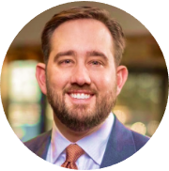
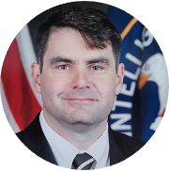

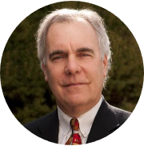

Unrivaled security without complexity or compromise
LEADERSHIP
Thank You
Jason Asbury
CEO, Co-Founder
Jason.Asbury@vectorzero.ai
Sean Grimaldi
CTO, Co-Founder
13 Years CIA Technical Leader
7 Years Microsoft Senior PM
Sean.Grimaldi@vectorzero.ai
Ray Martin
Unrivaled Security
Chairman, CFO, Co-Founder
Ray.Martin@vectorzero.ai
Andrew Blume
VectorZero is fully US-Owned and Operated.
VP, Sales
Andrew.Blume@vectorzero.ai
818-429-2357
Corporate Office: Reston, Virginia
©July 18, 2023, VectorZero Technologies, LLC All Rights Reserved Confidential – Do not circulate or duplicate
21
Notes:
So let’s keep your utility off the front pages. Let’s avoid headlines where a hack costs millions or worse, jeopardizes safety. Thank you.

Slide 22
Diverse and Experienced Advisory Committee Members
US Government
US Enterprise
William “Terry” Burruss
Retired CIA – 28 years
Former head of Agency Innovation
Heather Jackman
Retired CIA – 25 years
Former top Contracting Officer
Ira Winkler, PhD
Former Chief Security Officer at Walmart
Published Author & Keynote Speaker - Cybersecurity
Phil Kenney
Former P&G marketing
Entrepreneur with two successful exits
Louis Tucker
Retired Navy Seal Commander
CEO Mission Sync, LLC
Former Staff Director SSCI – US Senate Select Committee on Intelligence
Robert Flores
Retired CIA – 31 years
Former CTO
Various positions in Directorate of Intelligence and Operations
Calvin Hayes
Former national law firm partner for over 20 years
Focused on the defense of Enterprise class action suits including cybersecurity
Trip Phillips
30 years financial professional
Founding partner 2 branch offices Raymond James
Roger Campbell
Retired CIA – 30 years
Former President Informatica Federal Operations Corp.
Barry Nutter, CISSP, AISA
Retired CIA – 20 years
AWS Solutions Architect
Former Lockheed Martin Fellow
Certified Advanced Information System Architect, AISA
Jack Roehrig
Former Chief Information Security Officer (multiple companies)
International Privacy Expert
TM
©July 19, 2023, VectorZero Technologies, LLC All Rights Reserved Confidential – Do not circulate or duplicate
22

Slide 23
Unrivaled security without complexity or compromise
Thank You
Unrivaled Security
TM
©July 19, 2023, VectorZero Technologies, LLC All Rights Reserved Confidential – Do not circulate or duplicate
23

Slide 24
24
Locking Data
Unlocking Collaboration
Unrivaled security without complexity or compromise
SMPC Example: Finding Common Devices
TS/SCI Devices
Device #1
Device #6
Device #16
Device #24
Confidential Devices
Device #5
Device #7
Device #16
Device #24
TS Devices
Device #1
Device #7
Device #12
Device #24
Enclave computation
Encrypted data in
#1
#7
#16
#24
Program runs securely
#1
#16
#24
#7
TM
©July 19, 2023, VectorZero Technologies, LLC All Rights Reserved Confidential – Do not circulate or duplicate
24

